Slide 1

ADJUDICATION OF A
RESERVATION OF WATER APPLICATION
The Process
Notes:
MORE INDEPTH DISCUSSION ABOUT ASPECTS OF THE ADJUDICATION PROCESS

Slide 2

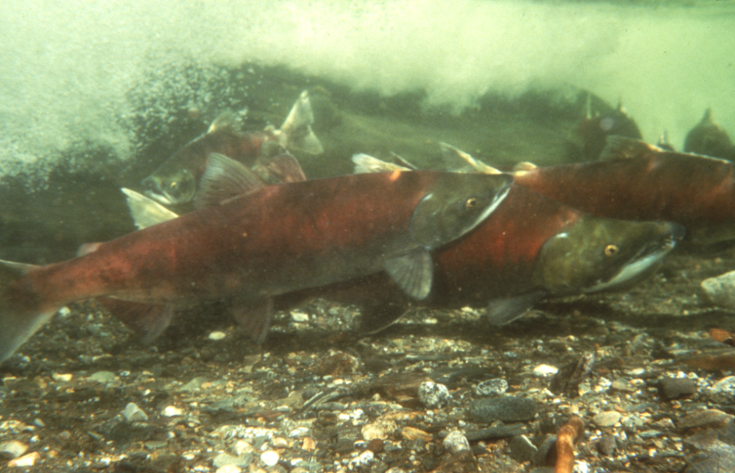
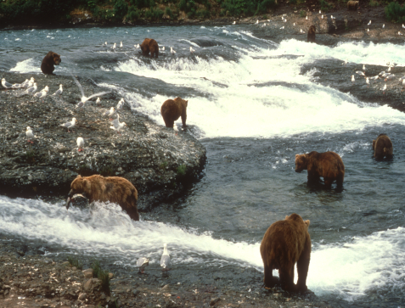
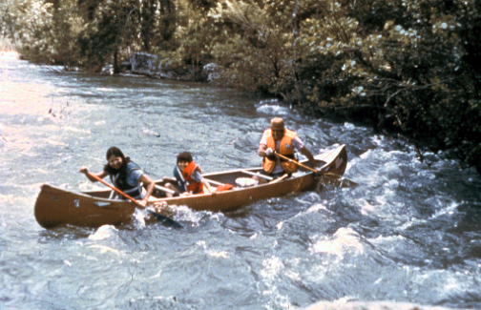
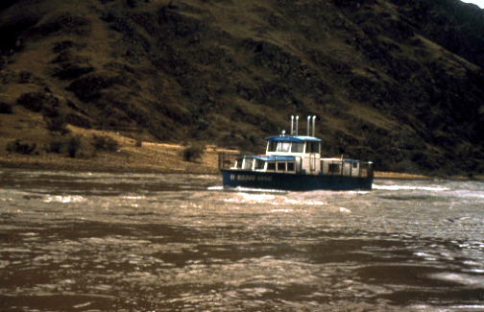
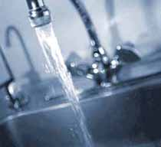
Purpose
Protection of fish and wildlife habitat, migration, & propagation;
Recreation and park purposes;
Navigation and transportation
Sanitary and water quality purposes.
Robert Angell, AK Div. Of Tourism
(USGS 1996)
(USGS 1996)
Notes:
HAMMER THIS IN!

Slide 3
Example from ADF&G applications:
“The primary purpose of this proposed reservation is to protect fish habitat, migration, and propagation within XXXX Creek and its watershed. This reach of XXXX Creek has been specified as important to anadromous fish under Alaska state statue AS 16.05.871, as AWC stream number XXX-XX-XXXXX-XXXX by the Alaska Department of Fish and Game. Chinook salmon (Oncorhynchus tshawytscha), coho salmon (O. kisutch), chum salmon (O. keta), rainbow trout (O. mykiss), and Dolly Varden (Salvelinus malma) utilize these reaches of the XXXX Creek for a portion of, or all of their spawning, incubation, rearing, and passage life phases. These species contribute to sport and commercial fisheries in the area and provide recreational opportunities' and values as well.”
THE ‘NEED’
Notes:
LOTS OF WORDING BUT LOOK AT THE UNDERLINED……DESCRIBE IN DETAILS THE NEED

Slide 4
Additional ADF&G ‘Need’ Example:
Sufficient flows are needed to support seasonal uses of riverine habitats by fishes and to provide for fluvial processes that maintain these habitats. To maintain seasonal uses of habitats by each life history stage, we recommend maintaining a flow regime that mimics the magnitude and timing of the natural flow regime as discussed above. This approach is necessary to meet the needs of species’ life history stages that have coevolved and exhibit biological adaptations to the river’s flow regime.
Notes:
HERE IT IS AGAIN….MORE SUPPORTING INFO FOR THE NEED

Slide 5
FWS EXAMPLE FOR ‘NEED’:
On August 14, 1941, President Franklin D. Roosevelt established Kodiak National Wildlife Refuge (NWR) by Executive Order 8857, and on December 2, 1980, President Carter signed into law the Alaska National Interest Lands Conservation Act (ANILCA). Section 393 (5)(B) of ANILCA declared the following purposes for which Kodiak NWR is established and shall be managed:
“(i) to conserve fish and wildlife populations and habitats in their natural diversity including, but not limited to, Kodiak brown bears, salmonids, sea otters, sea lions, and other marine mammals and migratory birds;
(ii) to fulfill the international treaty obligations of the United States with respect to fish and wildlife and their habitats;
(iii) to provide in a manner consistent with purposes set forth in subparagraphs (i) and (ii), the opportunity for continued subsistence uses by local residents; and
(iv) to ensure, to the maximum extent practicable and in a manner consistent with the purposes set forth in subparagraph (i), water quality and necessary water quantity within the refuge.”
Additionally, the water reservation is needed to comply with the legal and management directives (as described previously). The Uganik River is within the external boundary of the Kodiak NWR, where the conservation of aquatic habitat and associated biota through the maintenance of water quantity is mandated by law.
In the judgment of USFWS, the proposed reservation is necessary to maintain the habitat that supports a rich and abundant biota within the Uganik River and will aid USFWS in carrying out its management objective to maintain the natural water quantity and quality at stream flows and water levels that will provide suitable habitat for brown bears, fish, migratory waterbirds, raptors, and other wildlife.
Notes:
HIGHLIGHTED THE SPECIFICS AND UNDERLINED ADDITIONAL SUPPORT FOR NEED

Slide 6
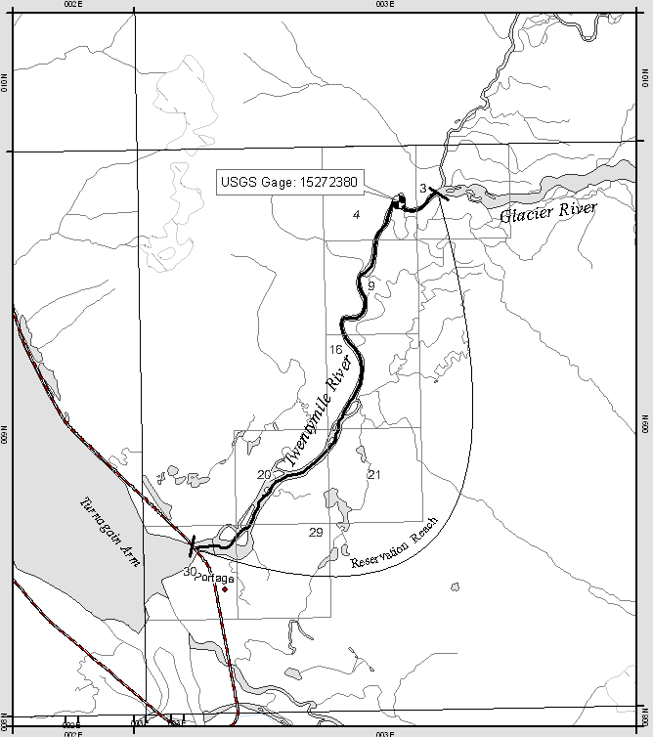
REACH EXAMPLES:
Example of an acceptable reach request:
Hydrologically distinct
Gage is located above any contributing tributaries
Does not include any lakes between the start and end point of a reach

Slide 7
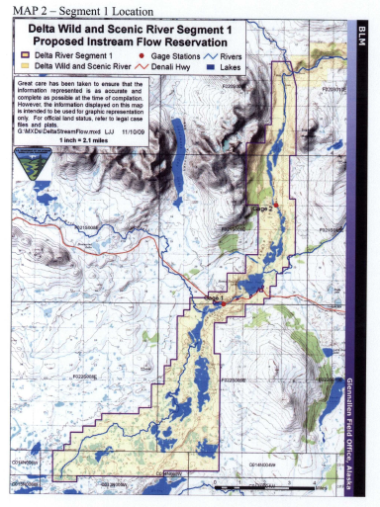
EXAMPLE OF WHAT SHOULD NOT BE REQUESTED:
Applicant asked for everything within the outlined box on one application
Included lakes within & outside the river system
Each lake and distinct reach would require separate applications.
Notes:
EACH ARE HYDROLOGICALLY DISTICT

Slide 8
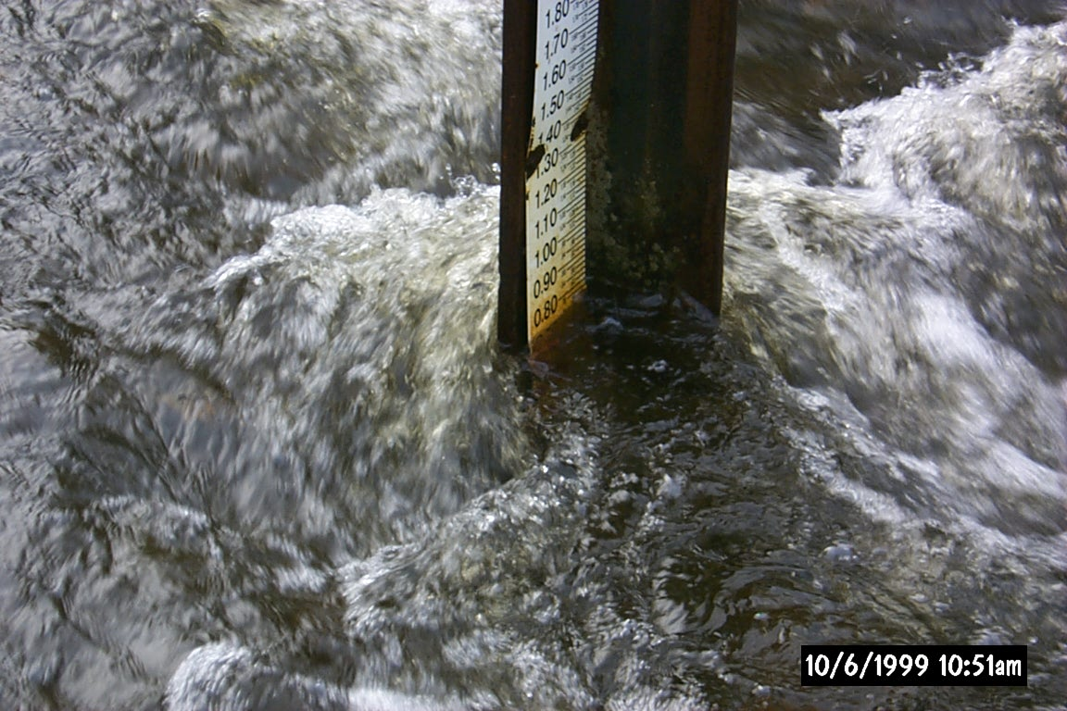
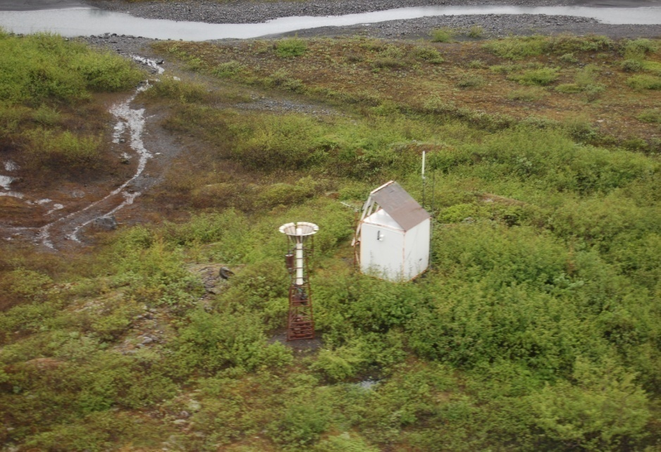
Measuring Stream Discharge
USGS stream gaging stations collect discharge (flow) data which are compiled and published.
  USGS is the most widely used in applications because the data has already been collected.
Other forms of discharge measurement allowable as well.
  Examples: BLM, ADF&G, consultants
    For data unavailable via online, the full data set/analysis will be required for DNR hydrologists to review.
USGS
ADNR
Notes:
IF ITS UNAVAILABLE FOR US TO READILY ACCESS, WE NEED THE DATA!

Slide 9
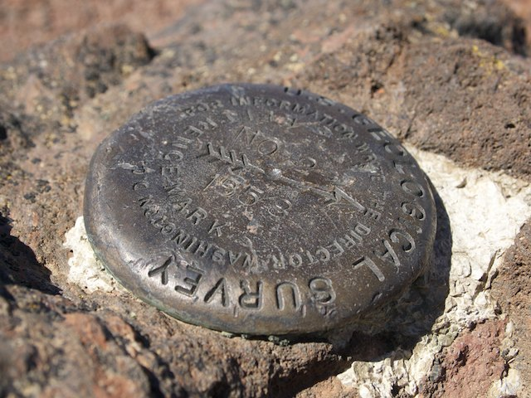
Measuring Water Level
Example:
  X Lake is 10.2 miles long, has a surface elevation of approximately 75 feet above mean sea level, and surface area of approximately 1, 305 hectares.
  The lake is steep sided with a max depth of 752 feet
  Requested quantities are lake elevations relative to a reference mark
  A galvanized expansion bolt, secured into bedrock at the gage site serves as the primary reference mark that lake elevations are measured relative to.
  The reference mark is assigned an arbitrary elevation of 10 ft.
    The difference between the reference mark and the vertical distance to the water surface is the lake elevation measured by the gage.
https://www.geocaching.com/mark/details.aspx?PID=QD1860
Notes:
WE HAVEN’T ESSENTIALLY DONE A LAKE BEFORE SO THIS IS AN AREA WE WILL HAVE TO NAVIGATE THROUGH……
JUST AN EXAMPLE OF WHAT IS NEED FOR A LAKE RESERVATION

Slide 10
Examples of Acceptable Time Periods
Time Periods
January
February
March
April
May
June
July
August
September
October
November
December
Time Periods
January 1-15
January 16-31
February
March
April
May 1-15
May 16-31
June 1-15
June 16-30
July etc…
Time periods can be set at seasonal, monthly, or broken out periods.
Time periods are not generally acceptable in less than 7 day increments for water management purposes.
Time periods should follow the hydrograph.

Slide 11
Flow Requests
Applicants can request what they deem is required flow for the purpose checked.
The flows must be justified and backed up within the application.
Requests are also dependent on prior appropriations, available amounts of unappropriated flows regardless of prior appropriators, and potential future uses.
Flows may be adjusted down but will never be adjusted up.
Time Period | Requested Flow (cfs)
Jan | 6
Feb | 5
Mar | 5
Apr | 7
May | 20
Jun | 78
Jul | 54
Aug | 44
Sep | 34
Oct | 24
Nov | 12
Dec | 7
Notes:
REQUEST WHAT YOU BELIEVE IS REQUIRED
FLOWS MUST BE JUSTIFIED
PRIOR APPROPRIATORS? UNAAPPROPRIATED FLOWS? FUTURE USES?
FLOWS CAN GO DOWN,….NOT UP!

Slide 12
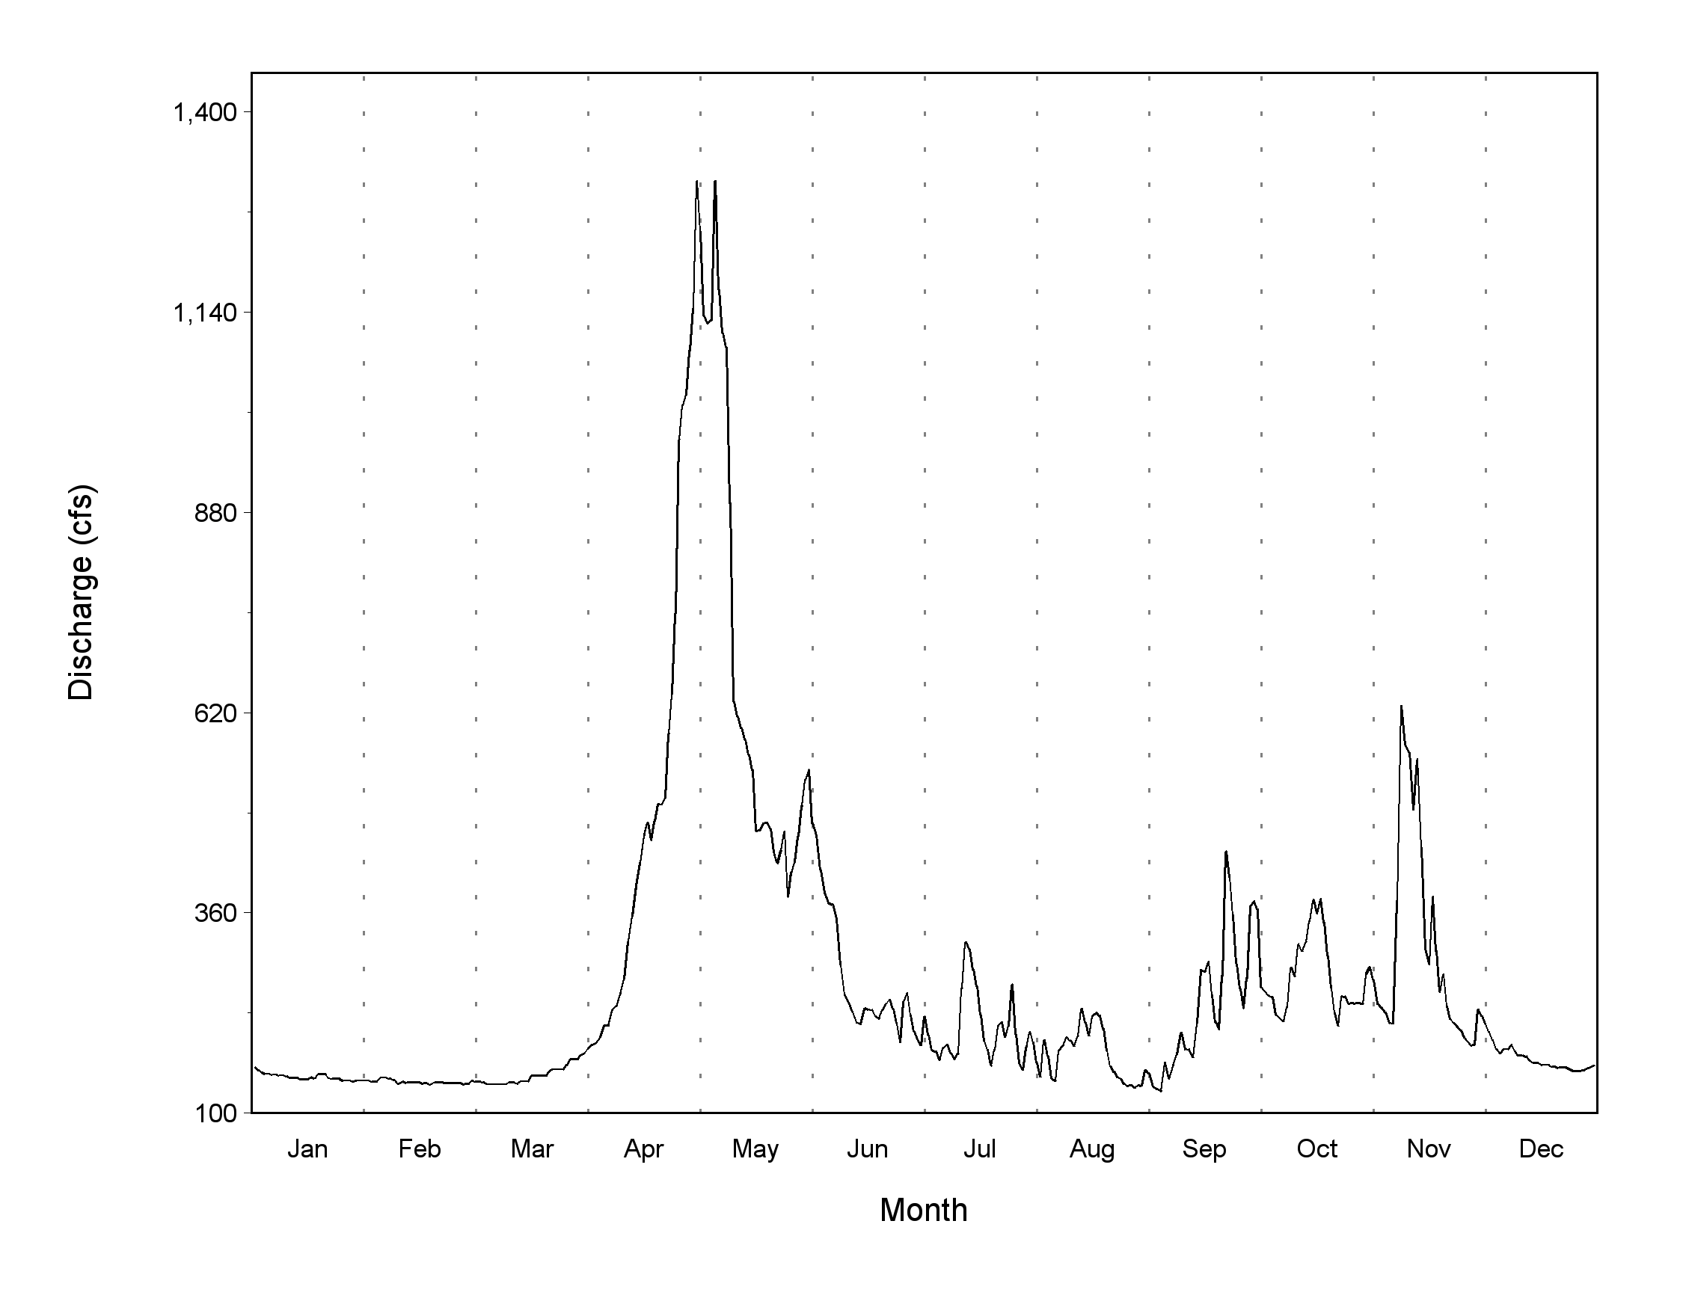
EXAMPLES OF REQUIRED INFORMATION
Aka: Physical, biological, water chemistry, and socio-economic aspects/data substantiating the need for and the quantity of water requested for the proposed reservation
Notes:
SHOW YOUR WORK! JUST LIKE IN SCHOOL…..
PART OF THE RECORD……JUSTIFY TO DNR, THE PUBLIC, THE COURTS

Slide 13
Natural Flow Regime
(colors represent different years)
Mean
Jan Feb Mar Apr May Jun Jul Aug Sep Oct Nov Dec
Notes:
ANOTHER EXAMPLE OF JUSTIFYING YOUR NEEDS, AND REQUESTS

Slide 14

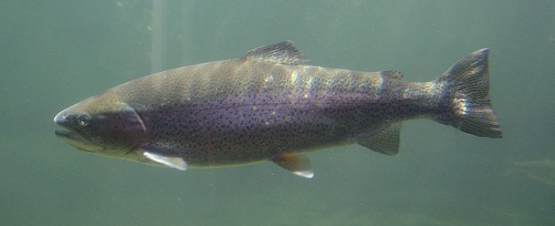
Fish Species Information
Example of a Fish Periodicity Table
Coho Salmon | Jan | Feb | Mar | Apr | May | Jun | Jul | Aug | Sep | Oct | Nov | Dec
Smolt Passage |  |  |  | XXXX | XXXX | XX
Adult Passage |  |  |  |  |  |  | XXXX | XXXX | XXXX | XXXX
Spawning |  |  |  |  |  |  |  | XXXX | XXXX | XXXX | X
Incubation | XXXX | XXXX | XXXX | XXXX |  |  |  | XXXX | XXXX | XXXX | XXXX | XXXX
Rearing | XXXX | XXXX | XXXX | XXXX | XXXX | XXXX | XXXX | XXXX | XXXX | XXXX | XXXX | XXXX
Pink Salmon
Smolt Passage |  |  |  | XXXX | XXXX | X
Adult Passage |  |  |  |  |  |  | XX | XXXX | XXXX
Spawning |  |  |  |  |  |  | X | XXXX | XXXX
Incubation | XXXX | XXXX | XXXX | XXXX |  |  | X | XXXX | XXXX | XXXX | XXXX | XXXX
Rearing
Robert Angell, AK Div. Of Tourism
Lyn Topinka, 2003
Notes:
SAW THIS PREVIOUSLY…..WE SPOKE ABOUT IT EARLIER WITH THE UGANIK
WE WANT TO SEE
PASSAGE
SPAWNING
INCUBATION
REARING
ANY OTHER PERTANENT STAGES THAT I’M MISSING

Slide 15
Methodology:
Many scientific method may be use and will be reviewed by DNR hydrologists for validity. It is up to the applicant to provide the necessary information. Some questions to ponder:
What data is already out there?
If you only have a few years of data collected, what is your plan for future data collection?
How did you analyze the data?
What method did you use?
Did you go into a discussion about your method used?

Slide 16
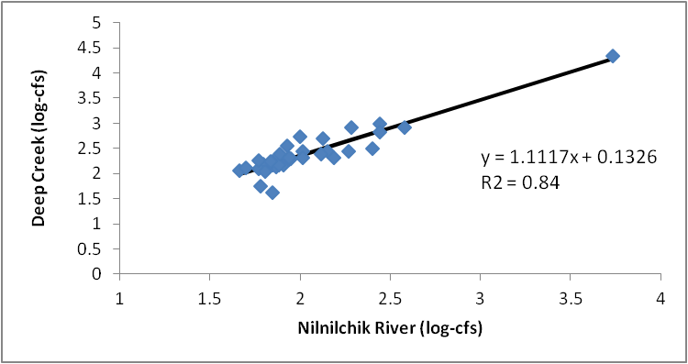
Examples of justifying the chosen method of analysis
Stream systems with limited data or ungagged data can be used, but must be justified.
Notes:
SOME EXAMPLES OF METHODS:
DURATION ANALYSIS
TENNANT METHOD – GETTING AWAY FROM THIS
SIMPLE LINEAR REGRESSION
UNIT AREA RUN OFF
MASS BALANCE
AREAS NOT USUALLY DONE/HASN’T BEEN DONE FOR IFRS
PHABSIM
STREAM STATS – STILL IN BETA VERSION & DNR DISCUSSIONS
ANY OTHER EXTENSIVE MODELING FORM

Slide 17
Review: Water Allocations and Flow Discussions
Example of Time Period Requests
Requested flows are reviewed
Prior appropriators are reviewed
Discharge data reviewed
Notice is issued based on requested flows
Flow discussions begin
Flows are finalized
Time Period | Flow Request (cfs)
January | 13,000
February | 11,000
March | 10,712
April | 10,712
May | 11,000
June | 13,500
July | 17,900
August | 17,900
September | 17,900
October | 17,900
November | 17,900
December | 15,000

Slide 18
Agency & Public Notice
11 AAC 93.080
Notice goes to:
  Newspapers
  Alaska Online Public Notice System
  Certified mail to prior appropriators of the same source
  Those formally requesting notice
  Land owners
  Local Governments
  Post Offices
Within 15 days of publication/service of notice, any person may file written comments with ADNR (AS 46.15.133 (a))

Slide 19
Management Plans/Research Conducted
EXAMPLE (Klehini):
Northern Southeast Area Plan (ADNR)
Chilkat Bald Eagle Preserve Management Plan
Hydrologic Reconnaissance of the Chilkat River Basin, SE Alaska
Haines State Forest Management Plan (ADOF)
Haines Borough Comprehensive Plan
“Special Use” designation?
“Management Area” designation?
Notes:
WHILE OUT TO NOTICE…..WE RESEARCH

Slide 20
Certificate Criteria
AS 46.15.145 (c)
The commissioner shall issue a certificate reserving the water applied for under this section if the commissioner finds that:
The rights of prior appropriators will not be affected by the reservation;
The applicant has demonstrated that a need exists for the reservation;
There is unappropriated water in the stream or body of water sufficient for the reservation; and
The proposed reservation is in the public interest.
Notes:
WE’VE ACCOUNTED FOR PRIORS
WE’VE DEMONSTRATED THE NEED
THERE IS UNAPPROPRIATED WATERS
PUBLIC INTEREST CRITERIA ARE MET
IF YOU CAN ANSWER ALL THESE QUESTIONS THOROUGHLY…..CERTIFICATE!

Slide 21

Public Interest Criteria
AS 46.15.080 (b)
In determining the public interest,
DNR considers*:
  Benefit to the applicant
  Effects to existing/future economic activity
  Effect on fish & game resources/public recreational opportunities
  Effect on public health (water quality)
  Effect of loss of alternate water uses that might be made within a reasonable time if not precluded or hindered by the proposed appropriation.
  Harm to other persons
  Intent/ability of the applicant to complete the appropriation.
  Effect upon access to navigable or public waters.
* These are the minimum 8 statutory criteria which must be considered. Other criteria, as appropriate, may be included.
Notes:
YOU WILL KNOW THESE BY HEART FOR A TEST LATER!

Slide 22

Final Steps
Findings of Fact, Conclusions of Law, & Decision is written and signed
Appeal time – 20 days
No appeal:
  Certificate signed after the 31st day
    Priority date: legally defensible
    Applicant now holds the rights to the flows or levels reserved under the certificate.
    Recording

Slide 23
10-Year Review
A review determines:
The purpose/need still applies?
Effects of the reservation to prior appropriators/public interest?
Has a new beneficial use been proposed?
Is new info available about the reservation?
Is quantity/level of water reserved adequate?
Do time periods still apply?
Are additional research/data/analysis needed?
Notes:
ARE THERE STILL FISH THERE?
IS THE PRIOR APPROPRIATOR STILL ABLE TO GET THEIR WATER? IS THE PUBLIC INTEREST STILL FOR THIS PURPOSE?
HAS SOMEONE COME IN AND DECLAIRED A HYDROPOWER PROJECT IS MORE PERTINENT?
NEW INFO THAT MIGHT CHANGE THE RESERVATION?
ARE THE FLOWS STILL GOOD?
TIME PERIODS? MAYBE CLIMATE CHANGE HAS SHIFTED THE FLOWS IN DIFFERENT TIME PERIODS?
…..

Slide 24
For Further Information
Kimberly Sager
Statewide Water Reservation Specialist
____________________________________
Department of Natural Resources
Water Resources Section
550 W. 7th Avenue, Suite 1020
Anchorage, Alaska 99501
(907) 269-2033
kimberly.sager@alaska.gov
Notes:
IN CASE YOU STILL DON’T KNOW WHO I AM, OR WHERE I WORK…..HERE YOU GO AGAIN!
QUESTIONS?

