Slide 1
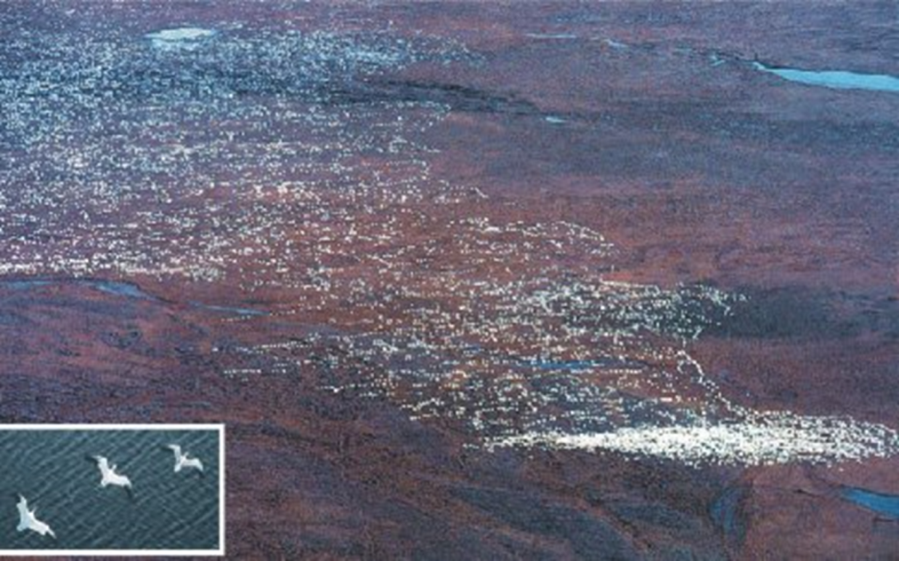
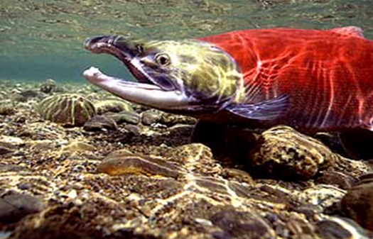
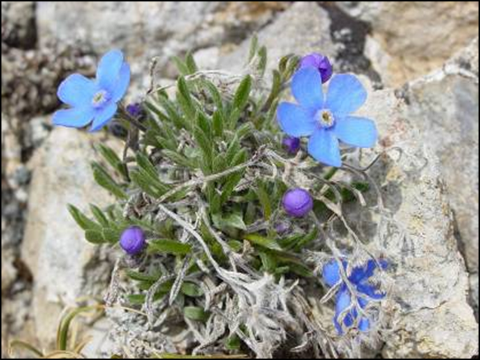
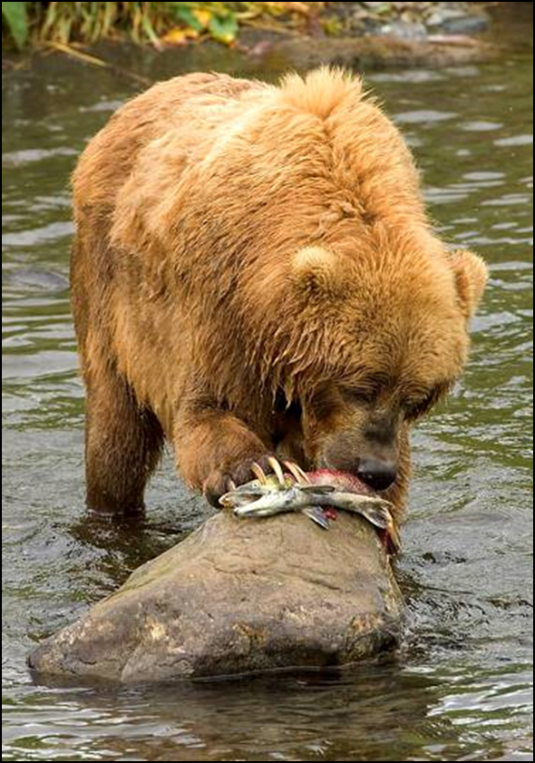
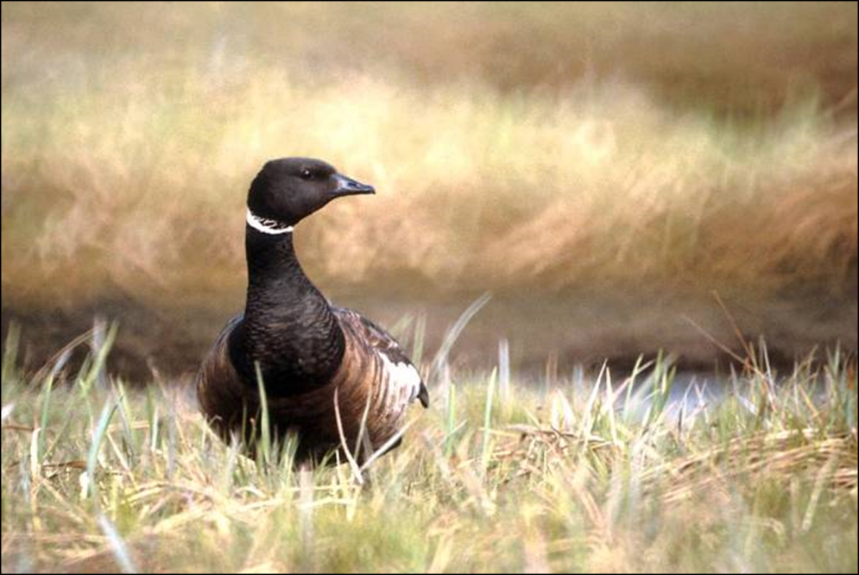
Notes:
Refuge system/service mission
ANILCA- 1. Natural diversity, 2. Subsistence, 3. Water, 4. International Treaties

Slide 2
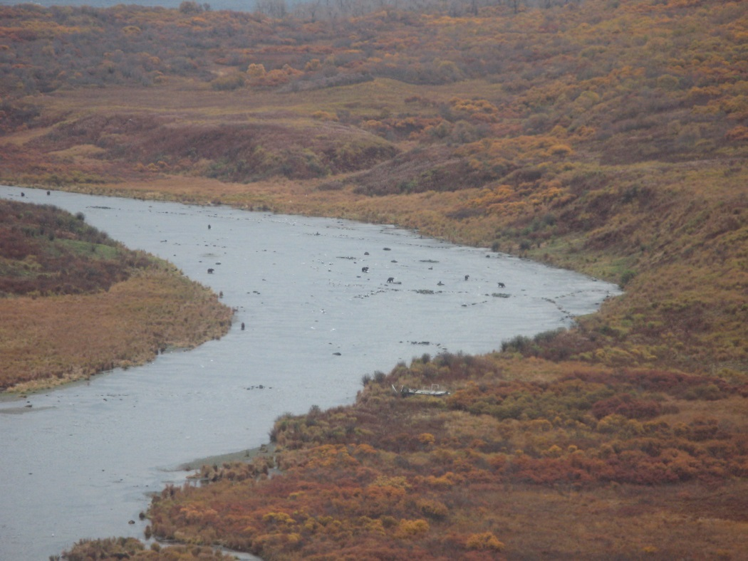
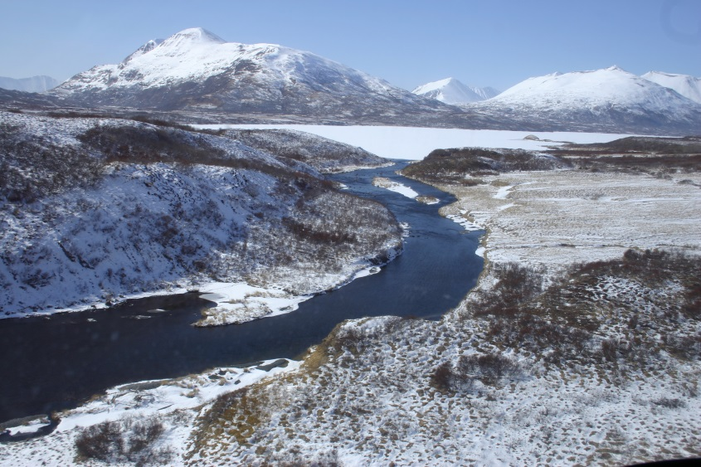
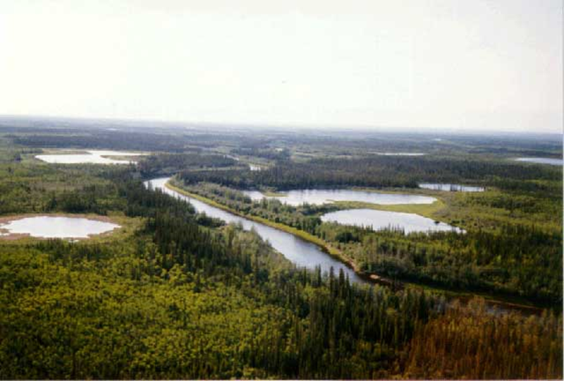
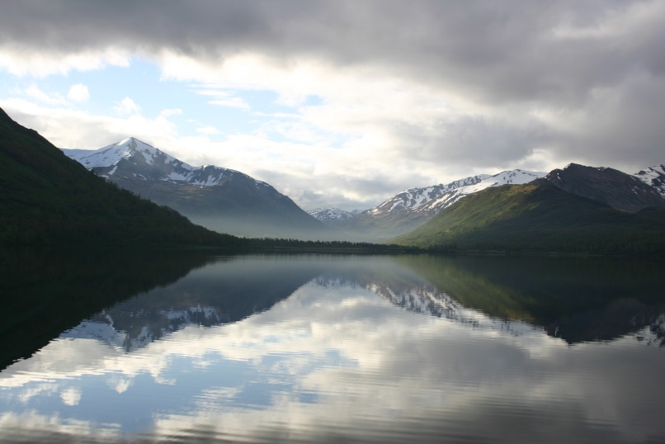
Notes:
Protection of water q&q

Slide 3
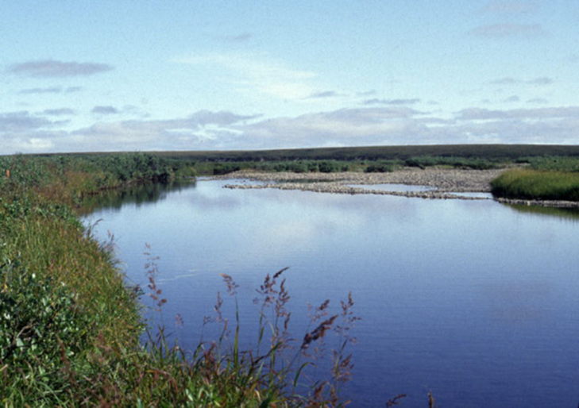
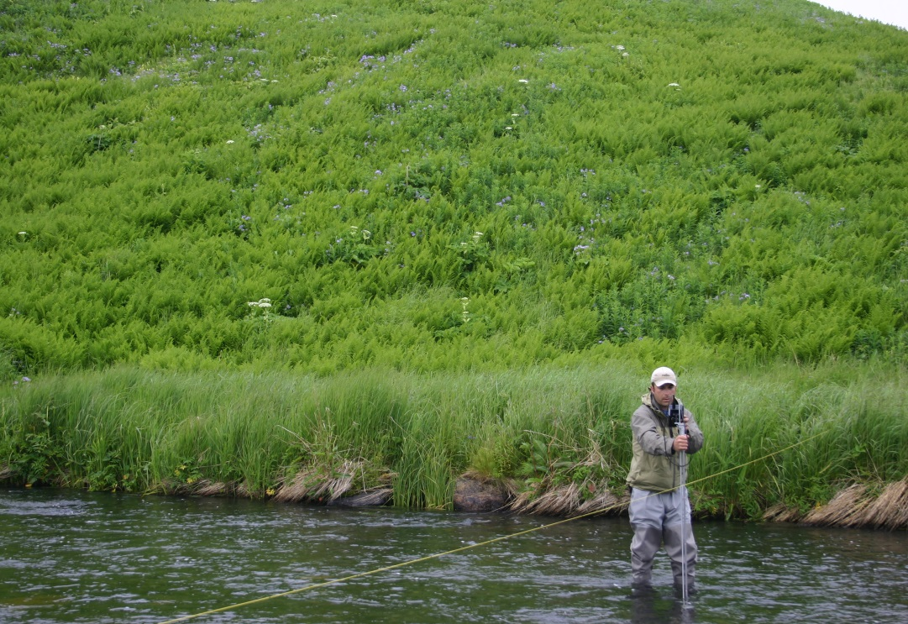
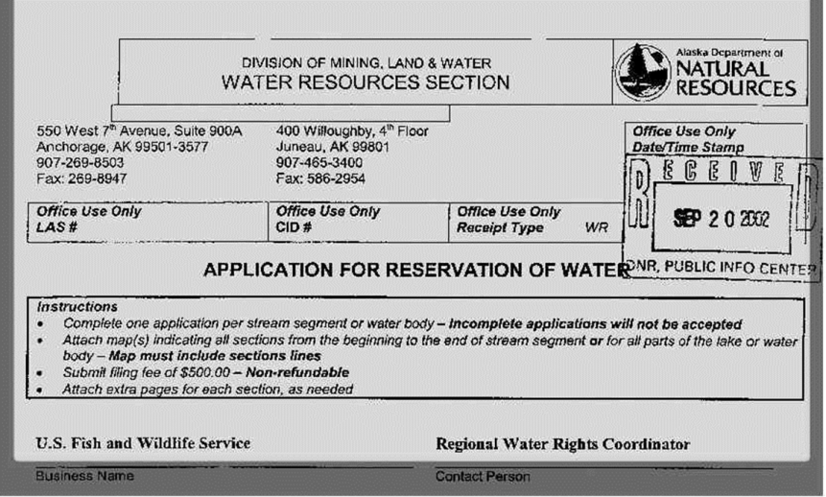
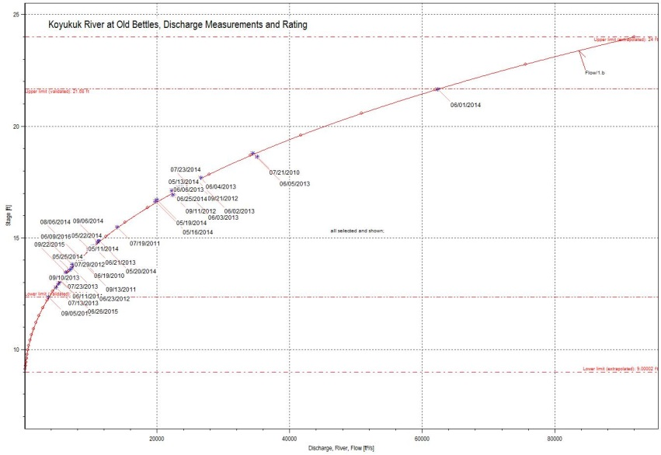

Slide 4
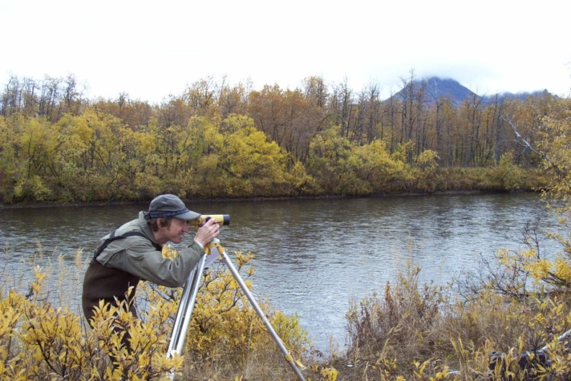
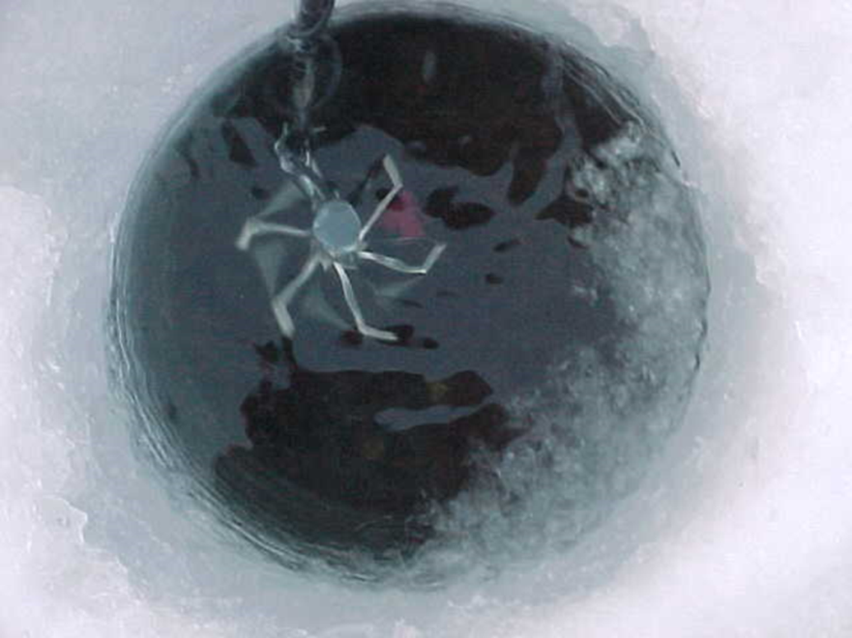
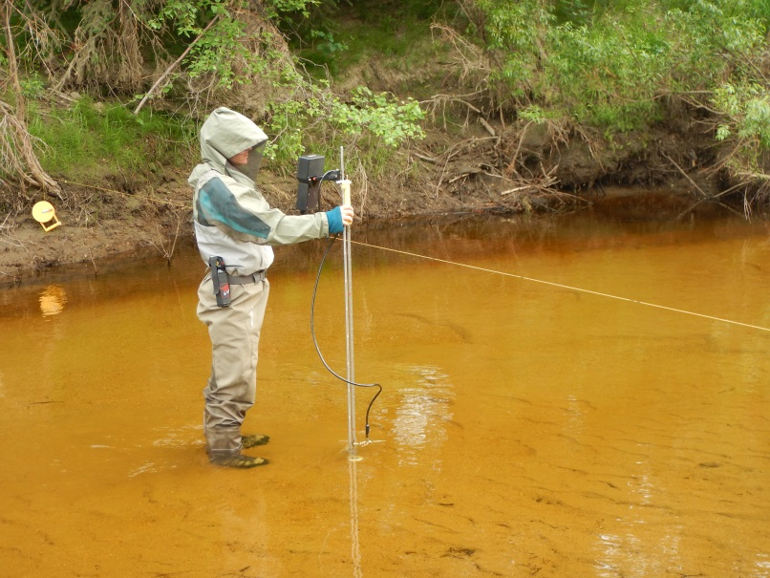
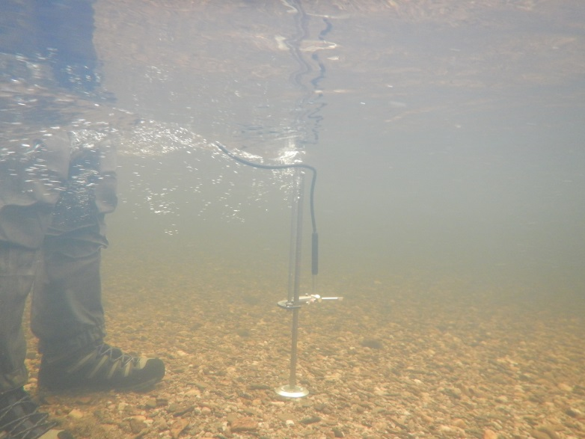
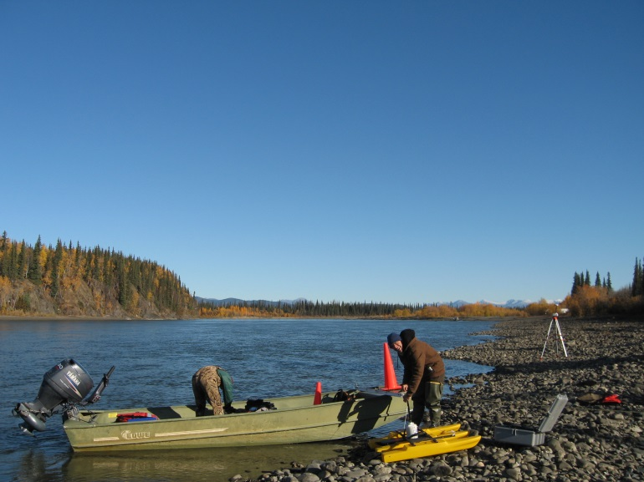

Slide 5
“The mission of the National Wildlife Refuge System is to administer a national network of lands and waters for the conservation, management, and where appropriate restoration of fish, wildlife and plant resources and their habitats within the United States for the benefit of present and future generations of Americans.”
Notes:
Welcome to AK
I am…..
16 refuges, 78 million acres (80% of refuge lands)
18.5 million acres wilderness
40% of nations surface waters in AK and 60% of nations wetlands
16 million acres of private lands within refuge boundaries (village corporations, allotments, 81 villages)
A few items that are unique- work with only one state,

Slide 6
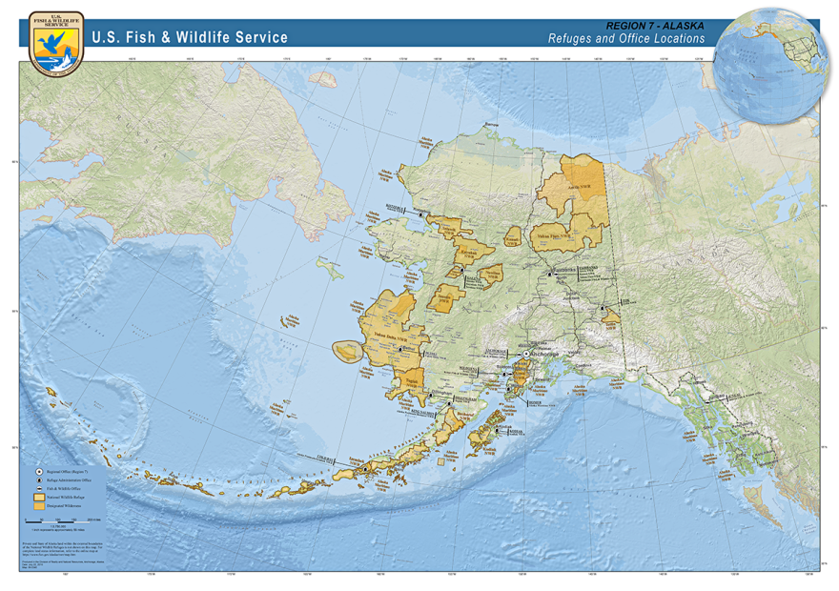
Notes:
Welcome to AK
I am…..
16 refuges, 78 million acres (80% of refuge lands)
18.5 million acres wilderness
40% of nations surface waters in AK and 60% of nations wetlands
16 million acres of private lands within refuge boundaries (village corporations, allotments, 81 villages)
A few items that are unique- work with only one state,

Slide 7
ANILCA Purposes, for all Refuges in Alaska
“to conserve fish and wildlife populations and habitats in their natural diversity…”
iv. “to ensure, to the maximum extent practicable and in a manner consistent with the purposes set forth in paragraph (i), water quality and necessary water quantity within the refuge”
Notes:
Welcome to AK
I am…..
16 refuges, 78 million acres (80% of refuge lands)
18.5 million acres wilderness
40% of nations surface waters in AK and 60% of nations wetlands
16 million acres of private lands within refuge boundaries (village corporations, allotments, 81 villages)
A few items that are unique- work with only one state,

Slide 8
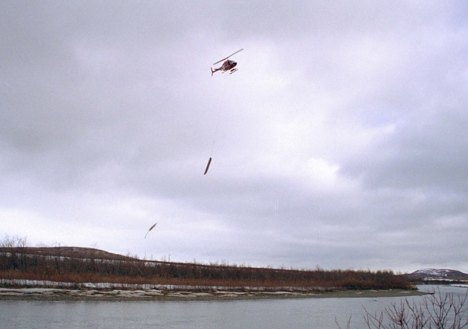
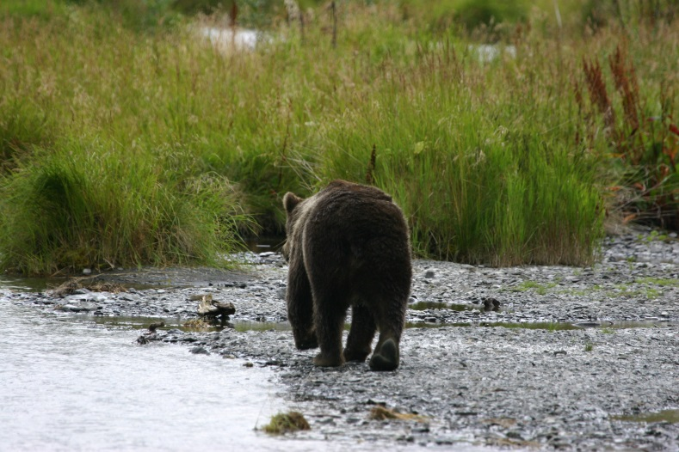
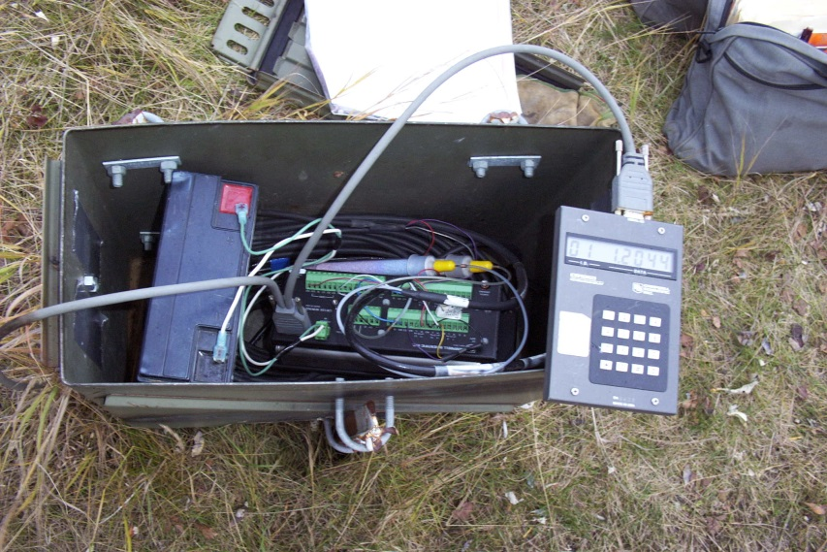
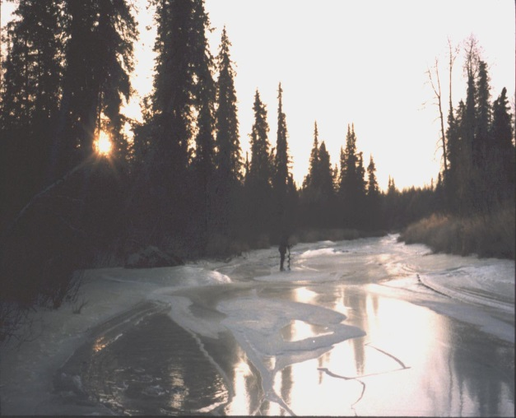
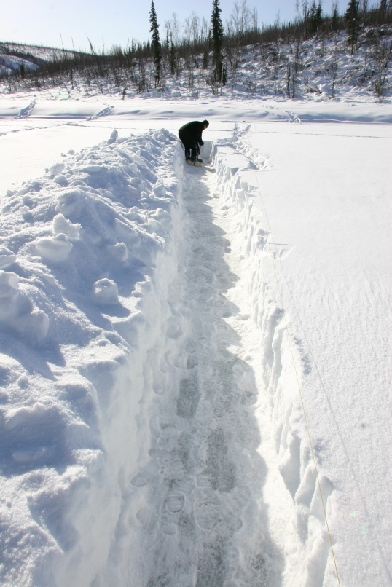
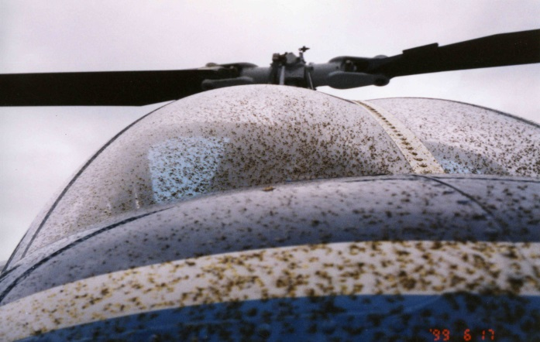
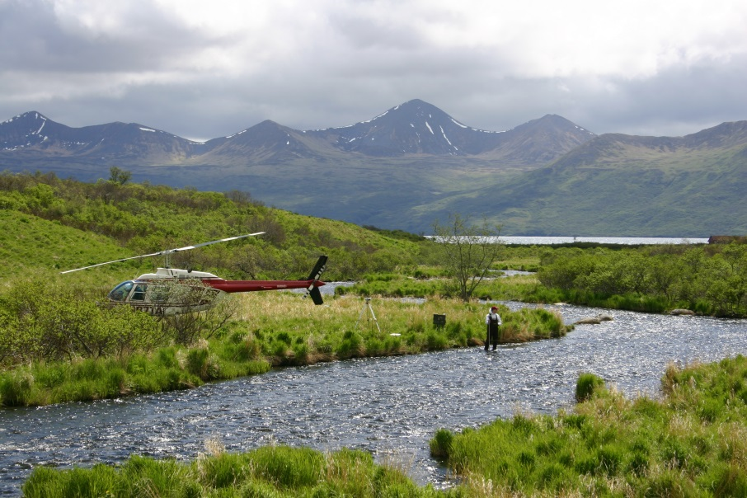
Notes:
Water Quality

Slide 9
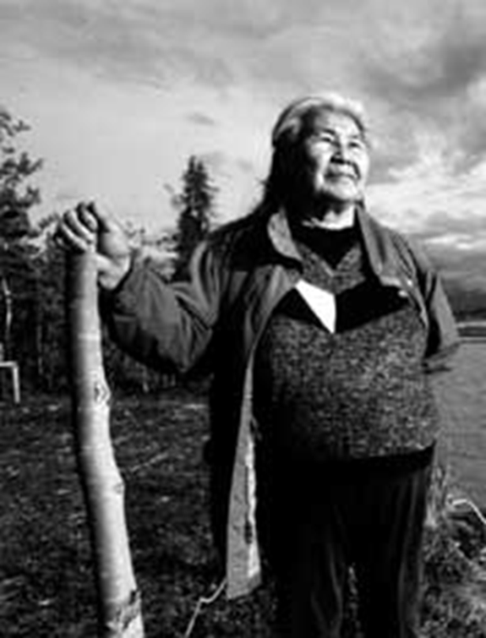
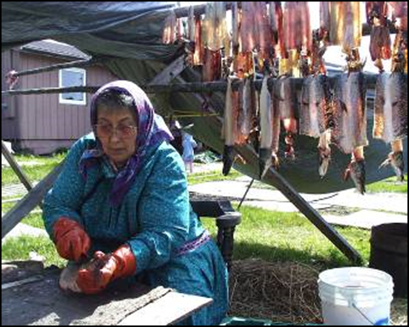
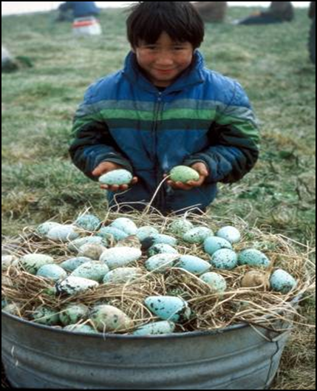
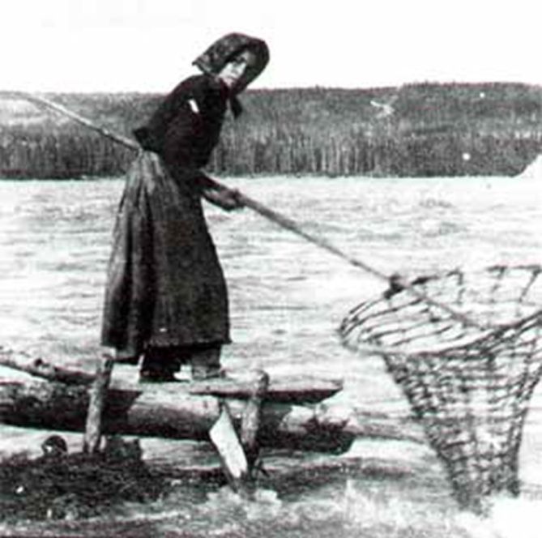
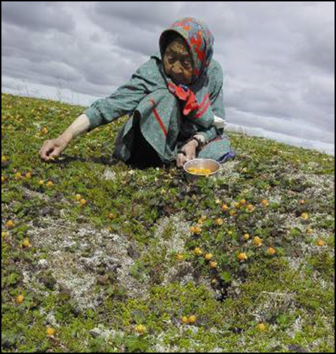
Notes:
subsistence

Slide 10
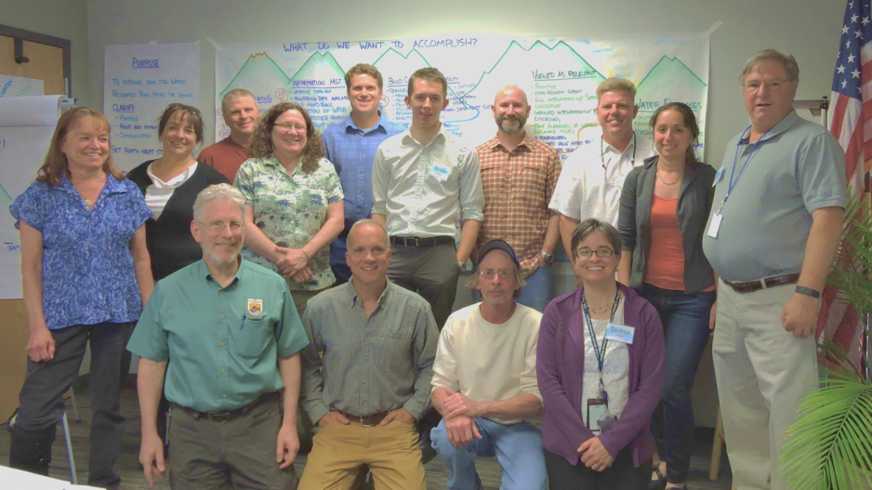
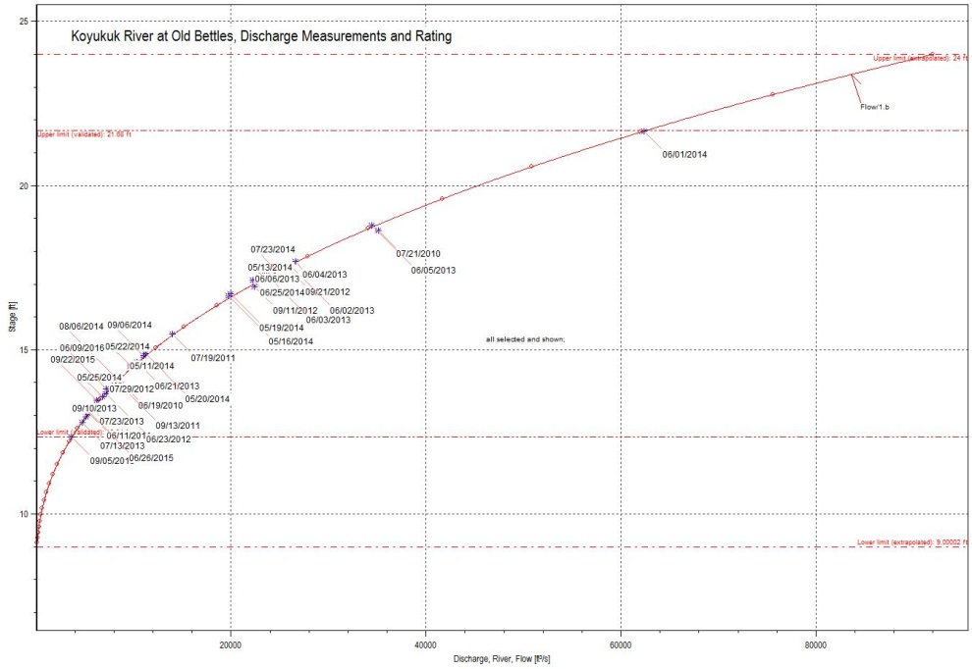
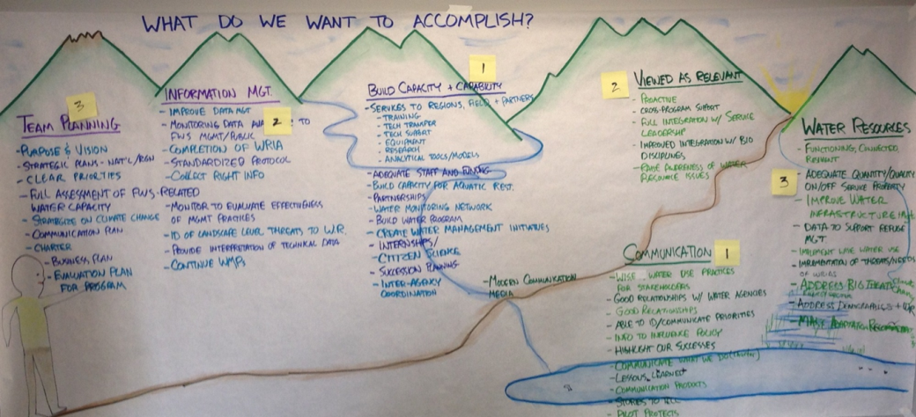
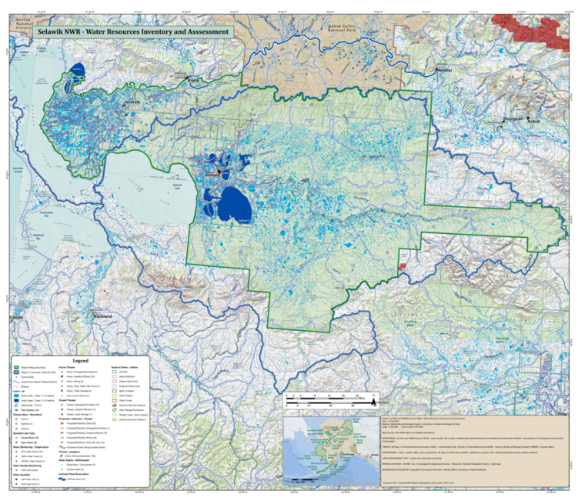
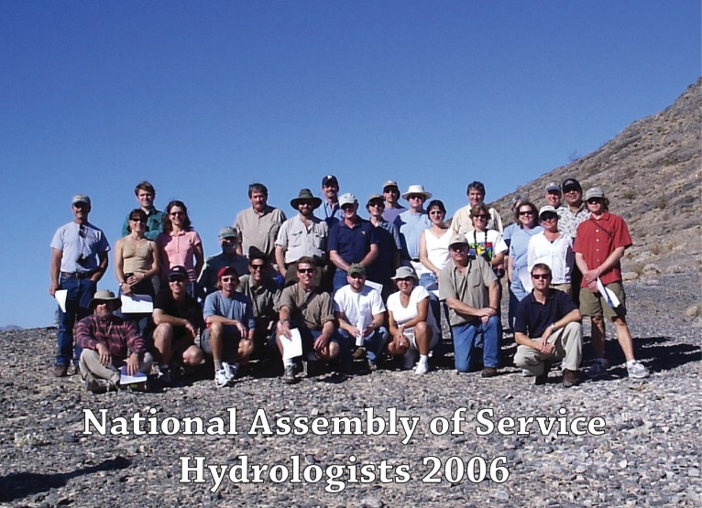

Slide 11
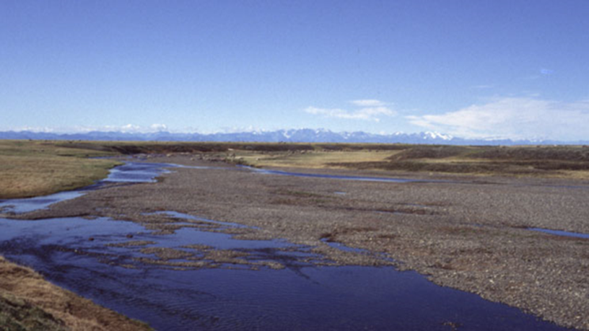
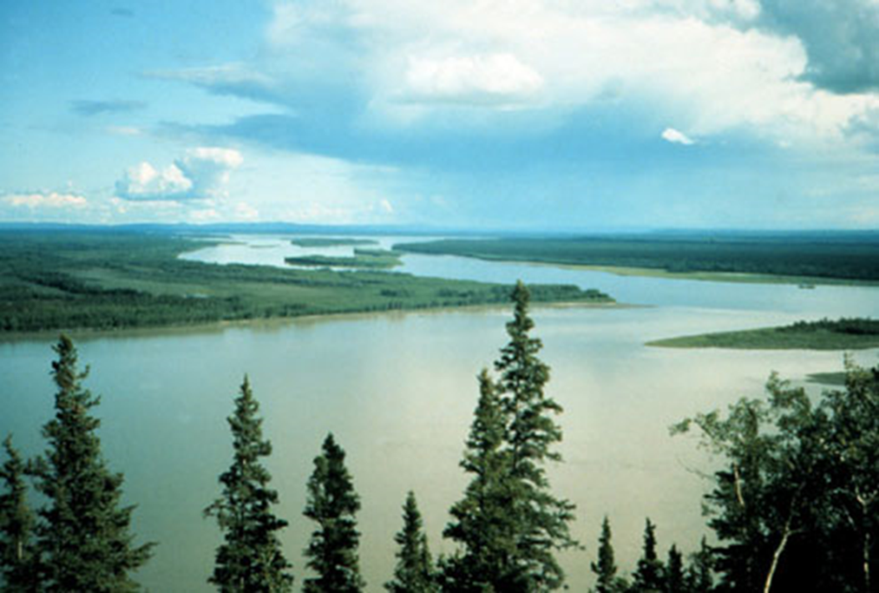
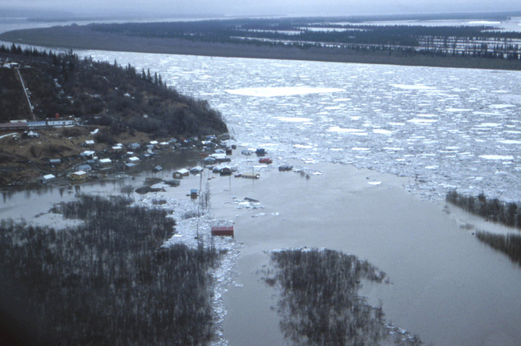
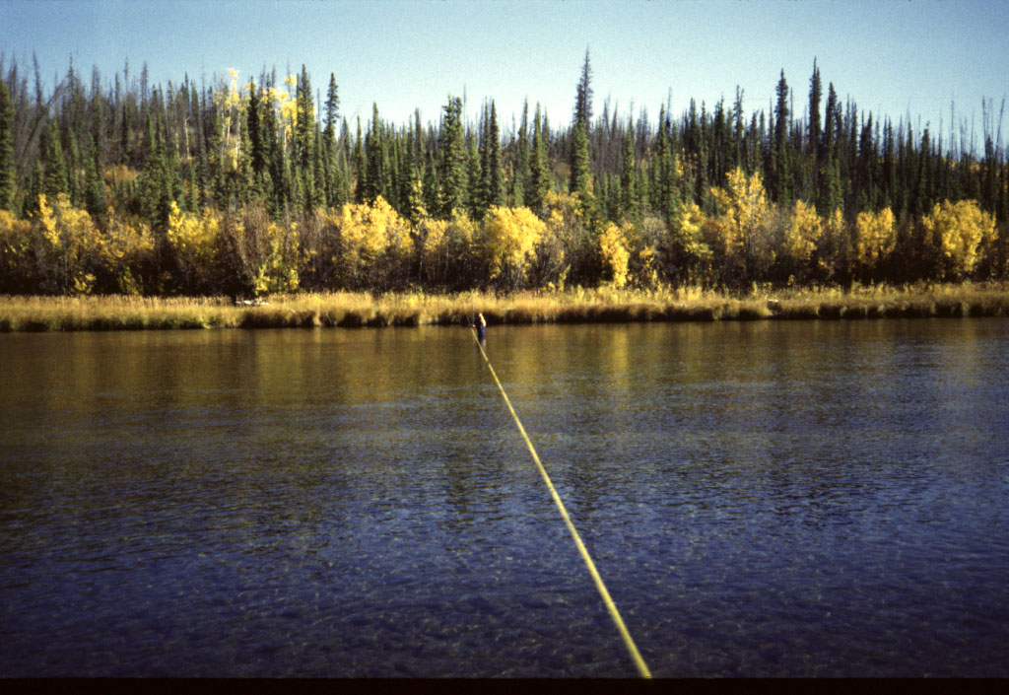
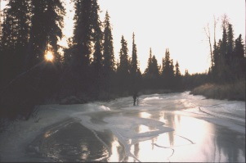

Slide 12
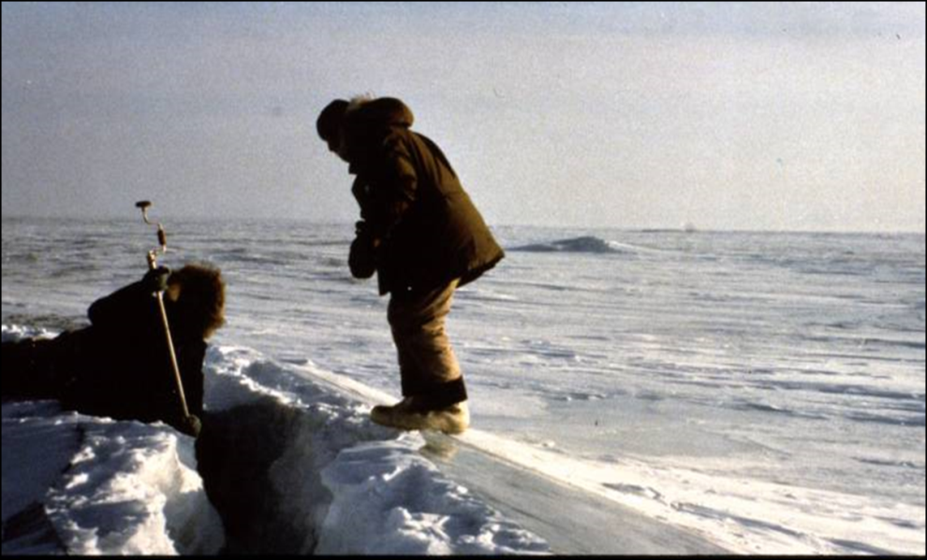
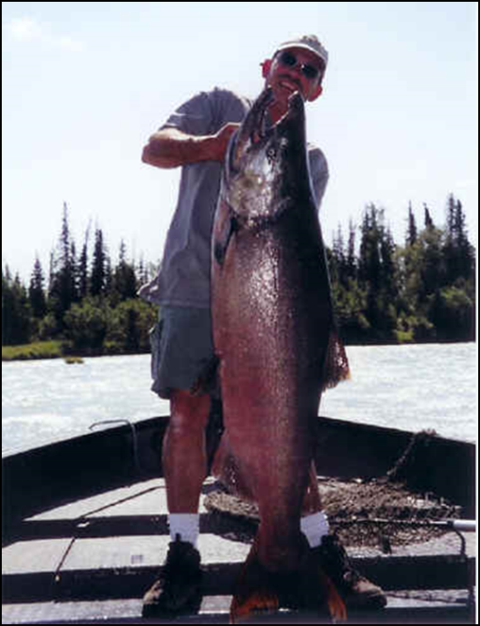
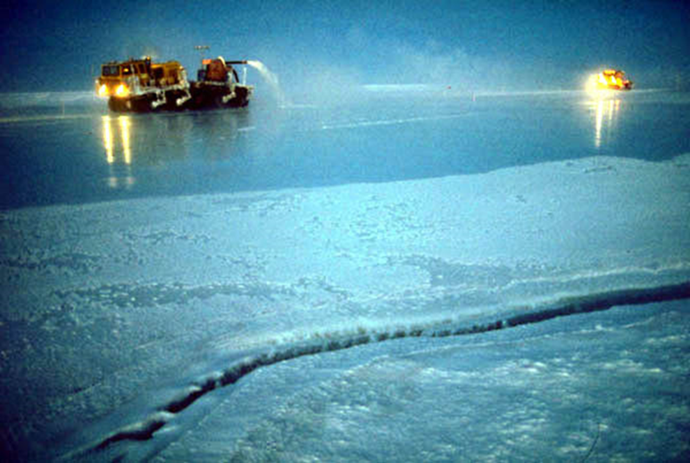
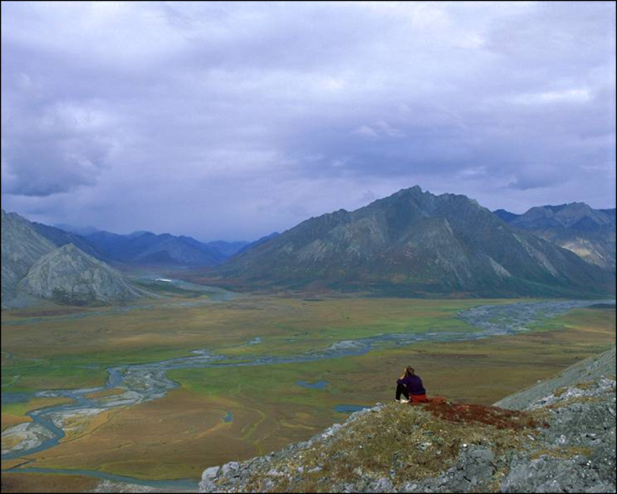
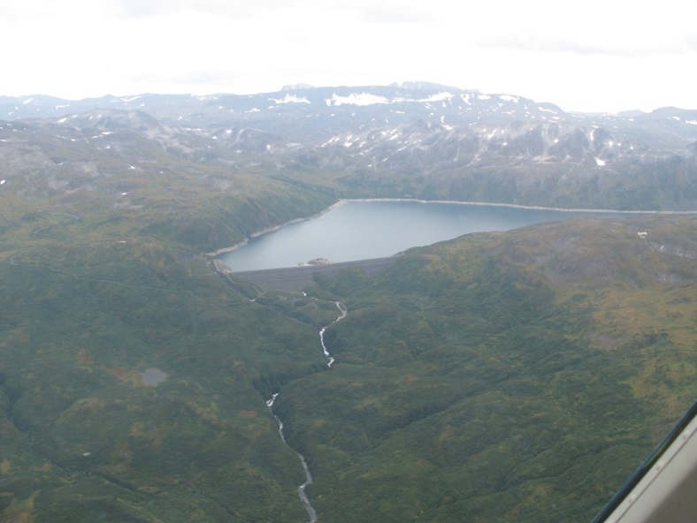
Notes:
Other uses: recreation, research, oil/gas…guide/transporters, commercial filming, hunting/fishing

Slide 13
Remember
Be Relevant
Speak your agencies language
Participate in planning
Inreach and Outreach- tell your story
Water rights are pro-active- hard sell
Communicate
The Legal Protection of Water Matters
Notes:
Welcome to AK
I am…..
16 refuges, 78 million acres (80% of refuge lands)
18.5 million acres wilderness
40% of nations surface waters in AK and 60% of nations wetlands
16 million acres of private lands within refuge boundaries (village corporations, allotments, 81 villages)
A few items that are unique- work with only one state,

Slide 14
Notes:
Welcome to AK
I am…..
16 refuges, 78 million acres (80% of refuge lands)
18.5 million acres wilderness
40% of nations surface waters in AK and 60% of nations wetlands
16 million acres of private lands within refuge boundaries (village corporations, allotments, 81 villages)
A few items that are unique- work with only one state,

Slide 15
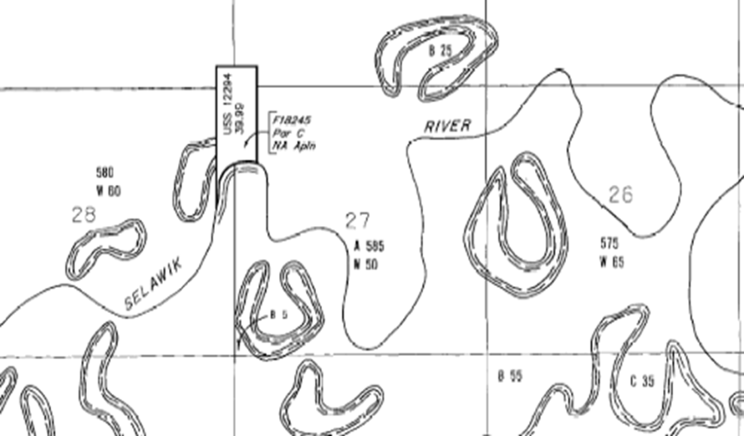
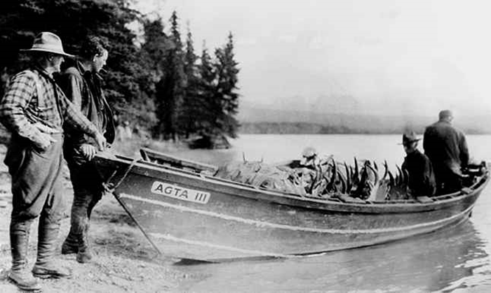
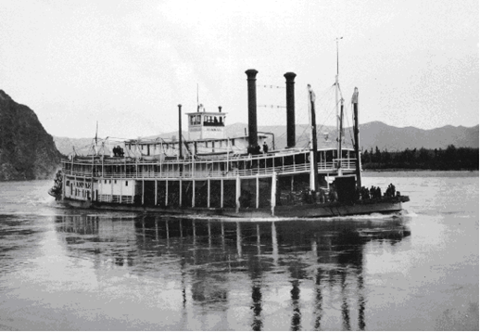
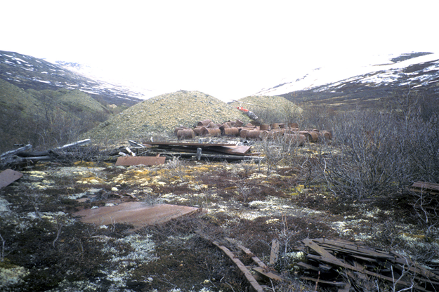
Notes:
Water Temperature

Slide 16
Notes:
Water Temperature

Slide 17
Notes:
Water Quality

Slide 18
Notes:
Welcome to AK
I am…..
16 refuges, 78 million acres (80% of refuge lands)
18.5 million acres wilderness
40% of nations surface waters in AK and 60% of nations wetlands
16 million acres of private lands within refuge boundaries (village corporations, allotments, 81 villages)
A few items that are unique- work with only one state,

