Slide 1
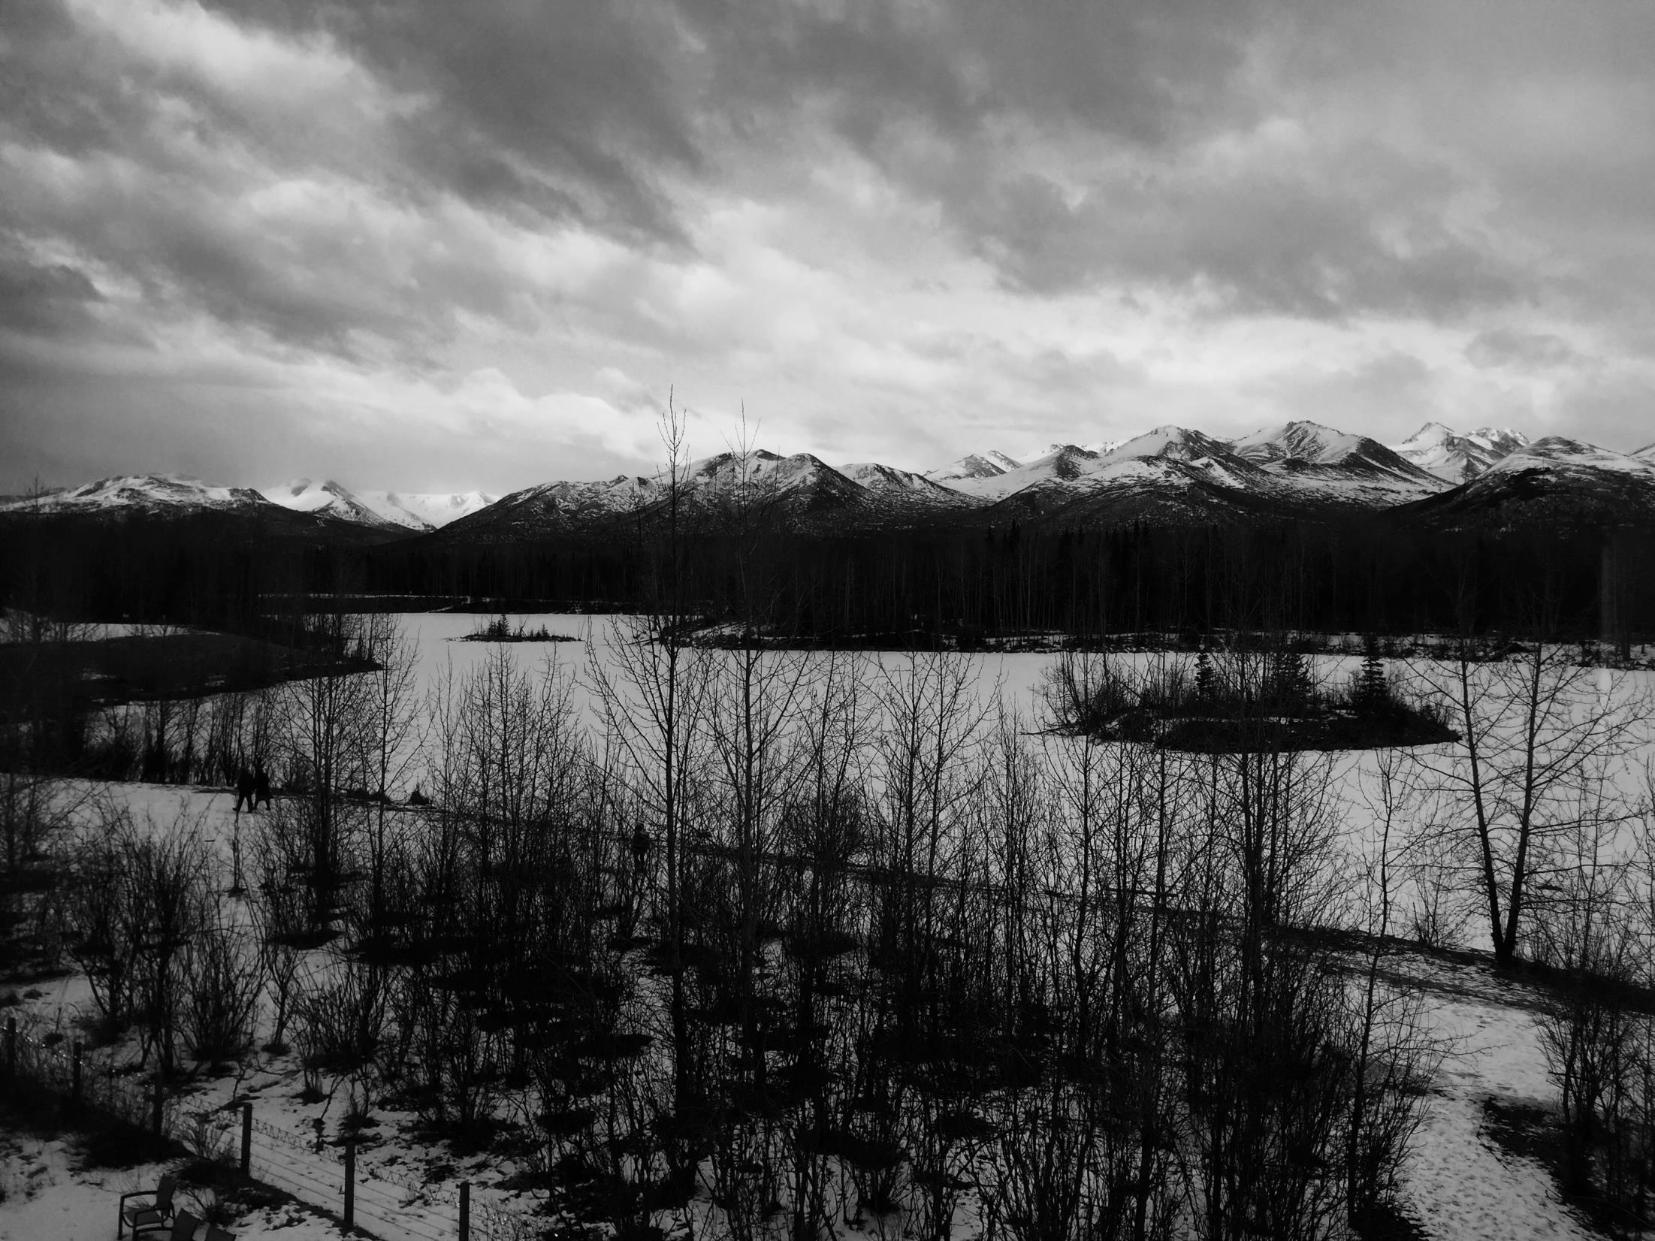
Welcome to the
Alaska
Water Rights Course
Presented by the
National Training Center – Bureau of Land Management
In collaboration with the
US Forest Service
Nation Parks Service
and the US Fish & Wildlife

Slide 2
Overall Course Goal:
The overall course goal is to provide participants with the knowledge and
practical skills necessary to protect, manage, and obtain water rights associated
with water resources on federal public lands in Alaska, in accordance with
agency policies.

Slide 3
Course Description:
This course is based on a review of case studies relevant to the agencies, as well
as instruction in Alaska State and Federal water law and policies. Participants
will discuss and apply water rights policies, processes, methods, forms, and tools
to protect a diversity of water-dependent values and a diversity of water uses.

Slide 4
Course Objectives:
Participants will understand how federal responsibilities can be implemented
by working through the state water rights system.
2. Participants will understand how the Alaska water rights system works and
be able to identify water rights procedures to meet specific land
management objectives.
Students will be able to formulate water right applications and understand
how to manage water rights as part of federal land management functions
in Alaska.
Participants will be able to understand how to obtain and manage state
reservations of water as part of federal land management functions in
Alaska..
Participants will be able to apply new water rights process knowledge
to on-the-ground situations.

Slide 5
Classroom Etiquette:
Students should participants in learning opportunities.
- Be an active participant in the classroom, don’t be a passive leaner.
- Volunteer a response rather than waiting to be called upon – don’t be
a reluctant participant.
Students should not limit the learning of others.
- Be respectful of classmates and faculty
- Give others a chance – don’t try to dominate the class discussion.
- Be attentive when other’s are talking.
- Actively listen by paying attention and listening to what others are saying.
- Critique the idea buy not the person presenting the idea.
- In group activities, be an active contributor – prepare for and attend
meetings. Do your fair share of the work.
Don’t disrupt the class.
- Turn off or silence your cell phone(s).
- Only use your laptop for course-related activities – checking emails/surfing
the internet can be done during breaks, before/after class.

Slide 6
Today’s Agenda
Day’s Objective: Participants will understand how federal responsibilities fit into state water rights systems.
12:00 Welcome & Orientation Jolene Tallsalt Robertson, BLM NTC
12:45 Course Introduction: Why Are Water Rights Important in Alaska?
Federal land manager – John Trawicki, FWS
1:00 Break
1:15 Basic Concepts & Procedures of Alaska Water Law
Lin Fehlmann, BLM contract
2:15 Break
2:30 Understanding Federal Reserved Water Rights
Roy Smith, BLM Colorado
3:30 Break
3:45 Exercise: Case Study With Question & Answer Session
Lin Fehlmann & Roy Smith
4:30 Wrap the Day & Daily Evaluation via Survey Monkey
https://www.surveymonkey.com/r/1730-26-Monday

Slide 7
Today’s Tasks
On a 3" x 5" card, please write down any questions that you may have
for the Alaska Department of Natural Resources regarding the water right
concepts and procedures discussed during their presentation.
These questions will be considered during a facilitated question and
answer session on Tuesday. (The cards are located in your folder)
Jolene/Marlo is collecting donations for the ‘Coffee Fund’ $5 and payments for this week’s lunches, each $11. CASH ONLY.
Wrap the Day & Daily Evaluation via Survey Monkey
https://www.surveymonkey.com/r/1730-26-Monday
Please use your electronic notebook link or type the above link into your browser.
Have a great and safe evening everyone!
We begin at 8am tomorrow!

Slide 8
Today’s Agenda
Day’s Objective: Participants will understand how Alaska water rights system works and be able to identify water rights procedures to meet specific land management objectives.
8:00 Intro to Day Agency representative
8:15 Alaska’s State Appropriative System: Obtaining Consumptive & Non-Consumptive Water Rights
Dave Schade, Alaska DNR
10:00 Break
10:15 Alaska’s State Appropriative System: Obtaining Reservations of Water
Kim Sager & Dave Schade, Alaska DNR
11:30 Working Lunch ($11/person buffet): Accessing Water Rights Information on Alaska DNR Internet site
Mike Walton, Alaska DNR
12:45 Moderated Question & Answer Session with Alaska DNR
Moderators Lin Fehlmann, Roy Smith & Jolene Robertson
2:00 Break
2:15 Perspective from Alaska DNR: Federal agencies working within the Alaska water rights system
Dave Schade, Alaska DNR
2:45 Break
3:00 Exercise: Using a case study, identify water rights tools available to a federal land management unit in Alaska
Lin Fehlmann & Roy Smith
4:00 Wrap The Day & Daily Evaluation via Survey Monkey
https://www.surveymonkey.com/r/1730-26-Tuesday

Slide 9
Today’s Tasks
On a 3" x 5" card, please write down any questions that you may have
for the Alaska Department of Natural Resources regarding the water right
concepts and procedures discussed during their presentation.
These questions will be considered during a facilitated question and
answer session on Tuesday. (The cards are located in your folder)
Jolene/Marlo is collecting donations for the ‘Coffee Fund’ $5 and payments for this week’s lunches, each $11. CASH ONLY.
Wrap the Day & Daily Evaluation via Survey Monkey
https://www.surveymonkey.com/r/1730-26-Tuesday
Please use your electronic notebook link or type the above link into your browser.
Have a great and safe evening everyone!
We begin at 8am tomorrow!

Slide 10
Today’s Agenda
Day’s Objective: Students will be able to formulate water right applications and understand how to manage water rights as part of federal land management functions in Alaska.
8:00 Intro to Day
Federal agency representative
8:15 Panel: Developing an Agency-wide
Water Rights Strategy
Roy Smith, Facilitator & Agency Leads
8:45 Federal Agency Break-Out Sessions.
BLM, USFS, FWS, and NPS meet in
separate groups to discuss strategy,
policy, and workload.
Agency Leads & Agency Personnel
Workshop #1: Obtaining & Managing State Appropriative Water Rights
11:00 Field Data for Water Rights Applications
Lin Fehlmann
11:30 Lunch ($11/person buffet)
12:45 Exercise: Generating a Water Right
Application for a Federal Facility in
Alaska Lin Fehlmann
1:15 Break
1:30 Land Use Authorizations on Federal
Lands for Third Party Water Users
Roy Smith
2:15 Break
2:30 Water Rights in Land Tenure
Adjustments
Lin Fehlmann
3:15 Break
3:30 Exercise: Water Rights in Lands Actions,
using a case study
Lin Fehlmann & Roy Smith
4:30 Wrap The Day & Daily Evaluation via
Survey Monkey
https://www.surveymonkey.com/r/1730-26-Wednesday

Slide 11
Today’s Tasks
Wrap the Day & Daily Evaluation via Survey Monkey
https://www.surveymonkey.com/r/1730-26-Wednesday
Please use your electronic notebook link or type the above link into your browser.
Have a great and safe evening everyone!
We begin at 8:30 am tomorrow!

Slide 12
Today’s Agenda
Day’s Objective: Participants will be able to understand how to obtain and manage state reservations of water as part of federal land management functions in Alaska.
8:30 Intro to Day
Federal agency representative
Workshop #2: Instream Flow & Lake Protection
8:45 Obtaining Instream Reservations: a FWS Case Study of the Uganik River
Cathleen Flannagan, FWS, & Kim Sager, Alaska DNR
10:00 Break
10:15 Alaska DF&G Perspective on Reservations of Water
Joe Klein, DF&G
11:45 Working Lunch ($11/person box lunch) & Field Discussion of Instream Flow Reservations on Campbell Creek
1:00 DNR Technical Review Process for Reservation Applications
Kim Sager, DNR
1:30 Break
1:45 Evolution of Alaska’s Water Reservation Program & Future Challenges/Opportunities
Christopher Estes,
retired Alaska Dept of Fish & Game (DFG)
3:15 Break
3:30 Panel: State & Feds Working Together on Instream Flow Reservations
Roy Smith, Facilitator, with Dave Schade, Kim Sager,
Joe Klein, Cathy Flannagan, Alan Peck
4:30 Wrap the Day & Daily Evaluation via Survey Monkey
https://www.surveymonkey.com/r/1730-26-Thursday

Slide 13
Today’s Tasks
Wrap the Day & Daily Evaluation via Survey Monkey
https://www.surveymonkey.com/r/1730-26-Thursday
Please use your electronic notebook link or type the above link into your browser.
Have a great and safe evening everyone!
We begin at 8am tomorrow!

Slide 14
Today’s Agenda
Day’s Objective: Participants will be able to apply new water rights process knowledge to on-the ground situations.
8:00 Intro to Day
Agency representative
8:15 Facilitated Discussion of Participant Topics/Issues
Discussion schedule and topics will be determined by participants. This session
is focused on addressing specific needs with experts through group or one-on-one
discussions. Participants should bring materials related to their issue(s) to class.
Roy Smith, Facilitator
11:15 Daily Evaluation via Survey Monkey
https://www.surveymonkey.com/r/1730-26-Friday
11:30 Course Adjourns
Thank you for Participating!!
Safe Travels and Have a wonderful weekend

