Slide 1
Alaska’s Reservation of Water Opportunities:
Why Reserve Water?
&
Class Highlights
Christopher Estes, Chalk Board Enterprises, LLC
Presentation for BLM Alaska Water Rights Workshop
October 27, 2016
Anchorage, AK

Slide 2
WHAT HAVE WE LEARNED
?
-
Notes:
2

Slide 3
ALASKA’S WATER MANAGEMENT
OPPORTUNITIES
ARE
UNIQUE!
-
Notes:
3

Slide 4
Water Management Challenges
- Size of AK versus the Lower 48 States
- Abundance of Existing Clean Water &
Intact Habitat versus Elsewhere
Extreme Weather (including cold, limited seasonal daylight)
Limited Road & Seasonal Access
- Limited Biologic Information
Notes:
4

Slide 5
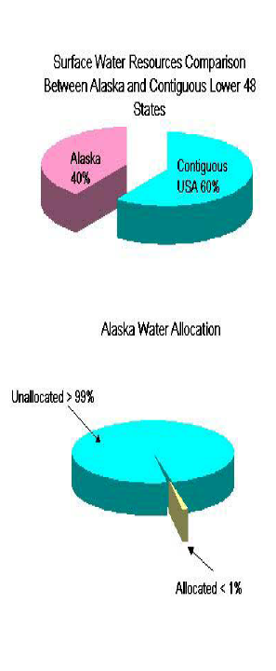
T
THE GOOD NEWS!

Slide 6
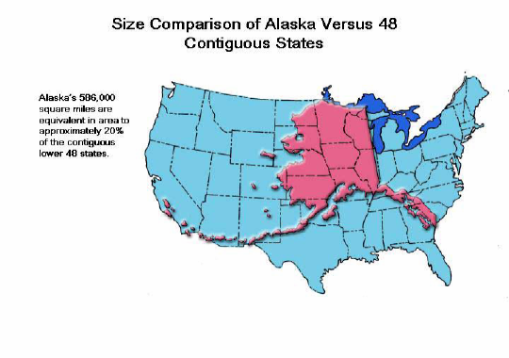

Slide 7
Challenges (continued)
Limited Hydrologic Information
~500 or less USGS continuous flow gages
~1 Gage/6 or 7,000 Square Miles
~100 or Less Gages Operating Annually: < 500 Historically
~ $50k/year+ for USGS Gaging
- Thousands of Rivers & Millions of Lake Fish Bearing Waters with Clean Abundant Water
-
Notes:
7

Slide 8
Summary of Alaska’s Water Law
(Reservation of Water Emphasis)
Alaska’s Constitution – 1959
Water Use Act – 1966, 1986, 1992, 2001
Regulations
Administrative (Agreements)
Case Histories & Examples
Other Reservation Types of Opportunities

Slide 9
State Infancy Historical Challenges
Limited Experience Using the Legal/Institutional
Toolbox
Variety & Changing Land Ownership Status
(subject to change)
Institutional Memory/Lobotomy Challenges
Limited Case Law
-
-
Notes:
9

Slide 10
Historical Challenges (continued)
Socioeconomic Shifts (Booms/Busts/Stable)
Political Shifts
Long-term Time/$ Investments (Filing/Adjudication)
Small Proportion of Water Bodies Reserved to Date & Limited to Subset of Purposes
-
-
Notes:
10

Slide 11
ELEMENTS!
-
Notes:
11

Slide 12
Alaska Water Law Use Examples
Instream:
Water needed* in the water body to support vital ecological functions and uses (includes lakes/wetlands)
Examples:*
Fish & Wildlife/Habitat
Recreation
Cultural/Aesthetic
Navigation/Transportation
Water Quality
-----------
* Ice Conditions, too
Out of Stream:
Water removed from the system or flow regime/water volume/stage altered* (subsurface/groundwater too)
Examples:*
Power Generation (hydro/fossil fuels/solar)
Industrial/Manufacturing
Public/Personal Water
Supply
Irrigation/Agriculture
Water Export/Transfer
Hatcheries
Resource Extraction (Minerals, Timber, Oil, Gas, etc.)
Ice Roads, Snowmaking, etc.

Slide 13
Why Did Alaska Establish a Reservation of Water Law?
-
Notes:
13

Slide 14
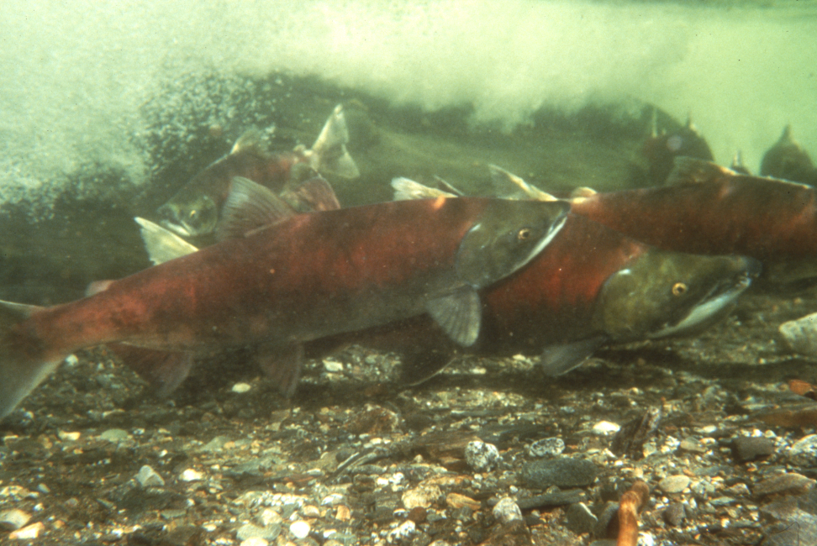
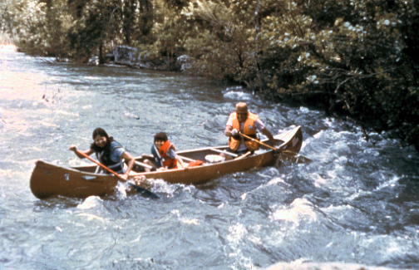
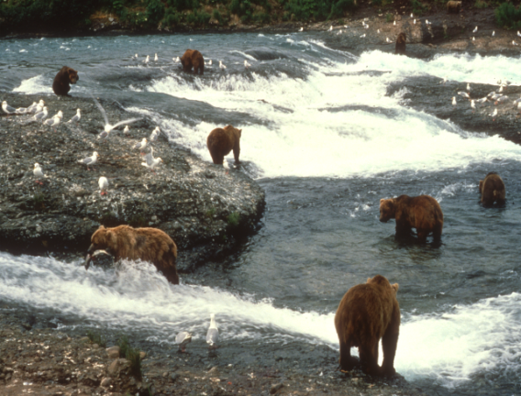
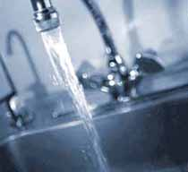
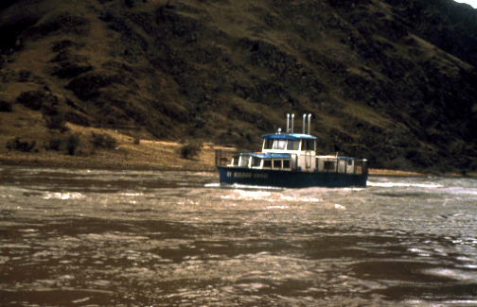
4 Categories of Instream Flow Uses
John Hyde ADF&G
(USGS 1996)
Robert Angell, AK Div. Of Tourism
(USGS 1996)
Notes:
could use better picture for water quality – so note that frozen WATER USES LANDING OF FLOAT PLANE AND OTHER USES SNOW MACHINES DOG SLEDS EG TRANSPORTATION IN WINTER IS DEPENDING ON WATER LEVELS AND THICKNESS OF ICE.

Slide 15
UNIQUE OPPORTUNITIES
APPROPRIATE WATER TO MAINTAIN WATER QUALITY, FISH, WILDLIFE, RECREATION & NAVIGATION IN ADDITION TO WITHDRAW, IMPOUND AND DIVERT PURPOSES
AUTOMATIC RESERVATIONS OF WATER ARE ESTABLISHED FOR WATER EXPORTS FROM LARGE HYDROLOGIC BASINS
Notes:
15

Slide 16
ANYONE CAN FILE FOR A WATER RIGHT
(APPROPRIATION OF WATER)
TO
WITHDRAW, DIVERT, IMPOUND & RESERVE
WATER THAT IS IN THE BEST PUBLIC INTEREST
-
Notes:
16

Slide 17
SURFACE/SUBSURFACE WATER BODIES ARE SUBJECT TO APPROPRIATION
(CONSIDERED 1 SOURCE IF HYDROLOGICALLY CONNECTED)
Notes:
17

Slide 18
APPROPRIATIONS MUST BE
DETERMINED TO BE IN THE BEST
PUBLIC INTEREST (AS 46.15.080)
-
Notes:
18

Slide 19
Elements That Affect Reservation of Water Opportunities/Outcomes in Alaska
under State & Federal Laws
Legal/
Institutional
Science
(Hydrologic &
Biologic
Components)
Public
Involvement
Notes:
The decisions and actions that all natural resource managers make are driven by the complex interaction of public input, laws, policies, science and judicial outcomes. The manner in which managers integrate information from each of these elements will determine what our planet and our quality of life looks like.

Slide 20
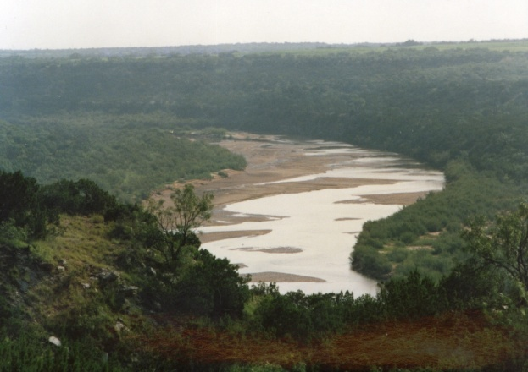
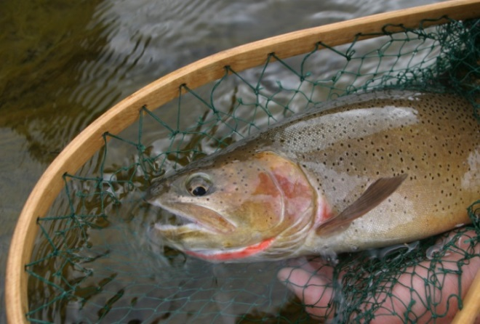
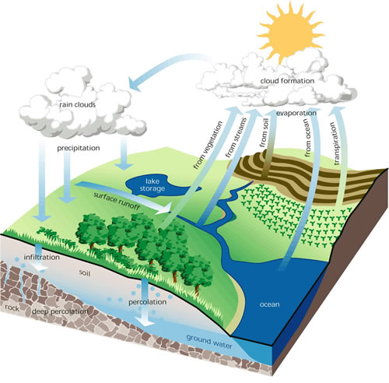
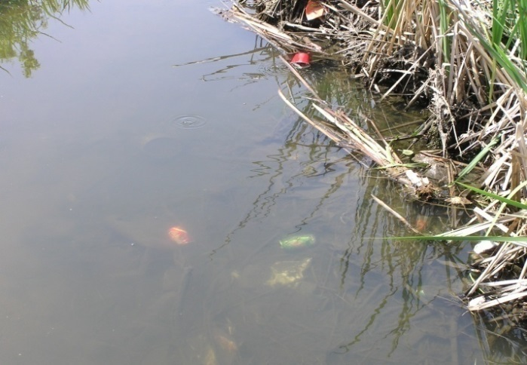
Scientific Elements
Geomorphology
Biology
Hydrology
Flow/Water Levels
Connectivity
Water Quality

Slide 21
RECOMMENDATIONS
Develop Statewide & Regional Long-term Water Uses and Needs Plans & Prioritize
Collect & Analyze Long-term Seasonal Baseline
Water Quantity & Quality Availability Information & Define Relationships
Collect & Analyze Data Required to Better
Understand Seasonal & Long-term
Watershed Ecological Functions &
Relationships to Human Socioeconomic
Needs/Values

Slide 22
RECOMMENDATIONS - continued
Joint Funding Requests (Federal, State, Academic, Private (including Tribal)
Public/Stakeholder Education/Involvement
Participate in Regional/National Initiatives
  (e.g. Drought Action Plan Implementation, USGS Water Smart/Census, LCC, NFHP, SSSF, other watershed scale efforts)
Use Graphics that Display Appropriate
    Geographic Information and Scale for
    Alaska

Slide 23
RECOMMENDATIONS - continued
Expand Upon/Mimic ADF&G MOU Agreement with ADNR
Review Welker Waterways Audit – Use Smaller Basin Definitions
- Train & Maintain Dedicated Interdisciplinary
Staff Expertise

Slide 24
RECOMMENDATIONS - continued
File Reservation of Water Applications under AS 46.15.145
WHY?
It is the Best Public Interest to Define Baseline Water Availability and How Much Water is
Available For Which Purposes
Its Common Sense!

Slide 25
QUESTIONS?
Christopher Estes
Aquatic Habitat and Resources Scientist
Chalk Board Enterprises, LLC
907-227-9549
christopher@chalkboardllc.com

