Slide 1
Protection of surface waters through the State of Alaska on Alaska Refuges
Case study of Uganik River Reservation of Water within
Kodiak NWR

Slide 2
Statutory Mandates for Refuges
National Wildlife Refuge System Improvement Act (NWRSIA) (1997)
Maintain biological integrity/diversity/health
Maintain adequate water quantity - quality
Acquire water rights under State law
Alaska National Interest Lands Conservation Act (ANILCA) (1980)
Primary purpose of each refuge in Alaska
Conserve habitats in natural diversity
Ensure “water quality and necessary water quantity”

Slide 3
Water & Law Factors on Alaska Refuges
Prior appropriation state w/ abundant water in unique hydrological and ecological systems
Progressive state water law
Expressed but unquantified FRWR in Alaska refuges
Sparse baseline hydrologic data
Limited ecological / biological data for aquatic habitat
Economic factors
oil/gas development, placer mining, water export, fisheries/wildlife, recreation, navigation, etc.
Whole, intact, mostly pristine waters and watersheds, with water rights uncertainty
Notes:
Assortment of thoughts in no particular order re Alaska and water rights. Unique, odd, peculiar, different characteristics and considerations related to instream water rights in Alaska
It is apart; does not abut another state; no possibility of interstate water dispute or need for compact or negotiation. (No international trans-boundary issues yet)
Lowest population density of any state (650,000 people) avg approx 1 person/square mile vs lower 48 w/ 100 people/square mile
In contrast to most western, prior appropriation states, Alaska is not water deprived or over appropriated.
Relatively little out of stream appropriation

Slide 4
Agency Mission Statements: Conflicts & Similarities
The U.S. Fish and Wildlife Service’s (FWS) mission is working with others to conserve, protect, and enhance fish, wildlife, plants, and their habitats for the continuing benefit of the American people.
The Alaska Department of Natural Resources’ (DNR) mission is to develop, conserve and maximize the use of Alaska’s natural resources consistent with the public interest.

Slide 5
Mission Statements: Conflicts & Similarities cont…
FWS
Conserve
Protect and enhance fish, wildlife, plants, and their habitats
for the benefit of the American people
DNR
Conserve and maximize
Develop the use of natural resource (lands and waters)
for public interest

Slide 6
Mission Statements: Conflicts & Similarities cont…
A Reservation of Water is the best route to gain protection and provide conservation….an opportunity.
The FWS may not meet all the legal obligations under ANILCA to protect the natural diversity of populations and habitats, but working through the state is the appropriate first step in ensuring water quality and quantity for refuges.
Notes:
Opportunity due to ak water law is progressive and waters aren’t over appropriated.

Slide 7
Agency’s Water Right Policy
FWS
Obtain sufficient water and water rights
Secure water rights under State law
Assert and protect Federal interests in water, as necessary
DNR
Assure state interests within water for the public
Neutral in determination of a reservation decision
Notes:
Obtain: sufficient quantities of water and the legal right to use that water to develop, use, and manage refuge lands and facilities, protect endangered species, and maintain instream flows.
Secure: All water rights needed for Service facilities and programs should be secured under State laws and procedures when available.
Assert: Assert when necessary to protect federal interests in water.
Review: Review and comment on notices for water right applications filed by others on or near refuges.
Identify: Identify and evaluate water rights on lands proposed for acquisition or disposal

Slide 8
Reservation of Water Purposes AS 46.15.145 (a)(1)
Protect fish and wildlife
Habitat, propagation, and migration
Recreation
Swimming, fishing, hunting, natural values, etc.
Navigation/Transportation
Sufficient quantity for boats, floatplanes, etc.
Water quality
Sanitary and water quality reasons

Slide 9
Agency’s Water Right Process Goals
FWS
Maintenance of:
natural diversity of species and habitat (ANILCA)
natural timing and magnitude of flow
flows for important life stages and channel form and function
DNR
Reserved to the people for common use and is subject to appropriation and beneficial use…
Adjudication process assures:
water is allocated in a reasonable and consistent manner based in part by public interest criteria
Determination of the validity and amounts of a water right.
Including conflicting claims among competing applications.

Slide 10
Why the Uganik River?
First adjudication between DNR and FWS
Data rich
Strong fisheries component
Low/No conflict issues that may arise in other FWS applications
Straightforward
An excellent start point

Slide 11
Uganik River History & Importance
Provides migratory, spawning, and rearing habitat for sockeye, pink, chum, coho and chinook salmon, steelhead, and Dolly Varden
The Uganik River drainage basin is considered a major rainbow trout area
The lower river is high use, key habitat for brown bear
The East Arm of Uganik Bay, into which the Uganik River flows, provides prime wintering habitat for puddle ducks and maintains a high concentration of waterfowl.
Subsistence hunting and trapping for residents of Port Lions and Ouzinkie
Notes:
The Kodiak NWR was originally established to protect brown bear habitat, especially feeding and breeding habitat. Conservation of brown bear and their habitat is a purpose of Kodiak NWR under ANILCA.

Slide 12
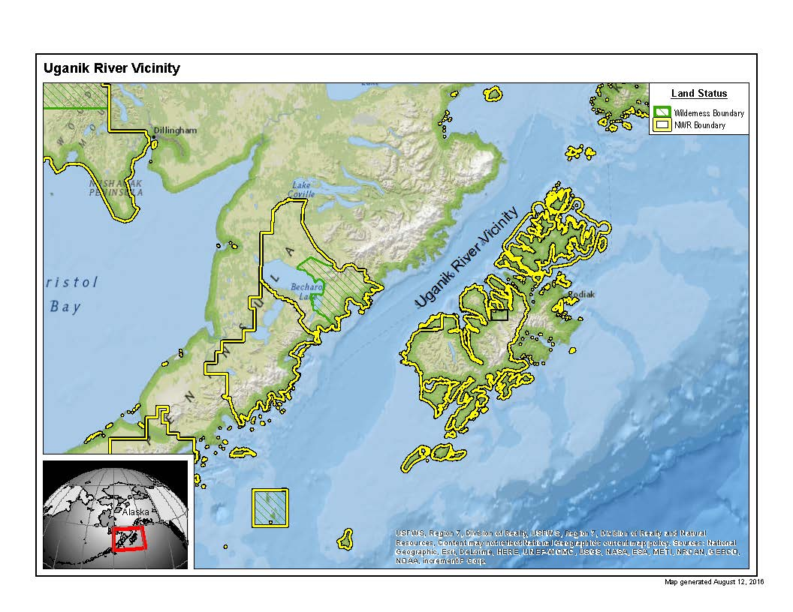

Slide 13
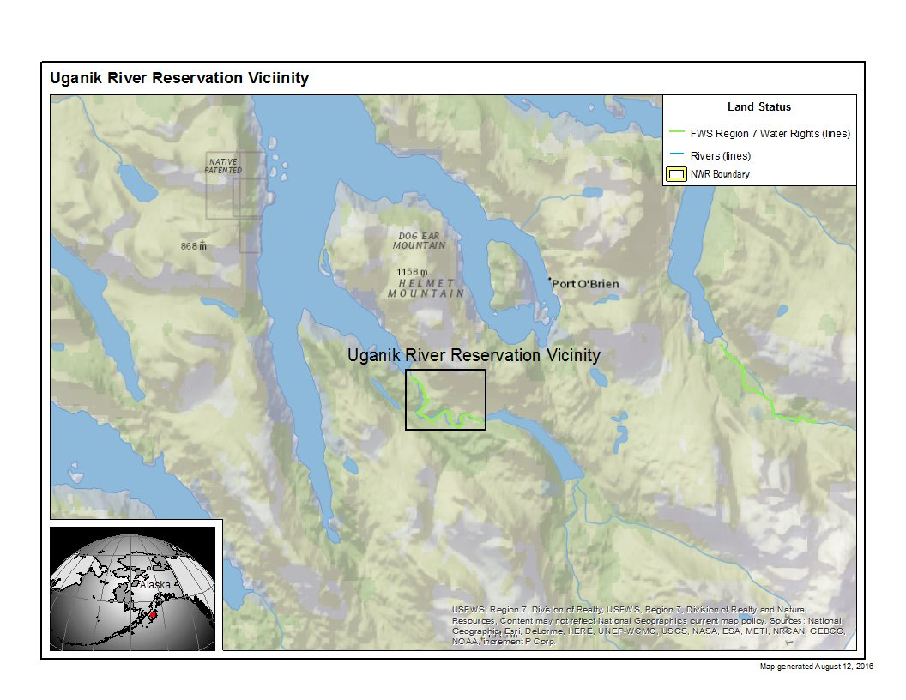

Slide 14
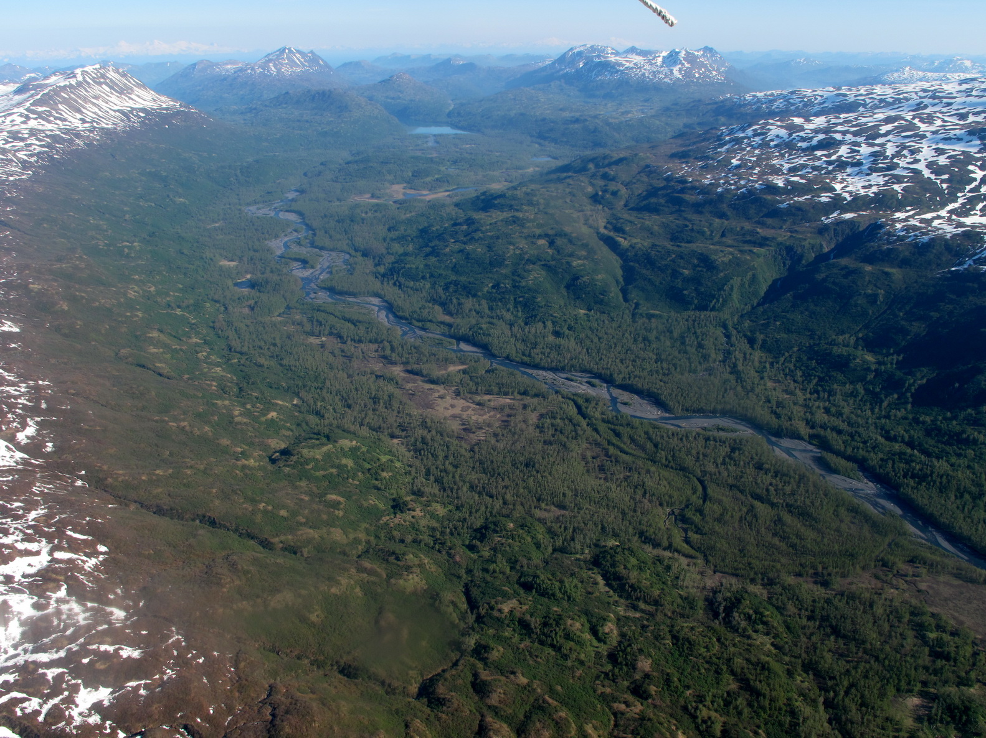
Uganik River

Slide 15
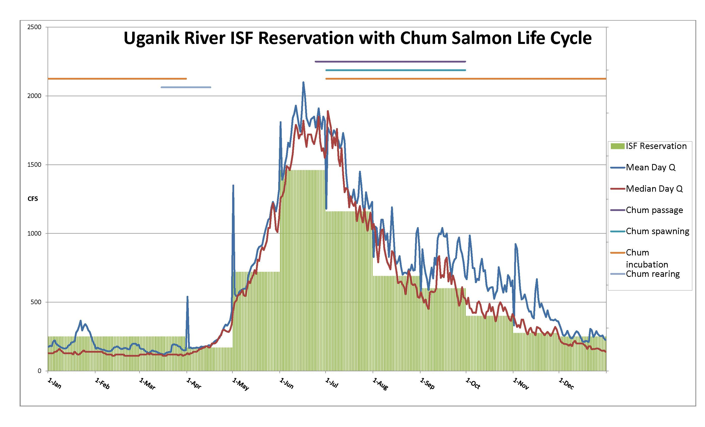

Slide 16
Uganik River Reservation Timeline
Applied for on 9/27/2001
Adjudication process began January 31, 2012
Email and in face correspondence between DNR and USFWS March 20, 2012 – June 12, 2014.
Public/Agency notice published August 1, 2014
Certificates signed September 19, 2014
Recorded certificates received January 14, 2015

Slide 17
Considerations in Flow Discussions
USFWS
Fisheries/biological purpose
Critical habitat needs
Timing of flow events
Overwintering
Channel form and function
River continuum paradigm
DNR
Fisheries/biological purpose
Critical habitat needs
Timing of flow events
Competing uses (prior/future)
Unappropriated Flows
Laws
Public Resource

Slide 18
Uganik Reservation Discussion
Time Period | Mean Time Discharge (cfs) | USFWS Requested Flow (cfs) | % Exceed | ADNR 1/2014 (cfs) | % Exceed | USFWS (cfs) | % Exceed | ADNR 4/3/2014 (cfs) | % Exceed | USFWS (cfs) | % Exceed | FWS alt 5/20/14 | % Exceed
January* | 232 | 250 | 18-20% | 150 | 45% | 230* | 25% | 150 | 45% | 200 | 32% | 200 | 32%
February* | 167 | 250 | 18% | 130 | 45% | 180* | 25% | 130 | 45% | 150 | 34% | 170 | 27%
March* | 150 | 250 | 10% | 125 | 45% | 150* | 25% | 125 | 45% | 140 | 35% | 147 | 28%
April 1-14 | 172 | 140 | 50% | 119 | 70% | 140 | 50% | 140 | 50% | 140 | 50% | 140 | 50%
April 15-30 | 274 | 245 | 50% | 175 | 70% | 245 | 50% | 245 | 50% | 245 | 50% | 245 | 50%
May 1-14 | 623 | 589 | 50% | 355 | 70-75% | 590 | 50% | 590 | 50% | 590 | 50% | 590 | 50%
May 15-31 | 1049 | 958 | 50% | 730 | 70-75% | 960 | 50% | 960 | 50% | 960 | 50% | 960 | 50%
June | 1770 | 1460 | 64% | 1280 | 75% | 1460 | 60-65% | 1460 | 60-65% | 1460 | 60-65% | 1460 | 60-65%
July | 1460 | 1160 | 62-63% | 990 | 75% | 1160 | 60-65% | 1160 | 60-65% | 1160 | 60-65% | 1160 | 60-65%
August | 896 | 690 | 55-56% | 559 | 70% | 690 | 55-60% | 690 | 55-60% | 690 | 55-60% | 690 | 55-60%
September | 832 | 600 | 50% | 416 | 70% | 600 | 45-50% | 600 | 45-50% | 600 | 45-50% | 600 | 45-50%
October | 675 | 400 | 56% | 318 | 70% | 400 | 55-60% | 400 | 55-60% | 400 | 55-60% | 400 | 55-60%
November | 503 | 275 | 54-55% | 198 | 70% | 338 | 45% | 338 | 45% | 338 | 45% | 338 | 45%
December | 258 | 250 | 35-36% | 120 | 70% | 200 | 45% | 200 | 45% | 200 | 45% | 200 | 45%
*Consents but acknowledges flows are insufficient to protect fish and wildlife habitat, migration, and propagation
Notes:
Flow determination can only result with compromise and consideration of each agencies purposes and responsibilities to the public

Slide 19
Certificated Flows
TIME PERIOD | Mean Time Period Discharge (cfs) | Original Flow Requests (cfs) | Granted Reservation Flows (cfs) | Reservation Flows (gpd) | Remaining Flows for Appropriation (cfs) | Remaining Flows for Appropriation (gpd)
January | 232 | 250 | 200 | 129,254,400 | 32 | 20,680,704
February | 167 | 250 | 150 | 96,940,800 | 17 | 10,986,624
March | 150 | 250 | 140 | 90,478,080 | 10 | 6,462,720
April | 226 | 170
April 1-14 | 172 |  | 140 | 90,478,080 | 32 | 20,680,704
April 15-30 | 274 |  | 245 | 158,336,640 | 29 | 18,741,888
May | 859 | 720
May 1-14 | 623 |  | 590 | 381,300,480 | 33 | 21,326,976
May 15-31 | 1049 |  | 960 | 620,421,120 | 89 | 57,518,208
June | 1770 | 1460 | 1460 | 943,557,120 | 310 | 200,344,320
July | 1460 | 1160 | 1160 | 749,675,520 | 300 | 193,881,600
August | 896 | 690 | 690 | 445,927,680 | 206 | 133,132,032
September | 832 | 600 | 600 | 387,763,200 | 232 | 149,935,104
October | 675 | 400 | 400 | 258,508,800 | 275 | 177,724,800
November | 503 | 275 | 338 | 218,439,936 | 165 | 106,634,880
December | 258 | 250 | 200 | 129,254,400 | 58 | 37,483,776

Slide 20
DNR Criteria
A certificate of reservation can only be issued if the four criteria are met:
Prior appropriators rights aren’t affected
Need exists
Unappropriated waters exist
Public interest (AS 46.15.080 (b))

Slide 21
Changed Perspectives
FWS
An understanding for DNRs mission
Better understanding of the adjudication process
Willingness to compromise within the limits of our mission goals
DNR
Better understanding of FWS mission
Willing to assist in the application process and applying for a reservation of water – 11 AAC 93.142(c)
The Uganik River was fully within refuge lands with minimal chance of any development occurring, which gave DNR the opportunity to view this river slightly different than other rivers.
Example: Terror River vs. Uganik River
High vs. Low
Managed unit vs. Unmanaged (both within the refuge)

Slide 22
Changed Perspectives Results
FWS
Good working relationship with DNR
Completion of Uganik adjudication
Cooperative scheduling of future adjudications
DNR
Working with the applicant
Defendable decision document (legally/purpose based)
Certificate of Protection

Slide 23
Adjudication Results – Goals met?
Were there struggles between the two agencies? YES
Response delays
Unclear request/responses
Additional projects/other work
Did the agencies come to an agreeable conclusion without elevation? YES
As this was the first FWS application adjudicated, were there lessons learned for the next FWS file adjudicated? YES
Both agencies!

Slide 24
Lessons Learned
Open and transparent communication
While there is an understanding that certain documents need additional internal review, a quicker adjudication occurs when requested actions are carried out in a speedy manner.
One single point of contact familiar with the application.

Slide 25
The End!
Questions?
Cathy Flanagan
Hydrologist/Water Rights Specialist
US FWS
cathleen_flanagan@fws.gov
907-786-3903
Kim Sager
Water Reservation Specialist/ Adjudicator
AK DNR
kimberly.sager@alaska.gov
907-269-2033

