Slide 1
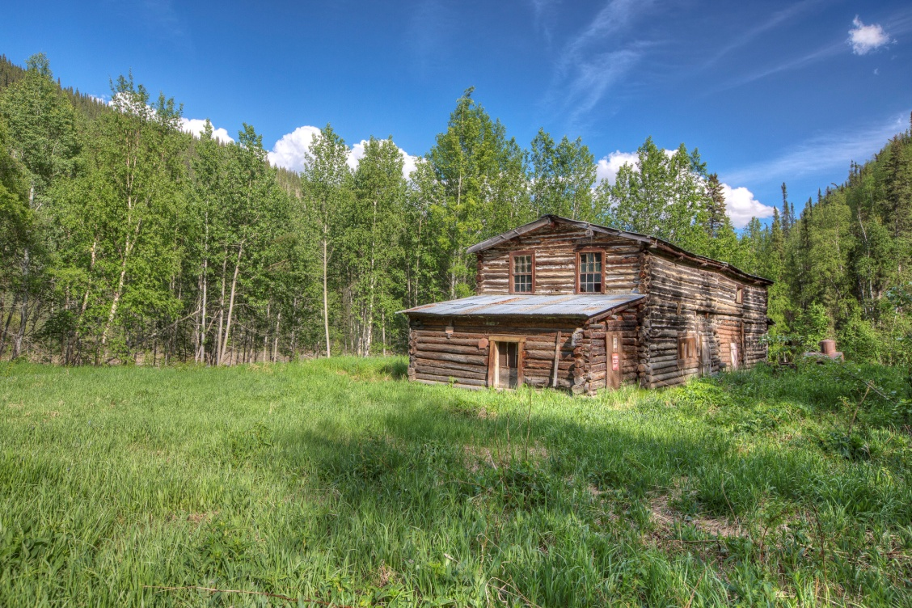
Water Rights
&
Land Tenure
Presented by:
Lin Fehlmann
Retired BLM
Water Rights Specialist
Notes:
WATER RIGHTS AND LAND TENURE – ALASKA
(purchases, donations, exchanges, disposals, direct sales, conservation easements)
Attachments for this session:
Alaska State Guidance:
Alaska Statutes – Change of Ownership of Water Rights
DNR form: Transfer of Ownership
Overall Federal Guidance:
Sec 1302 of ANILCA – Acquisition Authorization
BLM Guidance:
BLM Land Exchange Handbook, H-2200-1
Acquisition Process Checklist (BLM AZ)
Forest Service Guidance:
FSH 5409.13, Chapter 30
FSH 5409.13, Chapter 32.45
Region 3 Acquisition Checklist
FWS Guidance:
403FW3 – Acquisition & Protection
WR Determination Procedures
WR Determination SOP 2011
Example WR Determination Checklist
NPS Guidance:
Director’s Order 35A
General Guidance:
Warranty Deed with Water Rights
Special Warranty Deed Water Rights Only
Quit Claim Deed Water Rights Only
Conservation Easements and Water:
Overview of Conservation Easements
Conservation Easements and Water Rights
Example: Cosumnes River – Permitted Uses
Example: Cosumnes River – Prohibited Uses
Land Trusts and Water – Bates

Slide 2
Objective
Identify the steps and processes
used to address water right issues
in proposed land tenure actions.
Land Tenure Examples:
Land exchange
Acquisition
Disposal
Purchase or donation
Conservation easement
Notes:
Identifying and processing water rights and use issues are understandably important for lands/realty specialists; however, it is just as important for non-lands personnel. Most specialists write or review sections of NEPA documents for land tenure actions:
Collect data and/or identify issues relating to their specialty or program;
Document how acquiring or disposing of water sources and developments affects their program;
Identify opportunities to share data from their work with lands folks or vice versa;
May be asked to operate water facilities on acquired lands.

Slide 3
Right to Use Water – Basics
Real property right => “usufructuary” right
Water is an interest in land (see Federal Land Transaction Facilitation Act, FLTFA)
Can be disposed of or acquired
Considered when determining value
Notes:
Water is a real property right, called a “usufructuary” right (a right of use), on both federally owned and privately held in-holdings.
The Federal Land Transaction Facilitation Act (FLTFA): Although this Act has not been reauthorized, it is important to note the significance that all federal land management agencies have the authority to sell, exchange, acquire and dispose of land and water is an interest in land.
As with any property right, a water right may be disposed of (i.e., conveyed) or acquired, although other restrictions may apply.
Water must be considered when determining market value and in any other aspect of defining the land interest.

Slide 4

Right to Use Water in Alaska
Managed by :
Department of Natural Resources (DNR)
State regulations for Change of Ownership of water rights:
  Alaska Statutes – Chapter 46.15 Water Use Act
  Alaska Administrative Code – Title 11, Chapter 93 – Water Management

Slide 5
When & Where to Begin
Start EARLY!!
Identifying water rights is ESSENTIAL!!
Resolving issues TAKES TIME!
Notes:
When and Where to Begin
Start EARLY in the process. Identifying water rights is essential to the valuation, notification, environmental documentation, public interest determination and decision steps of the land exchange process and for other land tenure actions. Resolving water issues takes time!
Address Water Rights Analysis in land exchange Feasibility Analysis.
Address Water Rights Analysis in the evaluation of fee and partial interest (easement) purchases.

Slide 6
When & Where to Begin (continued)
Water Rights considerations:
  In general, appurtenant to land
  Adds value
  Document even if source has no water right
  Negotiate & Cost-share with proponent / seller / donor
  Know management’s position
Assign person familiar with:
  Water rights
  Alaska water law
Notes:
Water Rights Considerations:
Water rights are generally considered appurtenant to the land. (appurtenant = constituting a legal accompaniment (incidental right) attached to a principal property right and passing in possession with it; see course glossary for more). In Alaska, water rights are generally considered to be appurtenant to the land where it has been beneficially used. However, AS46.15.160 states that any or all of an appropriation may be severed from the appurtenant land, or may be sold, leased or transferred to other purposes.
The proponent/seller/donor may not want to assign the water rights or only assign a portion.
Water Rights add value; the appraised value can be an issue if the proponent/seller/donor thinks he/she has a valid right but does not. Is there a market?
If there is no water right on a source, document this fact and recommend whether a water right can or should be obtained.
Is there an opportunity to negotiate with the proponent/seller/donor on cost-sharing (for payment of assignment fees, costs associated with water source inventory, rectifying title problems, etc.)?
Note: Negotiate early with proponent to have him/her correct/change an existing water right or file a new application before acquiring.
If there is a period of five years nonuse of the water, negotiate with proponent to either confirm use/nonuse or cancel the right (or a portion thereof) prior to closing.
Federal agencies cannot legally give away or terminate federal property including water rights.
Keep in mind that disposal of water sources and rights and water-dependent values must be documented in the EA/EIS.
Does management want to continue to exercise an existing right that requires labor-intensive operation and maintenance?
Assign a person to address water use issues who is familiar with water rights and Alaska water law.
Note: For the USFS, this is usually the Forest Hydrologist.
Note: For BLM, it may be either the Field or District Office Hydrologist.
Note: For FWS, it is usually the Regional Water Rights Coordinator.
Note: For NPS, it is the Regional Hydrologist.
Contract out water rights title report.

Slide 7
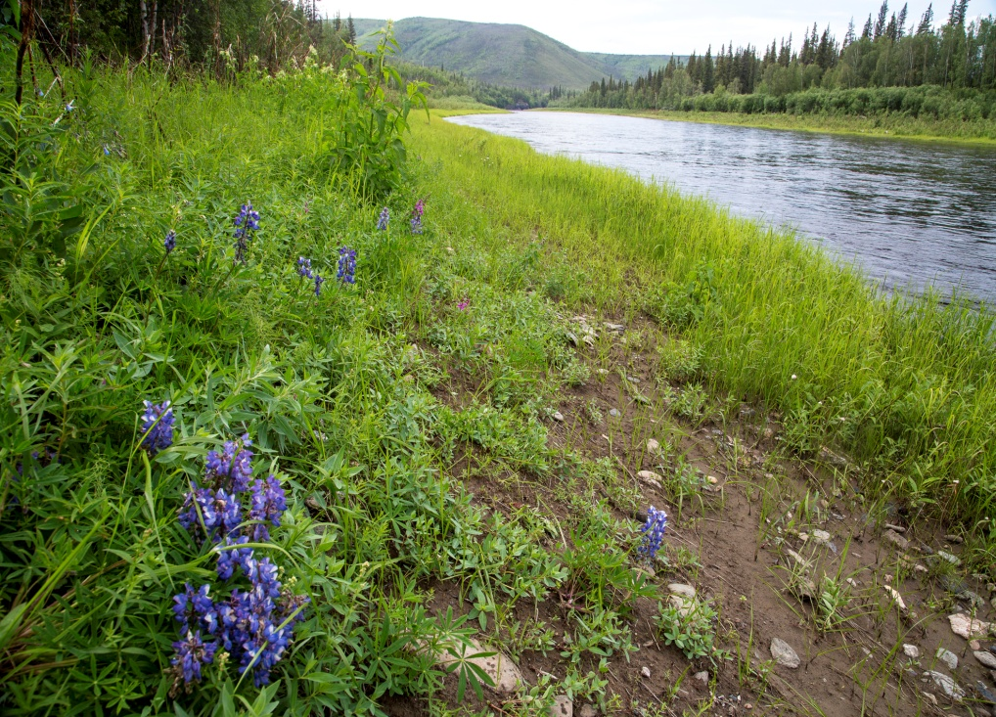
Water Rights – Proposal Process
Address Water Rights during the entire process:
Initial Proposal
Evaluating the Proposal
The Closing Process

Slide 8
  Initial Proposal Phases & Steps
Feasibility Phase
  Identify State Water Rights
  Identify Reserved Water Rights
  Gather Ownership & Encumbrances Info
Analysis Phase
  Field Verification: Is the Water “Wet”?
  Consult with Appraiser
Notes:
There are two phases with five basic steps in the initial proposal. We will cover each step.
Encumbrance = a charge against property (as a lien or mortgage). An example of a water-related encumbrance is that the property may be subject to annual assessment fees for a local water district (i.e, water supply district, waste water district, fire protection district).

Slide 9
1. Identify Water Rights
Initial Feasibility Phase
Obtain legal descriptions
Identify sources and uses
  Contact the proponent
  Check aerial photos & topographic maps
  Check agency files
Water Use
Inventory forms
Databases
Project Files
Wildlife & fisheries files
Notes:
Identify Water Rights on the Federal and Non-Federal Lands
Obtain a set of legal descriptions as early as possible for both the Federal and non-Federal lands. Who is the proponent/seller/donor? (individual, grazing permittee, corporation, local government, State government, other federal agency)
Identify all developed/undeveloped water sources and uses on the Federal and
non-Federal lands.
Contact the proponent/seller/donor; check aerial photos and topographic maps.
On Federal lands, check water source inventory & water rights databases (in BLM Field/District Offices, Forest Ranger District Offices, FWS Refuge Offices, NPS Regional Office), BLM allotment files, USFS INFRA files, old Water Use Inventory forms, etc. A water source/use inventory may need to be conducted to fully document existing uses.
For the USFS, consult the Natural Resources Information System (NRIS) database to complete the Federal Land Status Report. In some National Forests, water data may also be in other databases or as hard copies in file drawers. The Inventory includes:
Valid water rights of private parties on FS lands.
Water rights of U.S.
Reserved water rights.
Foreseeable USFS water uses.
If NRIS is not available in your District, ask the hydrologist/water rights specialist to prepare a summary of additional known water developments and rights.
The FWS has created a geodatabase that allows them to identify all water rights created within and upstream of a refuge geospatially. They still use the State system (searching by LAS) to look up status and quantities of water associated with each type of water right.
The NPS has a water right docket database (physically located in Ft. Collins, CO) that is available online to other NPS staff through the Integrated Resource Management Applications (IRMA) portal.
Check land status – is the land reserved from the public domain or acquired land?

Slide 10
1. Identify Water Rights (continued)
Initial Feasibility Phase
ID water sources with water rights by using:
  Previous deeds
  Preliminary Title Report
  List from proponent/seller/donor
  List of associated water rights from DNR
    Website for water rights & TWUAs: http://dnr.alaska.gov/mlw/mapguide/wr_intro.cfm
    Well Log Tracking System (WELTS):
    https://dnr.alaska.gov/welts/#show-welts-intro-template
    Local DNR offices (call or visit)
Notes:
1. Identify Water Rights on the Federal and Non-Federal Lands (continued)
Determine which water sources have water rights associated with them.
Note: Remember, certain water sources and uses are exempt and may not require a water right.
Review chain of title in previous deeds for references to water rights.
Preliminary Title Report – may identify water rights associated with the property or a partial/third party water right.
Request proponent/seller/donor to provide a list of all rights to transfer and to note at what stage each right is in (application, protested application, permit, certificate, TWUA).
Obtain a list of water rights associated with the parcels from DNR:
Access DNR’s web site at: http://dnr.alaska.gov/mlw/mapguide/wr_intro.cfm to obtain water rights and TWUA data. Reports can be accessed by:
Legal description (meridian, township & range)
Status date by year
Owner last name or business name
Access DNR’s WELTS website at:
https://dnr.alaska.gov/welts/#show-welts-intro-template to obtain well information .
- Call/visit one of DNR’s 3 offices (in Anchorage, Fairbanks or Juneau)

Slide 11
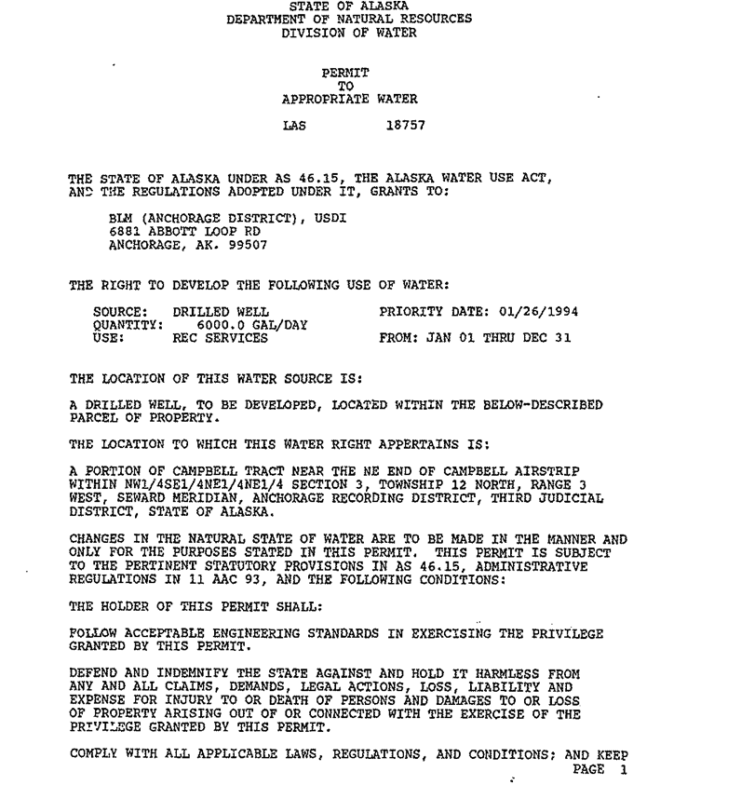
1. Identify Water Rights (continued)
Initial Feasibility Phase
Obtain copies of all water rights & verify information
The true measure of a water right is based on information from the original documents!
Notes:
1. Identify Water Rights on the Federal and Non-Federal Lands (continued)
Obtain copies of all documents (applications, permits, statements of beneficial use, certificates, TWUAs, etc.).
- Copies of scanned documents are available on the web; In addition, the three main offices in Anchorage, Fairbanks & Juneau can provide copies of maps and other documentation.
Information provided by original documents may include:
Temporary Water Use Authorizations (TWUAs)
Original application/permit/certificate showing name of source, priority date, authorized amount, period of use, beneficial uses and diversion/use points.
Proof evidencing completion of development & application to beneficial use
Corrections, changes or amendments.
Environmental terms and conditions.
Protests and stipulations reached with objectors to protect other users.
State databases frequently contain errors in legal descriptions or are unable to show additional information.
If/when a water right is in an area under adjudication or adjudicated, obtain copies of the applicable subfile order and/or final decree or any other court order.
For each water right, verify:
Priority date; authorized amount; season or period of use; purpose of use;
Any conditions DNR has placed on the water right.
REMEMBER, THE TRUE MEASURE OF A WATER RIGHT IS BASED ON INFORMATION
FROM THE ORIGINAL DOCUMENT, NOT ON A COMPUTER PRINTOUT!

Slide 12
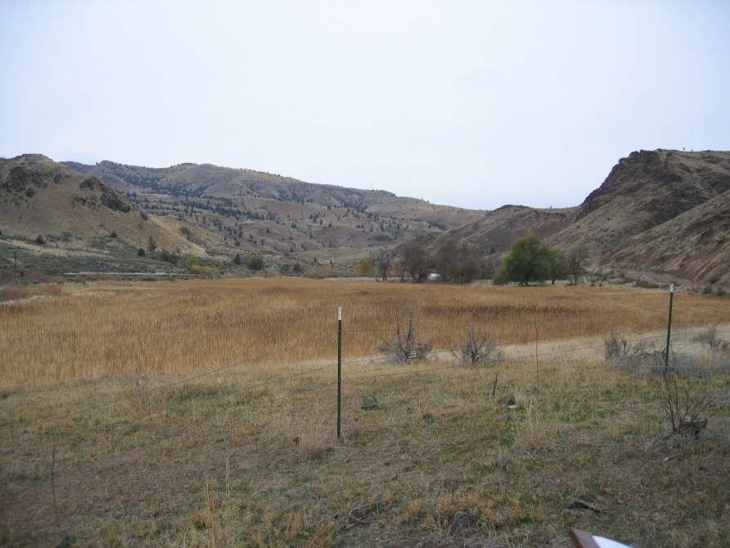
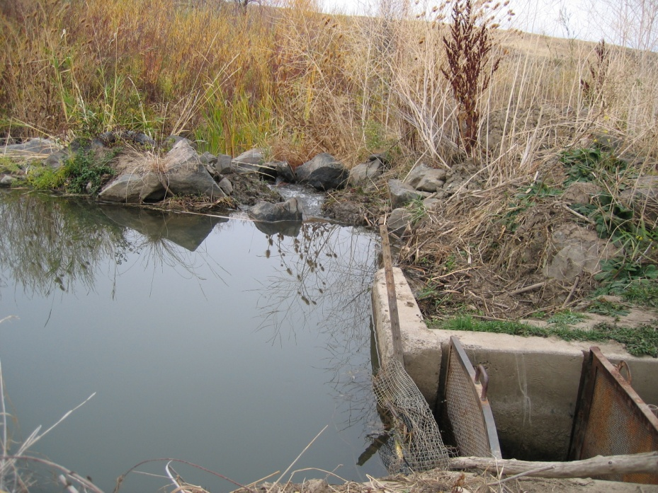
1. Identify Water Rights (continued)
Initial Feasibility Phase
Identify partial assignment/acquisition
Identify any associated infrastructures
Notes:
Identify Water Rights on the Federal and Non-Federal Lands (continued)
Identify whether a partial assignment/acquisition of water rights will occur. Sometimes, not all points of diversion and/or places of use will be transferred.
If a partial acquisition will occur, negotiate an equitable split between the proponent/seller/donor and federal agency (for example, the amount of irrigated acreage each will own after the exchange).
If the exchange results in the point of diversion on private land and the place of use being on Federal, make sure the Agency obtains a right-of-way across the private land for access to the headgate and ditch. Consult with DNR on how the water right would be managed since there may be multiple users.
Identify infrastructures associated with the water rights (e.g., metering devices, ditches, measurement flumes, etc.) that may have been installed and whether they will transfer with the water development. Obtain copies of any water use reports filed with DNR, if applicable.

Slide 13
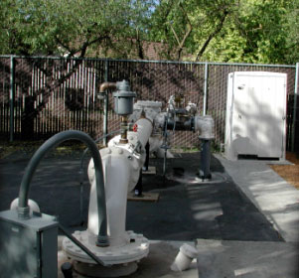
1. Identify Water Rights (continued)
Initial Feasibility Phase
For wells, obtain completion reports & logs
Consult with appraiser
Work with involved federal agencies
Notes:
Identify Water Rights on the Federal and Non-Federal Lands (continued)
Obtain logs for all wells on Federal and non-Federal lands. Has the static water level changed? Logs and other groundwater information can be obtained online at DNR’s website under the Well Log Tracking System (WELTS).
Access DNR’s WELTS website at:
https://dnr.alaska.gov/welts/#show-welts-intro-template to obtain well information . Reports can be accessed by owner or driller name, parcel description, borough or city, water right file or by log ID.
Consult with appraisal staff. For BLM, FWS and NPS, appraisers are involved early in the process before the agency makes an offer and, often, during the identification and validity of the water rights process. Initial appraisals typically identify irrigated acreage and water sources/developments. For the USFS, the hydrologist should provide needed water source/rights information to the lead realty specialist who, in turn, provides this information to the appraiser in the appraisal request package. Water rights generally only become an issue with the appraisal staff if there are conflicting water rights associated with a parcel.
Coordinate with other Federal agencies (e.g. Corps of Engineers, Bureau of Reclamation, FERC, etc), if applicable, to determine what permits/jurisdiction they have on water structures being disposed/acquired.
Are any of the acquired lands to be transferred to other federal agencies (F&WS, NPS) as part of a three-way exchange? If so, contact that agency’s water rights coordinator immediately.

Slide 14
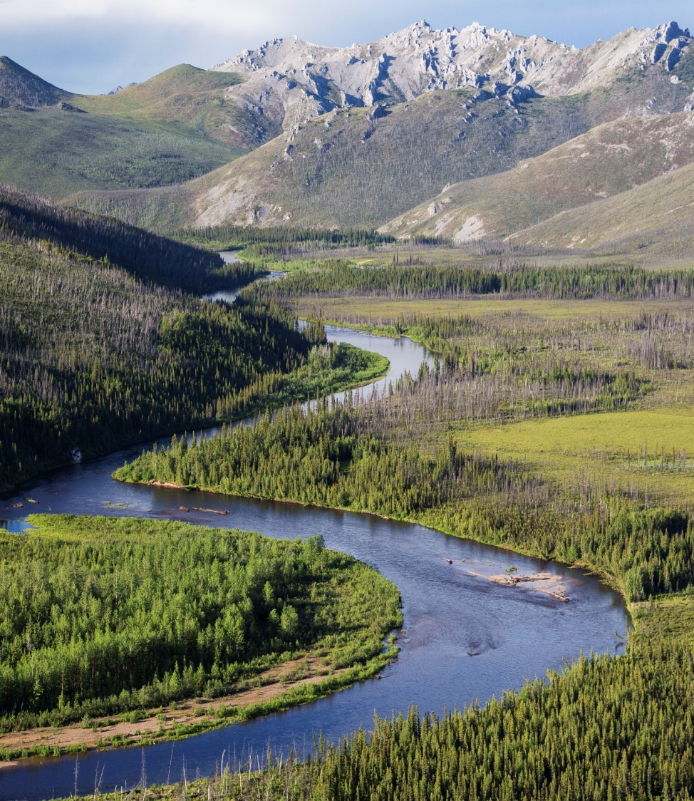
2. ID Reserved Water Rights
Initial Feasibility Phase
BLM
Wild and Scenic Rivers
USFS
Wilderness Act
National Monuments
1897 Organic Act
FWS
National Wildlife Refuges
NPS
National Parks/Preserves
National Monuments
Wild & Scenic Rivers
Notes:
Identify Any Reserved Water Rights on Federal Lands
The following federal reserved water rights may occur on BLM public lands identified for disposal: Public Water Reserves, Mineral Hot Springs, Stock Driveways, Public Oil Shale Withdrawals, Wilderness Areas, National Monuments & Conservation Areas, and Wild and Scenic Rivers.
Reserved rights for BLM in Alaska only includes:
Wild and Scenic Rivers
Reserved rights on USFS lands in Alaska include:
Wilderness Areas
National Monuments
1897 Organic Act (for the Tongass & Chugach NF)
Reserved rights for the FWS in Alaska include:
National Wildlife Refuges (existing prior to ANILCA and post ANILCA)
Reserved rights for the NPS in Alaska include:
National Parks & Preserves (existing prior to ANILCA and post ANILCA)
National Monuments
Wild and Scenic Rivers

Slide 15
2. ID Reserved Water Rights (continued)
Initial Feasibility Phase
ANILCA: Grants authorization to acquire land
May transfer between federal agencies
Cannot transfer to non-federal owners
No longer in effect if land transferred to private owners – Advise DNR of change
Notes:
2. Identify Any Reserved Water Rights on Federal Lands (continued)
Section 1302 of ANILCA:
The Secretary is authorized…to acquire by purchase, donation, exchange, or otherwise any lands within the boundaries of any CSU other than National Forest Wilderness.
(1) The Secretary is authorized to acquire by donation or exchange, lands … which are contiguous to any CSU established or expanded by this Act… and (2) Any such lands so acquired shall become a part of such CSU.
Wilderness, Wild & Scenic Rivers and National Monuments & Conservation Areas would most likely not be traded out of federal ownership; however, they may transfer from one federal agency to another through either a boundary adjustment or expansion (ex: Mohave Preserve, CA and NPS Petrified Forest Expansion, AZ).
Federal reserved water rights cannot be transferred out of federal ownership (applicable for private exchanges) because, by law, they can only exist on lands owned by the Federal government. Recognize that exchange of reserved public domain lands (applicable for the USFS) for lands that passed from federal ownership involves the giving up of reserved water rights for water rights that can only be obtained under State laws.
If land to be transferred out of federal ownership contains a federal reserved right, the proponent and DNR must be advised that the existing reserved right will no longer be in effect.

Slide 16
3. ID Ownership/Encumbrances
Initial Feasibility Phase
Is water right in name of
proponent/seller/donor?
  What do deed records &
  preliminary title report show?
Any land use restrictions?
  NOTE:
  See current BLM right-of-way (ROW)
  regulations regarding land disposal & ROWs.
Notes:
Gather Information about Ownership and Encumbrances
Determine if the water rights to be acquired are in the name of the proponent/seller/donor. Because ownership of a water right in Alaska is not necessarily determined by property appurtenancy , often the name on the permit, certificate, TWUA, etc. may be the initial applicant for the water right, the current landowner or severed from the land in a previous transaction. This information becomes important when researching encumbrances and notifying the State of changes in ownership.
If the water rights to be acquired are NOT in the name of the current owner, a chain of title search is required. Request proponent complete change of ownership forms and send to DNR to get water rights in his name prior to being acquired by the federal agency.
Obtain the latest deeds in the Chain of Title from the proponent/seller/donor.
Review preliminary title report and previous deed records for encumbrances on use of water. Obtain copies of easements, contracts, rights-of-way, and other historical documents.
Research whether there are any land use restrictions (local/state) that could affect water use.
Acquire affidavits and interview people as part of the water uses inventory; document nonuse.
Note: BLM right-of-way (ROW) regulations [43CFR2807.15(c)] allows ROW holder to negotiate new grant terms with BLM if land subject to ROW is transferred out of federal ownership. If the federal land to be disposed has a water ROW, this could trigger changes in conditions placed on the ROW.

Slide 17
3. ID Ownership/Encumbrances (continued)
Initial Feasibility Phase
Land located in:
  Critical Ground Water Area?
  Critical Water Management Area?
Proponent has water rights on leased land?
Water Power Withdrawals?
Reservations or outstanding rights?
Notes:
Gather Information about Ownership and Encumbrances (continued)
Note whether any of the Federal or non-Federal lands are within a critical ground water area or critical water management area. These areas may restrict water use.
Determine if the proponent holds any grazing or other leases on State or Federal lands that would transfer with his private land; if so, identify any water rights on the leased lands that would be acquired.
Water power withdrawals (power site classifications, power projects, power site reserves) must be identified and removed prior to an exchange.
USFS Manual 5470 - Reservations and Outstanding Rights – Objective is to accomplish real property adjustments free of encumbrances that would detract from present or future uses of FS land or that would needlessly restrict private land use and impose an unwarranted management obligation on the FS. (applicable to the USFS but may also apply to other federal agencies)
Feds don’t generally accept deed restrictions from the proponent/seller/donor.
Note any outstanding rights from previous transactions.
Potential deed reservations by the United States.

Slide 18
4. Verify: Is the Water “Wet”?
Initial Analysis Phase
Current Use
  Follow State Law
  Address Agency needs
  Include Water Sources to be filed on
  Identify inaccurate legal descriptions
  Identify systems that need repairs
FIELD CHECK PRIOR TO CLOSING
Notes:
4. Field Verification: Is the Water “Wet”?
Properties to be acquired by federal agencies should always be field checked prior to closing to ensure that:
Each water right is being exercised in accordance with State law and is not subject to forfeiture or abandonment due to nonuse, unauthorized changes in type or place of use, etc. This is soooo important!
The water right(s) will serve present and foreseeable Agency needs. Check with your local DNR office and/or proponent/seller/donor to determine the physical availability/reliability of the water. Does the water right(s) have a sufficient priority to allow it to be used in most years? Will the water right be sufficient for domestic use, fire protection and other Federal uses?
Identification of sources that will need to be filed on in the future.
Identification of inaccurate legal descriptions for the point of diversion, place(s) of use, etc.
Identification of infrastructures (water delivery and control systems) that need repairs.

Slide 19
4. Verify: Is the Water “Wet”? (continued)
Initial Analysis Phase
On-the-ground inspection
  Evaluate authorized Place of Use vs on-site conditions
  Is water amount sufficient to supply irrigated acreage?
  Has there been recent use?
  Are metering devices and fish screens installed?
  Amount of water sufficient for interpretation of acquired historical sites?
Well tested and examined?
Well access port functional?
Well delivery system operable?
Ground water quality sufficient for new uses?
FIELD CHECK PRIOR TO CLOSING
Notes:
Field Verification: Is the Water “Wet”? (continued)
On-the-ground inspections are very important for irrigation water rights:
Compare irrigated acreage claimed in the appraisal or on the water right with on-the-ground conditions.
Is the amount of water claimed on the water right sufficient to irrigate the acreage found?
Has irrigation occurred recently?
Are required metering devices and fish screens installed?
For acquisition of historic sites:
Is there enough water to provide interpretation of historic mining sites (e.g., water flowing through sluice boxes, dredges, etc.)?
For wells on the non-Federal lands to be acquired, in addition to the information provided on the Well Log and Statement of Beneficial Use forms:
Require a pump test and examination by a well driller to:
Determine if all well construction requirements have been met.
Check the conditions of the well, especially the casing.
Is the access port/removable cap functional and are the static water level and yield correctly stated on the water right?
Is the well shared with other households? If so, obtain copy of shared agreement between water users and well owners for operation and maintenance and copies of well meter reports.
Is the ground water quality such that it could be used for a visitor facility?

Slide 20
5. Consult with Appraisal Staff
Initial Analysis Phase
Provide information summary to appraiser
ALL water rights issues must be RESOLVED BEFORE the closing!!
The proponent/seller/donor has
little incentive to work with Agency on water rights issues after the fact!
Notes:
5. Consult with Appraisal Staff
A summary of the information gathered during the initial phase of the exchange proposal, including the field investigation, should be provided to the appraiser to complete the appraisal, as part of the appraisal request package.
NOTE that all water rights issues must be resolved BEFORE the closing. The proponent/seller/donor has little incentive to work with the Federal agency on water rights issues after the fact!

Slide 21
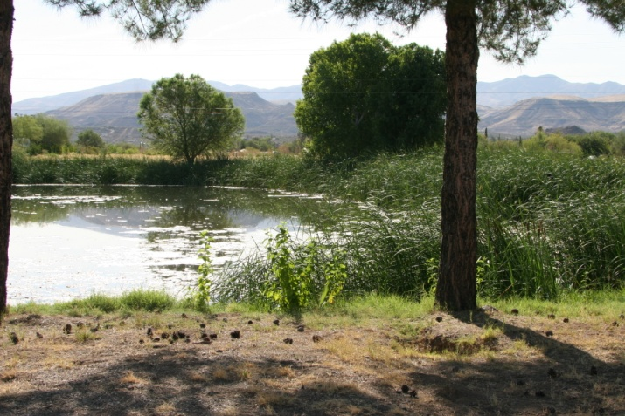
Evaluating the Proposal
Address water rights in all steps
  Feasibility Analysis (include valuation consultation)
  Agreement to Initiate
  Notice of Exchange Proposal
  Environmental Documentation
  Decision
  Notice of Decision
Notes:
Evaluate the Proposal
Water rights and uses information identified in the initial proposal steps should be addressed in all relevant steps during the evaluation process, including the:
Feasibility Analysis (should provide basic water rights information for incorporation into other exchange documents)
Agreement to Initiate (describe any proposed reservations by either party)
Notice of Exchange Proposal
Environmental Documentation – Specialists Report on water rights should be part of the NEPA Analysis (Note: For the USFS, see FSH 5409.13, Chapter 30, 33.43)
Decision (including reservations by either party). Note that management authority to acquire or dispose of a water right is reserved:
For USFS: to the Regional Forester;
For BLM: to the Field Manager;
For FWS: to the Regional Water Rights Coordinator; Chief, Water Resources Branch; Chief, Alaska National Wildlife Refuge System or the Regional Director (Region 7); and
For NPS, to either the Chief of Lands Resources Division or the Regional Director.
Notice of Decision

Slide 22
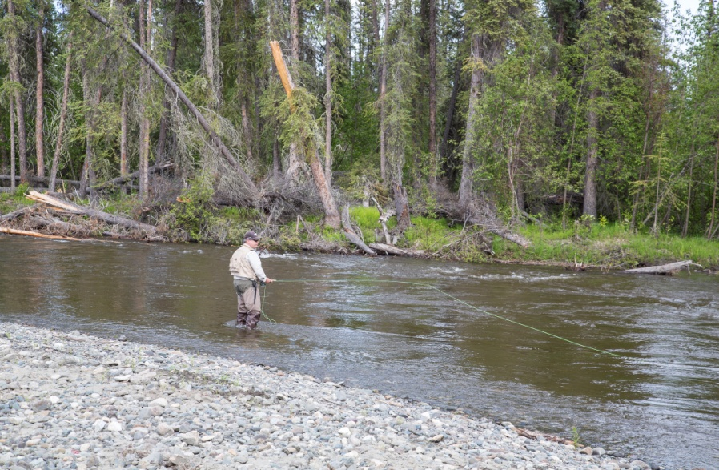
Evaluating the Proposal (continued)
  Consider Potential Desired Beneficial Uses
  Maintain riparian/wetland values
  Use existing right or transfer to instream uses
  Use entire or portion of acquired right(s)
  Quantify amount of water needed for new uses
Address management
costs &responsibilities
UP FRONT!
Notes:
Evaluate the Proposal
Consider future desired beneficial uses of the water sources being acquired.
If the land is being acquired for its potential riparian or wetland values, are the existing water rights sufficient to maintain these habitats?
Should the Agency continue to use the existing diversionary water rights or consider transferring them to other uses? How easy will it be to do this?
Will the Agency be able to use the entire acquired right(s) in its long-term management of the purchased lands? Or only acquire a portion of the rights?
If the acquisition is an historic mining site, is the water of sufficient quality to be used for other than mining?
How much water is needed for visitation and interpretation of other acquired historic sites? Of acquired river access and campground sites?
Evaluation process should also address all management costs or responsibilities associated with the acquisition of water rights such as:
maintenance of ditches
annual assessment fees associated with ditch companies or irrigation districts
right-of-way across private land
water quality or endangered species considerations affecting the ability of the Agency to use the water
assignment or conveyance fees (not applicable for Alaska)
time programmed for staff to maintain yearly compliance reports or to convert acquired rights to instream flow rights, etc.
Staff time (or contract labor) to actually irrigate or operate acquired facilities.
This evaluation/discussion should be done UP FRONT before acquisition!

Slide 23
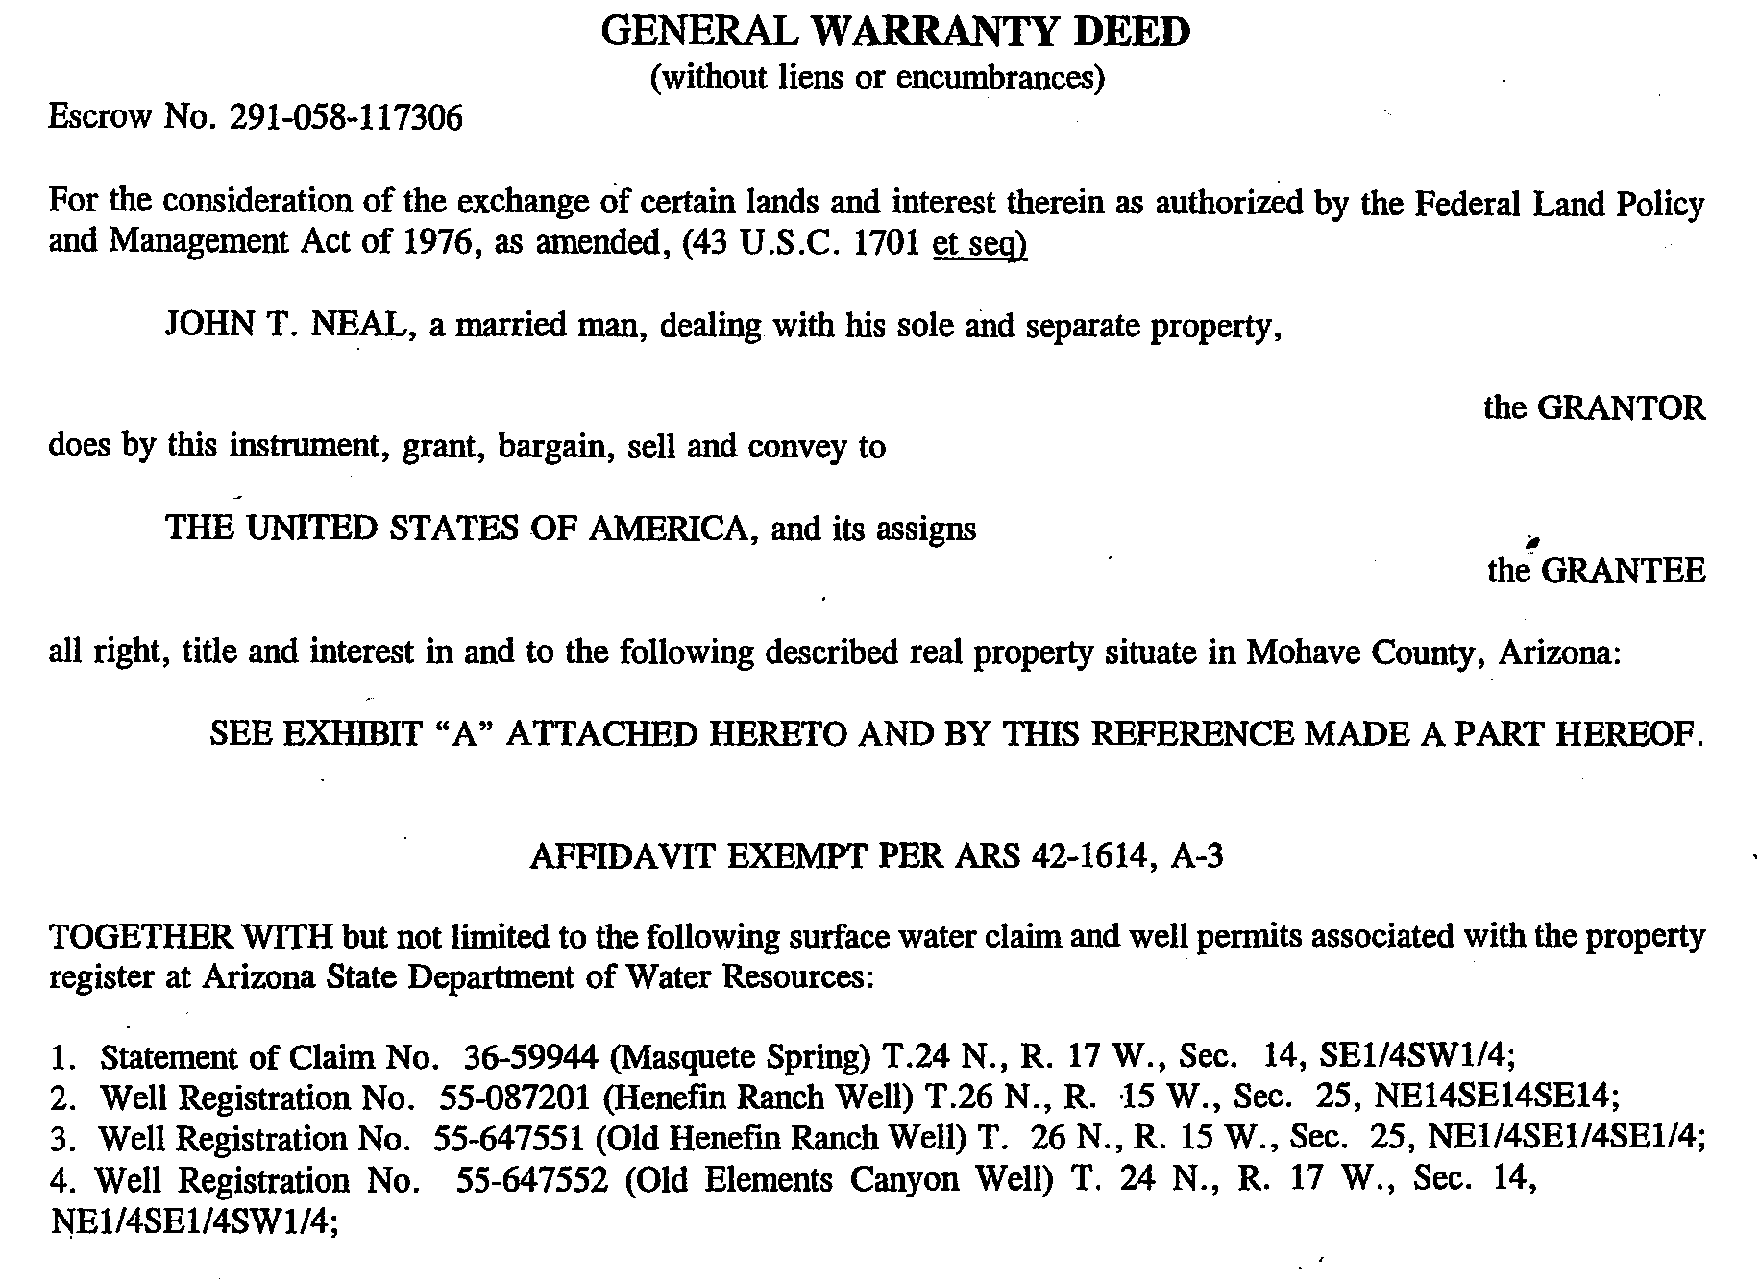
Closing
At or Before Closing
List all water rights to be conveyed in deeds
    List all elements of the water rights
    Mention all infrastructures associated with the
    water rights (e.g., metering devices)
Include general clause
to acquire all water rights
to cover any omissions
Provide documentation
to all parties
Notes:
At or Before the Closing
All water rights to be transferred should be specifically listed in the final deeds. Even though Alaska statutes make reference that water rights are usually transferred with changes in land ownership, interpretation of what constitutes an appurtenant right varies. A specific list will eliminate any doubt and future questions about ownership.
List all elements of the water rights in the deed (water right name, priority date, beneficial use, point of diversion, etc.)
Include mention of all infrastructures associated with the water rights (metering devices, headgates, well pumps, etc.).
Include a general clause in the deed such as “any and all water rights associated with the property including but not limited to…”. This will cover any water rights inadvertently missed and show intent to acquire all rights.
If not already done, ensure all parties are provided with existing documentation for the water rights each are acquiring. Attach a copy of the final chain of title to each package.
(Note: For USFS, water rights analysis must be included as part of the Forest Service permanent title file. See FSH 5409.13, 38.7)

Slide 24
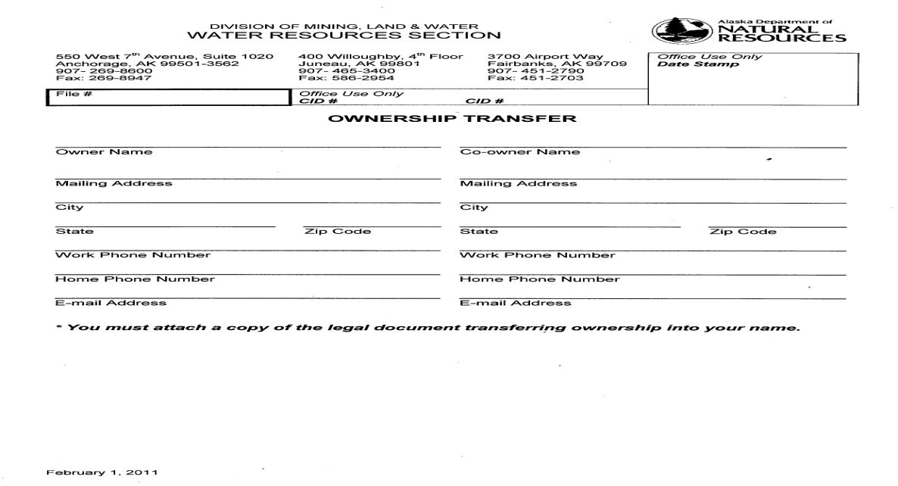
Closing (continued)
At or Before Closing
Closing
Complete DNR “Ownership Transfer” form for:
  Surface and ground water rights
  Temporary Water Use Authorizations (TWUA)
  Existing (vested) rights
No change of ownership fees in AK
Imperative to update
ownership with DNR
Notes:
At or Before the Closing (continued):
Prior to closing, have all parties complete and sign the necessary paperwork for transferring ownership.
Prepare one form for each application, permit, certificate, TWUA, existing right:
DNR Form: “Ownership Transfer”
To change ownership of a Dam:
DNR Form: “Application to Transfer a Certificate of Approval to Operate a Dam”
Change of Ownership Fees: Alaska does not charge a fee to transfer ownership of a water right.
Once DNR receives the Ownership Transfer forms (along with a copy of the recorded deed showing the land transfer), they will change their electronic records to indicate the new owner of the water right(s). The original “hard copy” of the water right remains in the original owner’s name – no revised permit or certificate is issued to the new owner.
NOTE: In order to receive important notices and updates from the DNR, it is imperative to update ownership!

Slide 25
Closing (continued)
After Closing
Record deed with appropriate recording district
    Keep a copy of deed for water rights file
    Submit recorded deed and forms to DNR via registered mail
Lands Staff: Update exchange file
Water Staff: Create files
Add to & update databases and maps
File any needed new applications, changes, etc.
Notes:
2. After the Closing
For the acquired water rights:
Once the deed has been recorded in the appropriate recording district, submit deed and forms to DNR.
It is recommended that the Agency transmittal letter to DNR be sent via registered mail “w/return receipt requested” as documentation of the submittal.
DNR does not charge a fee to change ownership. However, it does charge a $50 fee for the “Statement of Beneficial Use” form (a portion of which DNR applies to the fee it receives when it has the perfected right (certificate) recorded).
For the Lands staff, add acquired water rights information to the exchange title docket file.
For the Water staff, create files for the water sources and add the water rights documentation
Add acquired information to Agency databases:
For BLM, add to water inventory maps;
For USFS, add data to the new FS-NRIS (Natural Resources Information System) water module – the WRU (Water Rights and Uses) database;
For FWS, paper copies are listed with the State filing number, uploaded to Serve Cat in digital form & added to their geodatabase and water rights inventory in WRIAs (Water Resources Inventory & Assessment) for each refuge;
For NPS, the Water Resources Branch updates the water rights docket database with the new information.
For water rights/sources transferred out of Agency ownership, update databases and inventory maps
If acquired water rights need to be changed , submit changes to DNR by letter using the field information gathered earlier (to correct an inaccurate or incomplete legal description, change or add beneficial uses, etc).
File new applications, as necessary, to protect those acquired sources with no previous filings.

Slide 26
Post Acquisition Responsibilities
Manage => Ensure it will not be lost
Remember =>
  Apply the water as specified in the water right
  Maintain all facilities in operable condition
  Be vigilant in reviewing notices
Use it
or
Lose it
Notes:
Federal Agency Post-Acquisition Responsibilities
In summary, a water right is a valuable property right that must be managed in a way to ensure that it will not be lost - use it or lose it! Increasing demand for water in the West will make charges of nonuse more common in the future.
When managing water rights and other interests acquired under State law, the basic rules to remember are:
To apply the water to the purposes and in the manner specified in the permit or certificate.
To maintain in operable condition all diversions, impoundments and other facilities required to exercise the associated water right(s).
To be vigilant in reviewing notices of new applications and filing objections, when appropriate, to protect existing rights.

Slide 27
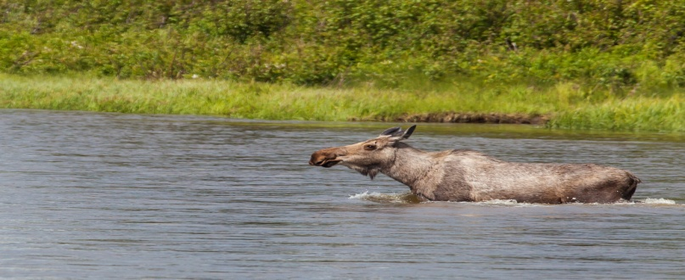
Conservation Easements & Water Rights
What is a Conservation easement?
  Restrict use of land for specific purpose(s)
  Economic Importance
  Tool to protect natural resources
Water Rights on Conservation Lands
  Identify all water sources and rights
  Identify water rights needed for conservation purpose(s)
  Ensure water remains with the land
  What happens if water provisions not enforced?

Slide 28
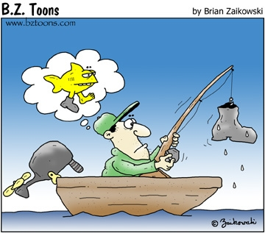
No Assumptions! Do your Homework!

Slide 29

Questions?

