Slide 1
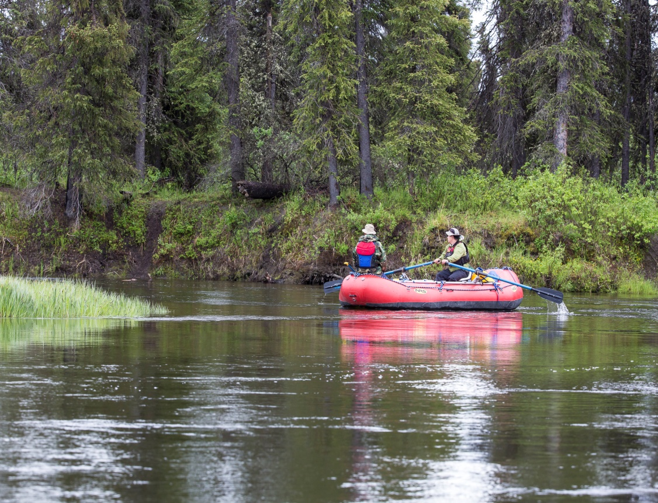
Overview of Conservation Easements and Water
Lin Fehlmann
Retired BLM
Water Rights Specialist

Slide 2
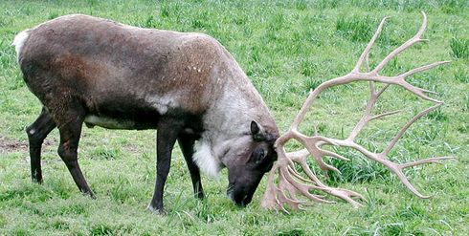
Conservation Easements
Conservation easement
Restrict use of land for specific purpose(s)
Economic Importance
Tool to protect natural resources
Nonuse – do not lose land right
Water Rights
Water Right – lose if not used
Identify water sources and rights
Notes:
Conservation Easements and Water Rights
A conservation easement is an interest in land which prohibits the landowner from doing things which otherwise would be lawful upon his estate in order to protect the natural resources of the property. This is another tool that can be used to protect natural resources (open space, wildlife, riparian habitat, wetlands, etc.).
Economically attractive way to maintain irrigated agriculture, wildlife habitat and wetlands:
Landowner gets substantial tax advantages from irrevocable dedication of his real property for conservation purposes.
Land trust or government agency obtains interest in the property that allows it to restrict certain uses by the landowner and may provide for certain affirmative uses of the land and water consistent with the terms of the easement, without paying full market value for the property.
A water right is a right of use and can be lost through nonuse, whereas nonuse of land does not result in a loss of property. This essential fact has implications for water rights in conservation easements.
Identify all water sources and rights on the easement property.

Slide 3
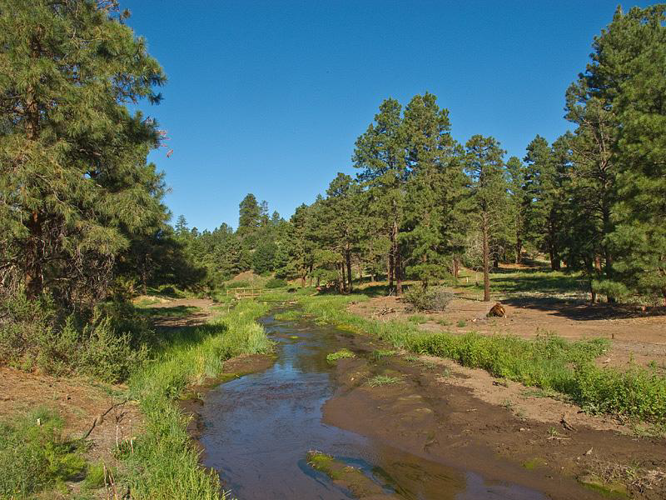
Conservation Easements (continued)
Water Rights for conservation purpose(s)
Inventory all water sources and uses
Identify those rights needed for conservation purpose(s)
Determine actual historical use
Water rights add value
Notes:
Conservation Easements and Water Rights => Water Rights Issues:
Are water rights needed for the conservation purpose(s)?
Field inventory all water uses and sources on the property and identify which sources have water rights.
List all water rights and identify those that are needed specifically for the conservation purpose(s).
Determine the extent of actual historical use of the water.
Water rights are an important part of the value of an easement for federal tax deduction/state tax credit purposes and should be identified and included in the easement. Presence of water & water rights increase the value of an easement.

Slide 4
Conservation Easements (continued)
Ensuring water remains with the land
List all water rights on easement
Restrict use of water
Use and maintain water rights
Prevent legal separation of water from land
Notes:
Conservation Easements and Water Rights => Water Rights Issues: (continued)
How do you ensure that water remains with the land?
If no restrictions are placed on the easement, the property owner can strip the water rights off the land and sell them separately.
It is crucial that an easement list all the water rights.
Restrict use of water rights consistent with the conservation purpose(s).
Obligate the property owner to use and maintain the water rights and not abandon them.
Prevent change of use, sale, permanent lease or other legal separation of water from the land.

Slide 5
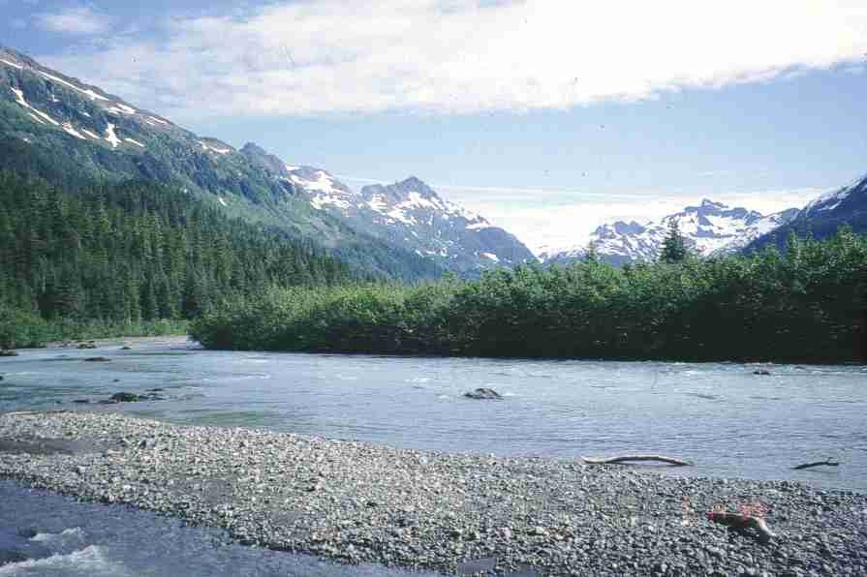
Conservation Easements (continued)
Water provisions not enforced
Loss of conservation purpose(s)
Abandonment or forfeiture of water rights
Notes:
Conservation Easements and Water Rights =>Water Rights Issues: (continued)
If the conservation easement contains appropriate water rights provisions, what happens if the easement is not enforced?
The conservation purpose(s) could be lost if owner fails to use the water rights for the intended purpose.
The potential loss of water rights could trigger abandonment or forfeiture procedures with DNR (five consecutive years nonuse in Alaska).
For more information on conservation easements:
Check out these publications from the Land Trust Alliance:
“Protecting Surface Water Quality with Conservation Easements”
“Land Trusts and Water” by Sarah Bates (contains a water rights due diligence checklist)

