Slide 1
Water-Related Rights-of-Way and Special Use Permits on Federal Lands
Roy Smith
Water Rights Specialist
BLM Colorado and BLM Utah
Notes:
Notebook References For This Presentation:
Formal Agency Guidance
01 - ANILCA Regulations for Transportation and Utility Systems 43 CFR Part 36
02- BLM Right-Of-Way Handbook 2801 - Canals and Reservoirs
03 - USFS Special Uses Handbook 2709.11, Supplemental Terms and Conditions for Water Facilities
04 - FWS Right of Way Regulations 50 CFR Section 29
05 - NPS Director's Order 35A - Sale or Lease of Park Resources
Supplemental References For Processing Water-Related Land Use Authorizations
06 - USFS Region 3 Water Development Manual
07 - USFS Technical Guide to Managing Groundwater Resources
08 - USFS Sample Ditch Operating Plan
09 - Sample ROW Decision - Kane Springs Valley GW Development Project
10 - US Court of Appeals Decision - Washoe County
Interior Board of Land Appeals Decision Related to Water Developments
11 - IBLA Grant Hacking Decision
12 - IBLA King’s Meadow Ranches Decision
13 - IBLA Eugene Vogel Decision
14 - IBLA George W. Philp Decision
15 - IBLA Lederhause Decision

Slide 2
Why do we discuss authorization of water facilities on federal lands in a water rights course?
Proposed developments can have significant impacts on federal water rights and water-dependent resources.
Federal agencies should be an effective partner with the state in reacting to and guiding proposed water development.
Federal agencies should engage in the water rights process when new facilities are proposed.
Notes:
Impacts to aquatic habitats are one of the most severe and widespread impacts found on federally managed lands. Many of these impacts can be minimized or avoided if federal agencies are active participants in the water rights and water supply planning processes, rather than simply waiting to react to water supply proposals. One forum (among many) for engaging in water supply discussions is the water rights process.

Slide 3
Module Objectives:
Given a proposed water diversion and conveyance facility on federal lands, students will be able to:
determine the legal authority and processes that should be used to evaluate the facility and make an authorization decision
identify the general types of operational terms and conditions that may be appropriate, if the facility is authorized
Identify how federal agencies should participate in the water rights process for a proposed facility

Slide 4
What types of facilities are you likely to encounter?
Ditches, canal, laterals
Pipelines, flumes, siphons
Diversion dams, headgates, pump stations
Dams, spillways, inundation
Livestock ponds, fish ponds, settling ponds, recharge pits, stormwater reservoirs
Spring developments, storage tanks, troughs

Slide 5
What types of facilities are you likely to encounter?
Wells: production, domestic, livestock, injection, monitor
Infiltration galleries in streambeds
Measurement infrastructure – stream gages, flumes, stage rods, flow meters
Related infrastructure – roads, electric lines, turbines, maintenance facilities

Slide 6
Land Use Authorizations For Water-Related Facilities
First, PROCESS . . .
What processes should we use ?
With whom should we coordinate?
What do we say in the water rights process?
Then, SUBSTANCE. . .
What issues should we analyze?
How do we make a decision to approve or deny?
What terms and conditions should we use in a land use authorization?

Slide 7
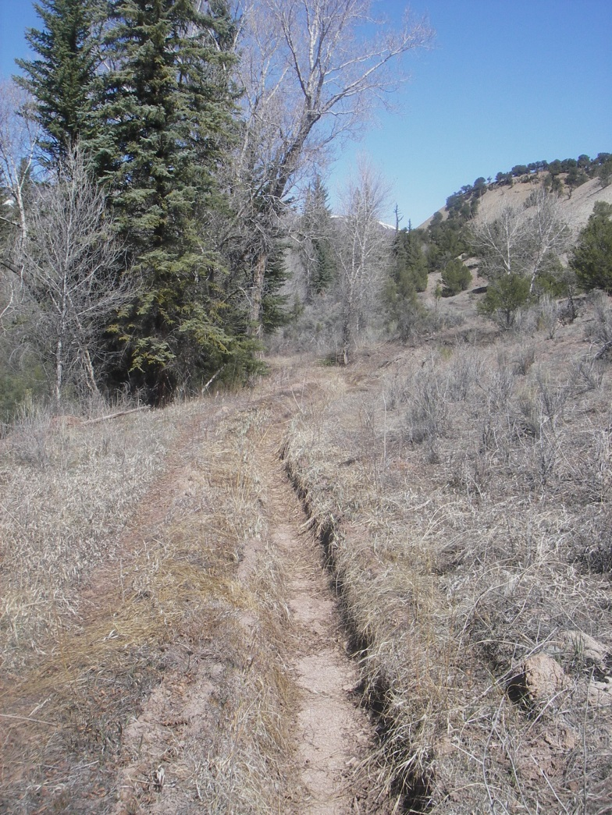
This presentation focuses only on new land use authorizations in Alaska.
In the Lower 48 states, many water facilities operate under pre-Federal Land Policy and Management Act (pre-FLPMA) Rights-Of-Way and Special Use Permits.
These authorization have an entirely different legal basis and management approach.

Slide 8
Processing land use applications for water-related facilities
What comes first?
Land use authorization or water rights process?

Slide 9
The land use authorization process and water rights process should proceed simultaneously.
Carefully review all water rights applications for activities that could affect federal lands. Don’t assume state will notify you, because state must rely on applicant-supplied info.
Encourage applicants to consult with both feds and state BEFORE water right and land use applications are filed.
Notes:
Landowner notification processes that are run by state governments are far from foolproof. Frequently, landowners will state that they own all the land on which the proposed facility will be located, even if they don’t. States rely upon land ownership information provided by water rights applicants, and they often do not have the resources to independently verify that information.
Landowner permission processes vary highly from state to state. Some states require landowner permission before they will start processing the application. Some states require evidence of landowner permission when the proof of beneficial use is submitted by the holder of the permit, before the state issues the certificate or license. Other states require no proof of landowner permission at all.
The statute that guides the Alaska water rights notification process (Alaska Statutes Section 46.15.133) reads as follows:
The commissioner shall also have notice served personally or be certified mail upon an appropriator of water or applicant for or holder of a permit who, according to the records of the division of lands, may be affected by the proposed sale, appropriation, or removal and may serve notice on any governmental agency, political subdivision, or person.

Slide 10
The land use authorization process and water rights process should proceed simultaneously.
Protest the water right application if the federal agency has not authorized or cannot authorize the facility.
Don’t issue final land use authorization unless you are confident that the water right will granted. Consult with AK DNR on application status.
Notes:
The status of current Alaska water right applications can be research by using the Land Administration System accessible on the Alaska DNR website.

Slide 11
What points can I make in a protest?
Status of land use authorization
Laws, regs, and plans that will govern authorization process
Federal water rights that could be injured if application approved
Potential impacts and injury to federal water rights and to water-dependent resources on federal lands
Notes:
There are many types of information that federal agencies can provide in a protest that are extremely useful to Alaska DNR and to the applicant for the water right. These types of information include:
The current status of the applicant’s land use authorization application. If the applicant hasn’t applied for land use authorization, it is especially important to note that.
Laws, regulations, and plans that will govern the federal agency processing of the land use application. It is especially important to note any restrictions on granting land use authorization that may be found in these documents. For example, if a water right application is in a location known to be habitat for species that are listed under the Endangered Species Act, it is important to note that. Similarly, if an application is an area that is closed to new land use authorizations, that is critical information that should be provided to all parties.
Federal water rights that could be affected by the proposed appropriation. You should list federal reserved water rights, even if they have not yet been quantified or claimed. You should also list all known uses of water by the federal agencies that could be affected, even if the federal agency has not yet applied for state-based water rights to cover those uses.
Potential impacts to federal lands and water rights. It is appropriate to summarize potential impacts, refer to studies or documents that support those concerns, point to people within the federal agencies who can provide more detailed information, and ask for an opportunity where the information can formally presented and discussed.

Slide 12
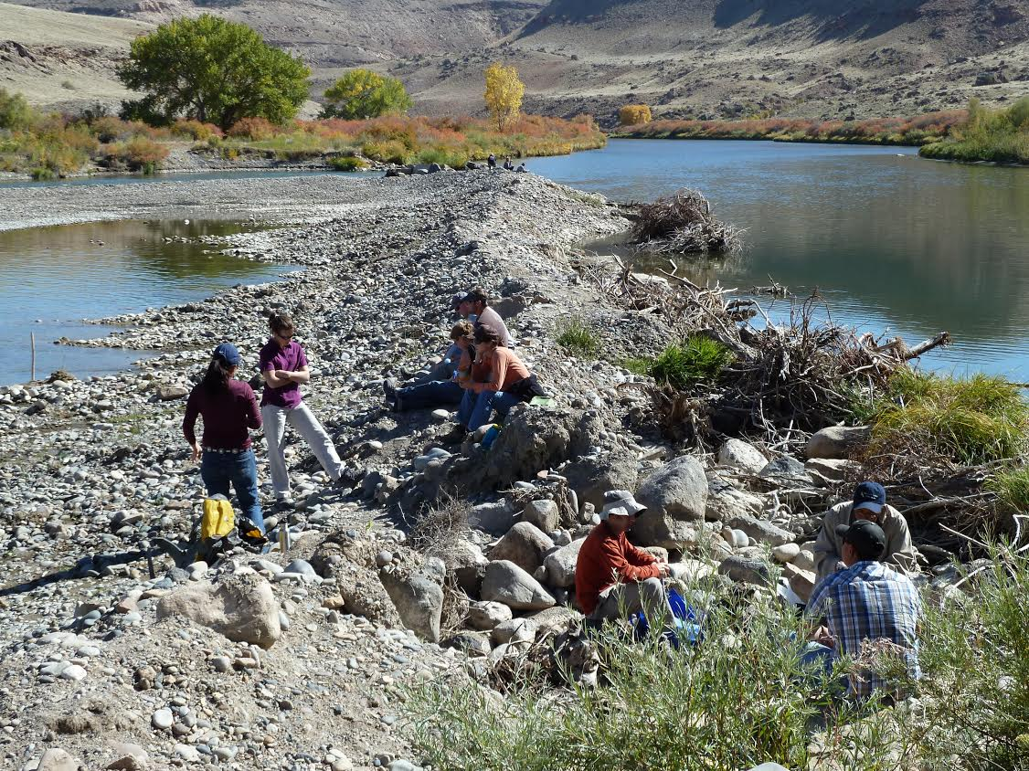
What points can I make in a protest?
Data that the state can use during evaluation of the water right application
Delay approval of application until we are confident that federal land use authorization can be obtained OR include term/condition that right will terminate if federal land use authorization is denied
Notes:
Federal agencies often have hydrologic and natural resources information that is not readily available to state agencies that process water right applications, in the form of unpublished reports, NEPA documents for federal actions, and monitoring databases/files. Offer to make this data available. If publicly available information is particularly relevant to the pending application, specifically note that this information should be considered and where it can be accessed.
If there is a serious question of whether or not land use authorization can be approved, this should be noted in the protest. It is appropriate to notify the state how long the land use authorization process is expected to require, so that the state can make a decision on whether it is appropriate to delay processing of the water right application until federal land use issues are resolved. If it appears that the state must proceed with processing in order to meet statutory deadlines, it is appropriate to request a term and condition in the water right which specifies that the permit automatically lapses if federal land use authorization is not granted.

Slide 13
Processing land use applications: how do I resolve water rights issues?
NEVER issue authorization:
- without investigating water rights situation first
- when any federal agency water rights protest is unresolved
NEVER assume authorization needs to be issued just because applicant already has a permit or water right.
REMIND applicant that federal land use approval is a DISCRETIONARY ACTION.
Shelby says: Get out on the ground and
investigate the water rights situation!
Notes:
NEVER issue a water-related ROW/SUP without thoroughly investigating the water rights situation. Prematurely issuing a ROW/SUP can give the applicant unnecessary leverage in dealing with federal agencies on other issues related to the authorization.
NEVER issue a ROW/SUP when any federal agency has a water rights protest that hasn’t been resolved – you could disrupt the entire negotiating strategy for the Department of Justice, Solicitor’s Office or Office of General Counsel.
Remember that water rights and permits issued by state governments specifically state that such rights do not provide access to the land that is necessary to develop the water right. When that location is on federal lands, the land use authorization is processed according to federal law procedures, which specify that such authorizations are discretionary actions and that such authorizations must be consistent with the purposes for which federal lands are managed.
Exceptions to discretionary ROWs/SUPs are when federal legislation specifies that a ROW or SUP must be granted. An example is the Lincoln County, NV Conservation, Recreation, and Development Act of 2004, which requires BLM to issues ROWs to Southern Nevada Water Authority for a groundwater development project in east-central Nevada. Another is exception to discretionary ROWs/SUPs is when BLM/USFS acquire lands with an acquisition agreement which specifies that a ROW will be issued for an existing facility on the private lands.

Slide 14
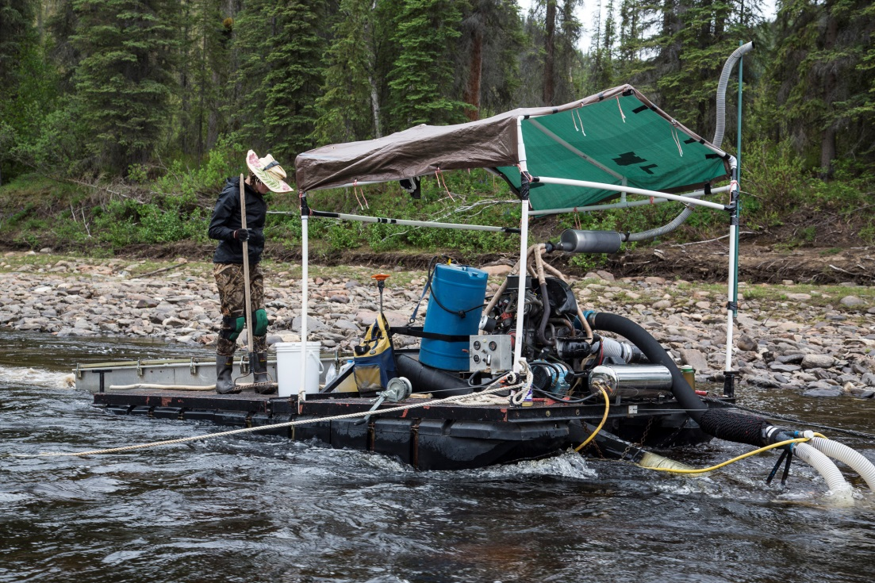
Processing land use applications: how do I resolve water rights issues?
Instead, proceed through land use authorization and NEPA process to identify whether facility can be authorized without significant impact to federal resources and water rights.
Notify state of analysis results and/or decision, including terms and conditions regarding location, amount, and timing of water use.
Notes:
A frequent oversight made in NEPA processes is that impacts to federal rights are not fully analyzed.
Once the NEPA analysis and a decision is complete, it is appropriate to forward that document to the state agency processing the water right application. Information in the NEPA document and decision may be useful to the state in making a final decision on critical aspects of the water right, such as location, amount, timing, and allowed uses.

Slide 15
Resolving water rights issues: who should own water rights on federal lands?
In U.S. ownership when:
When water is used by public or agency for federal land management purposes (e.g visitor facilities, wildlife water facilities, etc.)
When permittee, contractor, or other public land users consume water for federal land management purposes (e.g. concessions, forestry management contract, etc. )
In private ownership when:
Federal agency authorizes permanent facility on federal lands for a usage location that occurs off of federal lands (e.g. municipal water supply)
For time-limited energy, mineral, and commodity development and water use ceases when authorization ends. Rights should be forfeited or assigned to U.S. upon termination.
Notes:
All four federal land management agencies have manual provisions specifying when water rights should be held in the name of the U.S. and when water it is permissible to allow water rights on federal lands to be owned by other parties:
USFS Manual Section 2541.32 – Possessory Interests
BLM Manual Section 7250 – 1.5 (A) – Water Rights Policy
FWS Manual Section 083 – 1.3 – Water Rights Policy
NPS Director’s Order RM-53 - Special Park Uses, Appendix 4 – Water Rights

Slide 16
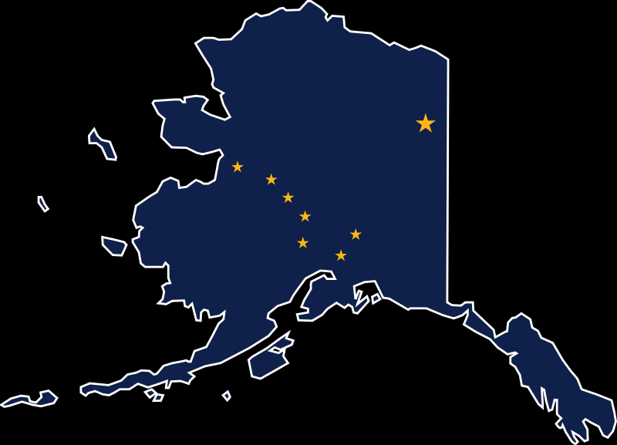
Resolving water rights issues: Does state deal with all water use impacts?
States typically have authority only for water allocation, not for addressing environmental impacts from water use.
Federal agencies have authority and obligation to conduct impact analysis, avoid/minimize impacts, and make decisions that provide for sustainable resource use.
Federal agencies are obligated to address impacts associated with water usage, even if decisions result in reduced yields for approved water rights.
Notes:
State water allocation system have inherent barriers that prevent such systems from dealing with environmental impacts:
Some states don’t have statewide systems for regulating groundwater use (e.g. California)
Some states make artificial distinctions between groundwater associated with streams and deep groundwater (e.g. Arizona).
Many state constitutions encourage maximum water utilization without a corresponding obligation to protect the environment (e.g. Colorado).
Some state statutes actually envision large scale vegetation change associated with groundwater development (e.g. Nevada).
In Alaska, DNR must make a public interest determination when granting a water right permit. The state must consider the effects on fish and game resources, on public recreational opportunities, and on public access to navigable or public water.

Slide 17
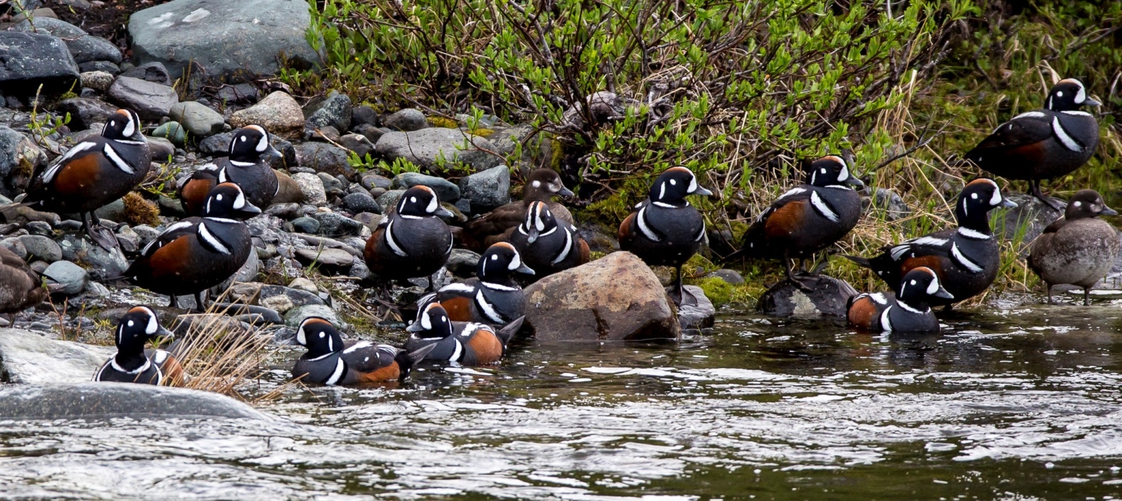
What processes do we use to authorize water-related facilities?
National Park Service:
Fish and Wildlife Service:
Application letter pursuant to National Wildlife Refuge System Act
Letter requirements set forth in 50 CFR Subpart B, Section 29
Application for Special Use Permit, and/or
Application for Transportation and Utility Systems on Federal Lands (SF-299)

Slide 18
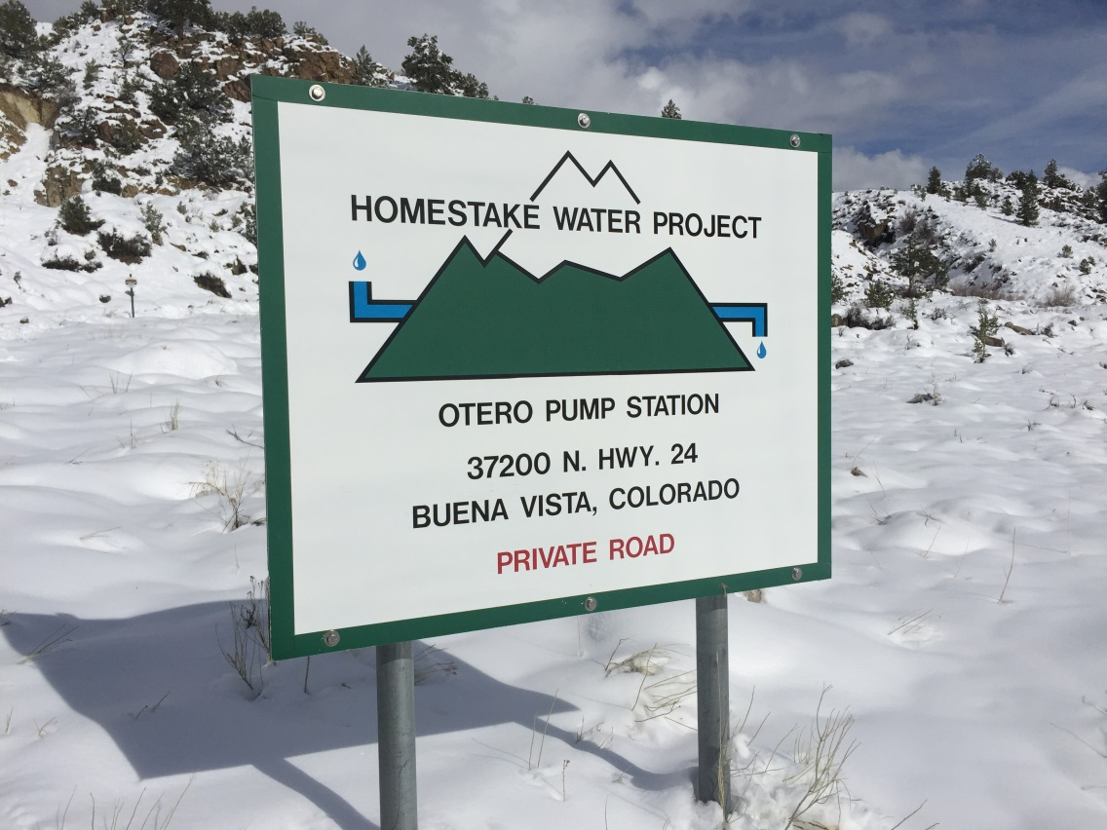
What processes do we use to authorize water-related facilities?
BLM & USFS
Multiple Use Methods
Pre-Federal Land Policy and Management Act Rights-of-Way (pre-1976)
Federal Land Policy and Management Act Authorizations
- Rights-of-Way (BLM)
- Special Use Permits (USFS)

Slide 19
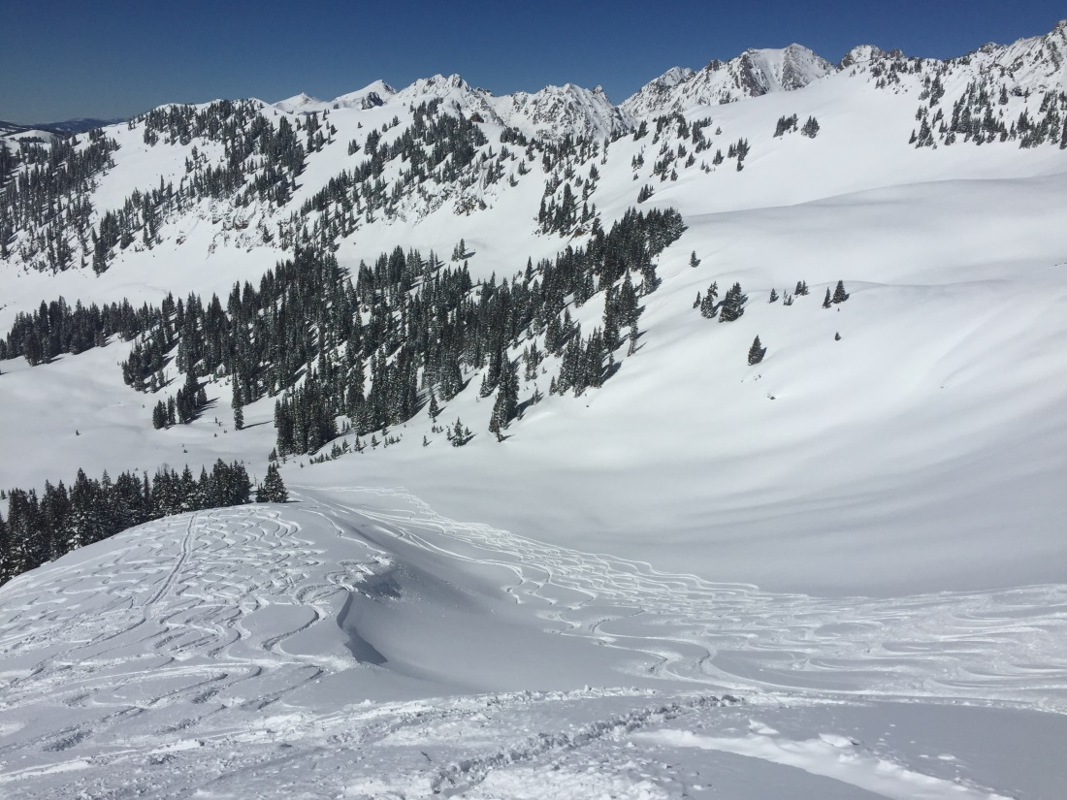
What methods can we use to authorize water-related facilities?
BLM & USFS:
Program-Specific Methods
Plans of Operation for Minerals/Energy Leases – oil, gas, coal, geothermal, etc.
Recreations Leases (BLM) and Permits (USFS) – ski areas, concessions, recreational residences, etc.
Forestry Contracts – special stipulations

Slide 20
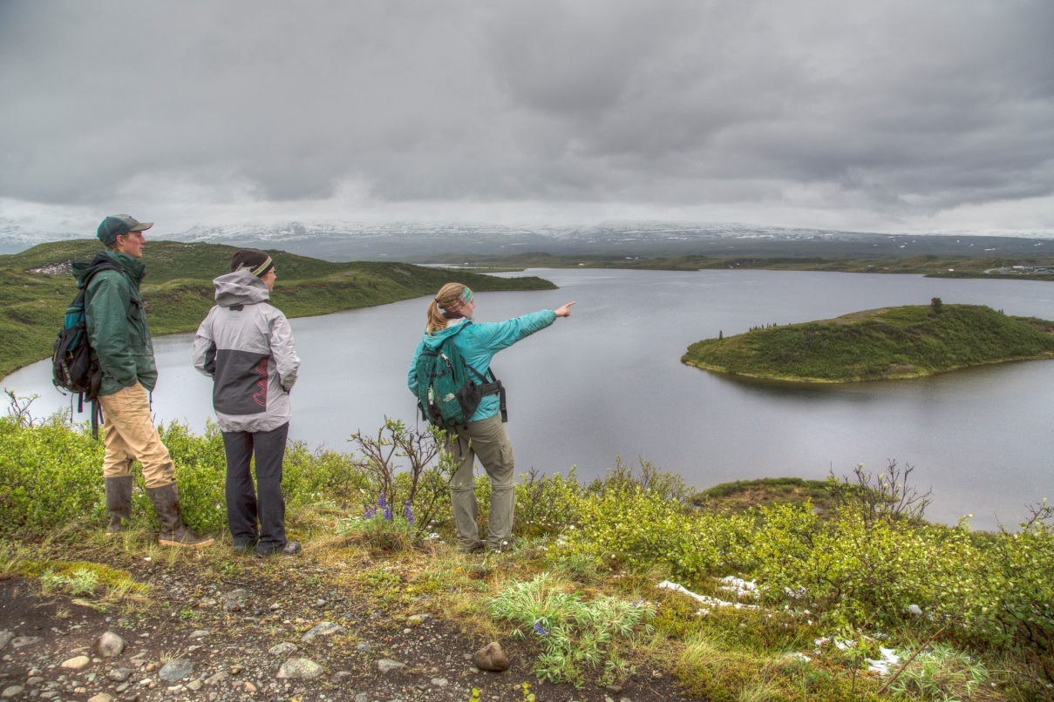
What methods can we use to authorize water-related facilities?
ANILCA processes for utility systems in Conservation System Units (Title XI)
Utility systems include any water conveyance facility
Joint applications to all federal agencies affected
Joint EIS by federal agencies, if required
Statutory deadlines for a decision

Slide 21
ANILCA Process Requirements
Federal agencies must analyze:
Need and economic feasibility
Alternative routes through non-CSU lands
Impacts on local economics, fish and wildlife, and traditional rural lifestyles
Impacts on purpose of the CSU
Impacts on public values versus long-term public benefits

Slide 22
Processing ROW/SUP applications: What analysis process should I use?
Federal agencies must:
Collect data to justify terms and conditions
Provide documentation of reasoned analysis
Reference laws/regs/policies leading to decision
Consider mitigation measures proposed by applicant
Appeal decisions assume that federal agencies follow procedures correctly. The appealing party must prove that the federal process or analysis was in error.
Federal agencies can reject (not process) applications if:
Proposed use is inconsistent with law/regs/land use plans
Do not comply with screening criteria found in regulations
Notes:
BLM and USFS have published regulations under which applications for land use authorization may be rejected. Some of the criteria under which applications may be rejected include threats to public health and safety, if granting the authorization would create a perpetual right of use, if the proposed use would interfere with the administration of public lands, or if the applicant is not qualified to hold a land use authorization. See the references section for this module.

Slide 23
What goes into a “reasoned analysis”?
1. Questions about the water source:
Is access to the water source available on private lands?
Are other water sources available?
Would the proposed use injure existing uses from this source?
Would the water source itself be damaged?
2. Questions about the resource: What impact on riparian, wetlands, wildlife, water quality, erosion, cultural, T&E species, etc?

Slide 24
“Reasoned Analysis” Example
Are there other water sources for livestock?
Will the aquifer be damaged? Are aquifer levels stable?
Can well construction techniques avoid impacts?
Will fens be impacted?
Will water be available for wildlife use?

Slide 25
IBLA Cases For Process Guidance
Grant Hacking (Utah)
Water needed for public purposes
King’s Meadow Ranches (Utah)
Destruction of riparian habitat and erosion
Vogel (Oregon)
BLM must have record to support decisions
Philp (Oregon)
BLM fails to supply supporting rationale
Lederhause (Colorado)
No obligation to approve structures that could be built on private lands
Notes:
IBLA Cases To Read For Process Guidance
Grant Hacking (Utah) - BLM properly rejected application for ROW from PWR, because all water was needed for public purposes.
King’s Meadow Ranches (Utah) – BLM can reject ROW when spring development will result in destruction of riparian habitat and create erosion.
Vogel (Oregon) – BLM must have a record that supports its decision and demonstrates that proposed water use would be detrimental to natural resource values on public lands.
Philp (Oregon) – BLM fails to supply supporting rationale in denying an application to drill a new well on public lands.
Lederhause (Colorado) – BLM is upheld in rejecting an application for a pipeline across public lands where a reasoned analysis shows the pipeline is not in the public interest. The pipeline would have destroyed archaeological resources in an Area of Critical Environmental Concern, and the water could be delivered by crossing private land.

Slide 26
Land Use Authorizations For Water-Related Facilities
First, PROCESS . . .
What processes should we use ?
With whom should we coordinate?
What do we say in the water rights process?
Then, SUBSTANCE. . .
What issues should we analyze?
How do we make a decision to approve or deny?
What terms and conditions should we use in a land use authorization?
Notes:
We have completed our discussion of processes, so now we will now turn to a discussion of the substantive issues that must be addressed when processing an application for land use authorization.

Slide 27
The Substance: Standard for Approval/Denial
Consistent with the mission of the Forest Service to manage lands and resources in a manner that will best meet the present and future needs of the American people, taking into account the needs of future generations for renewable and nonrenewable resources.
The proposed use cannot be reasonably accommodated on non National Forest System lands.
Does not authorize use of National Forest System lands solely because it affords the application a lower cost or less restrictive when compared with non NFS lands.

Slide 28
The Substance: Standard for Approval/Denial
Consistent with the purposes for which BLM manages public lands (multiple use)
Consistent with public interest
Protects natural resources
Prevents unnecessary and undue degradation to public lands

Slide 29
The Substance: Standard for Approval/Denial
Contributes to the achievement of the National Wildlife Refuge purposes
Does not materially interfere with or detract from the mission the National Wildlife Refuge . This standard is known as “compatible use.”
Will not unduly interfere with the management, administration, or disposal by the United States of the affected lands.

Slide 30
The Substance: Standard for Approval/Denial
Does not jeopardize or unduly interfere with the primary natural or historic resources of the area involved
Provides public services within the immediate vicinity of the park
There are no reasonable alternatives to acquire the water
Will not contribute to future dependency on park resources

Slide 31
The Substance: Terms and Conditions

Slide 32
Authority for Terms & Conditions
Federal Land Policy and Management Act:
“minimize damage to scenic and aesthetic values and fish and wildlife habitat or otherwise protect the environment”
Endangered Species Act:
“every federal agency shall.. ensure that any action authorized … is not likely to jeopardize the continued existence of any endangered or threatened species or result in destruction or adverse modification of habitat of such species …”

Slide 33
Authority for Terms & Conditions
National Environmental Policy Act:
Requires best available science to analyze, minimize, and avoid environmental impacts
Utah Power and Light Co. v. U.S. 243 U.S. 389
Access to state water rights on federal lands occurs under FEDERAL LAW.

Slide 34
Agency Guidance - Terms & Conditions
USFS Water Uses and Development Manual Section 2541.35:
Include stipulations in the authorizing documents to ensure the quantities of water needed to fulfill purposes of the National Forest and for environmental needs will be maintained instream.
BLM Water Rights Manual 7250 - Section 1.5.B.6:
In all land use authorizations, the BLM shall include terms and conditions to protect water rights and water uses on public lands.

Slide 35
Agency Guidance - Terms & Conditions
50 CFR 29.21-4 (Fish and Wildlife Service regs):
An applicant, by accepting an easement or permit agrees to such terms and conditions as may be prescribed by the Regional Director in the granting document.
NPS Director’s Order #53, Special Park Uses – Section 8
To protect NPS interests, the Superintendent shall incorporate appropriate conditions into all special park use permits.

Slide 36
Federal management objectives for water-related ROWs/SUPs
Predictability of operations and impacts
Minimization and avoidance of impacts
Applicants remain within authorized purposes
Authorize practices, not just structures
RESULT: Facility operation plans; increased reporting

Slide 37
Meeting federal management objectives with terms/conditions
Example General Stipulations:
Applicant will not sell, lease, or use water for any other than stated purposes
Applicant may not change type, place, or volume of use without consent
Usage must include water conservation measures
Modify water facility to support other values, such as wildlife and wetlands
Notes:
General stipulations are designed to ensure that the water use doesn’t drift from the purpose and need that was stated in the application for land use authorization. They are also designed to make the use as compatible as possible with the federal agency missions.
See Forest Service Handbook 2709.11 for more examples of general stipulation language.

Slide 38
ROWs/SUPs in hydrologic systems where little data exists
Example Stipulations:
Applicant collects baseline data impacts analysis
Applicant pays for studies to ID relationships between groundwater basin and springs, streams, and adjacent basins
Applicant agrees to long-term monitoring.
Applicant agrees to adaptive management and project modification if unexpected impacts occur
Notes:
Little hydrologic data exists for many basins and groundwater systems in Alaska. If an applicant seeks to construct a facility in one of these locations, it is entirely appropriate to place the burden on the applicant for collecting the data to understand baseline conditions in the hydrologic system.
In hydrologic systems where little data exists, an emerging approach is called 3M – monitoring, management, and mitigation. Once a system is approved and constructed, the applicant is responsible for maintaining monitoring system to detect impacts from the projects. If unexpected impacts are detected, then the applicant is expected to take management measures to reduce the impact of the project and avoid further impacts. If the unexpected impacts cannot be avoided and continued operation of the project is essential for public health and safety, then the applicant is expected to mitigate the unexpected impacts.
A good example of the 3M approach in basins with little hydrologic data was adopted when BLM Nevada approved right-of-way grants for the Southern Nevada Water Authority Groundwater Development Project.

Slide 39
Meeting federal management objectives with terms/conditions
Example stipulations for surface water facilities:
Limit volume/rate diverted
Limit diversion season
Design structures to prevent fish entrainment and allow fish passage
Move facility locations to avoid sensitive habitats
Use alternative sources of water (e.g. wells, water stored in reservoirs) during sensitive low flow periods
Notes:
Stipulations for surface water projects are typically designed to prevent direct impacts associated with flow alteration. Stipulations designed to prevent flow impacts can be set up so that the stipulation takes effect when flow rates meet a certain trigger point, below which impacts are expected to occur.
Placing new restrictions on diversion rates for facilities that have been diverting for decades is typically very controversial. However, placing diversion restrictions on new facilities is contemplated under federal law, and is often necessary to avoid impacts.

Slide 40
Addressing new environmental drivers with terms/conditions
Example stipulations for groundwater facilities:
Submit copies of all permits and test results
Require well pump test before authorizing project
Cease pumping during critical aquifer periods
Monitor water quality for unexpected changes
Install meter and submit annual report on pump rates and pump volumes
Notes:
The primary objective for stipulations for small groundwater systems is to learn as much as possible about the aquifer and to prevent irretrievable impacts. Owners of small groundwater systems typically can’t afford to redrill or shut down a well if unexpected impacts occur, so authorizations must anticipate, avoid, and minimize impacts. The following techniques help you gather essential information:
Permits and tests required by other agencies often provide a wealth of information that will assist in analyzing potential impacts.
Pump tests can determine aquifer response to sustained pumping and help determine if the proposed project will deliver sufficient yield to meet project purposes.
Applicants can be asked to cease pumping during predictable periods when aquifer levels are low, such as late fall when snowmelt-fed streams provide little recharge to alluvial aquifer.
Water quality tests can assist in identifying the source of the groundwater pumped by the well, and can indicate changes in groundwater flow direction.
Requiring meter installation and reporting almost automatically reduces the amount of water consumed.

Slide 41
Water Facility Operation Plans: Certainty and Communication
Diversions - rates, dates, and measurement procedures
Access – routes, equipment, and snow removal
Repairs – routine, major, catastrophic
Maintenance – timing, tools
Ditch problems – washouts, downcutting, erosion
Instream work – diversion dams, vegetation control
What happens when a flood destroys facility?

Slide 42
Water Facility Operation Plans: Advantages
Can include a schedule for regular revision and updates
Revision to an operating plan doesn’t require amending the right-of-way grant or special use permit
Can and should be negotiated before the SUP or ROW is offered
What happens when a flood destroys facility?
Notes:
Disadvantages of Operation Plans – Very time consuming to negotiate. Can be controversial for pre-FLPMA facilities. Sometimes not necessary for simple facilities.
Advantages of Operation Plans: Relationships are established for dealing with inevitable challenges, such as facility failures or needed upgrades. Up-front investment of time results in far less time dealing with ongoing facility management issues and problems. New owners are aware of expectations and procedures.

Slide 43
Notebook References
Notes:
References: (To Be Filled In)

