Slide 1
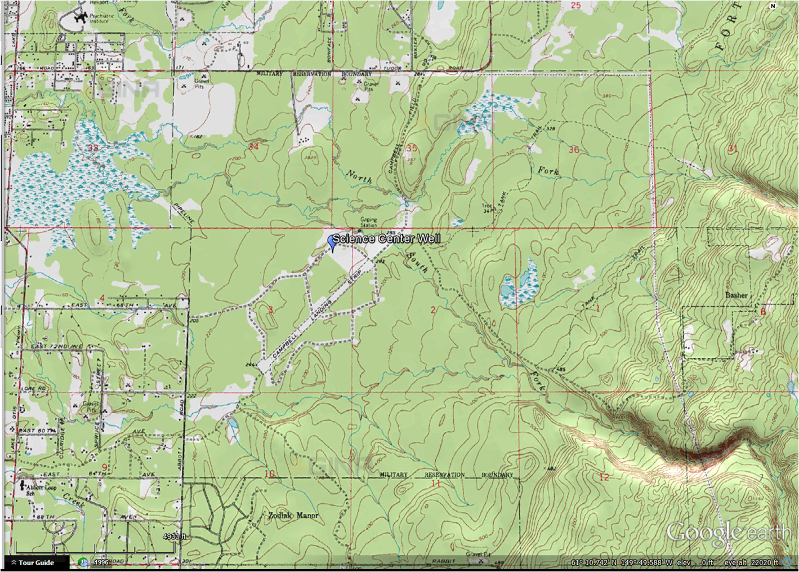
Map: Campbell Creek Science Center Well
Location: T.12N., R.3W, Section 3 NWSENENE, Seward Meridian
Lat/Long: 61° 9.850’ N 149° 46.674’ W

Slide 2
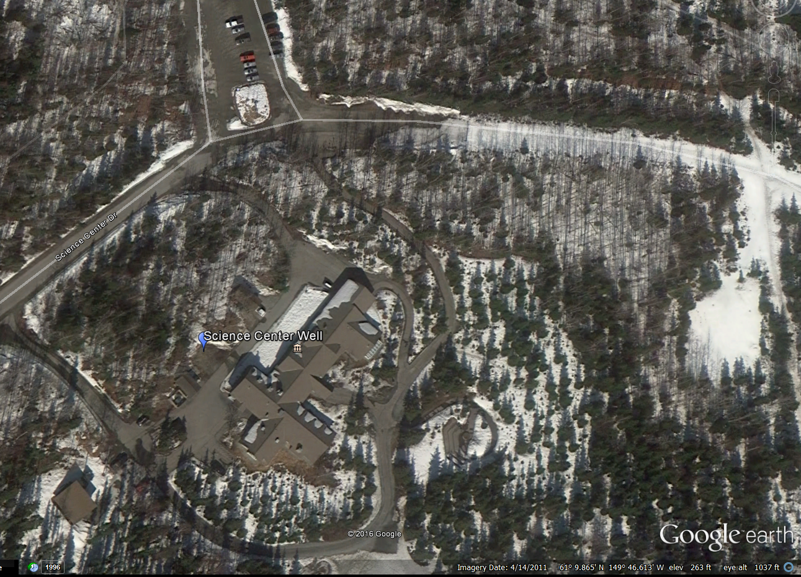
Google Aerial Photo: Campbell Creek Science Center Well

Slide 3
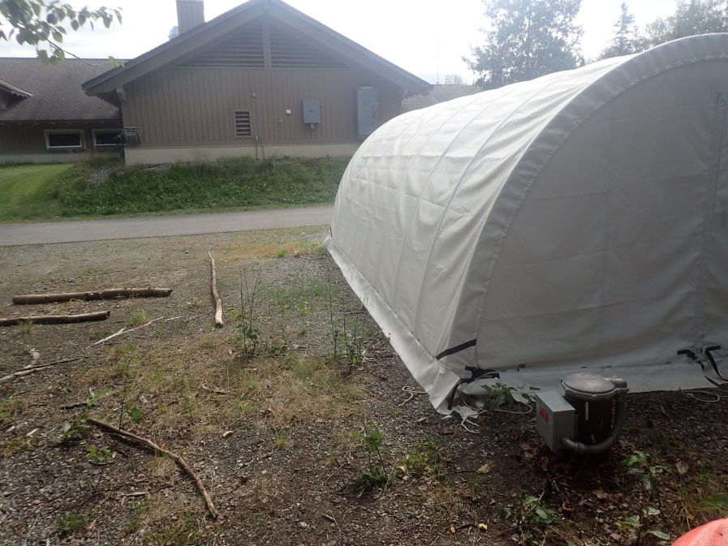
Campbell Creek Science Center Well
Well Head location usually covered with orange traffic barrel (that the bears chew on)

Slide 4
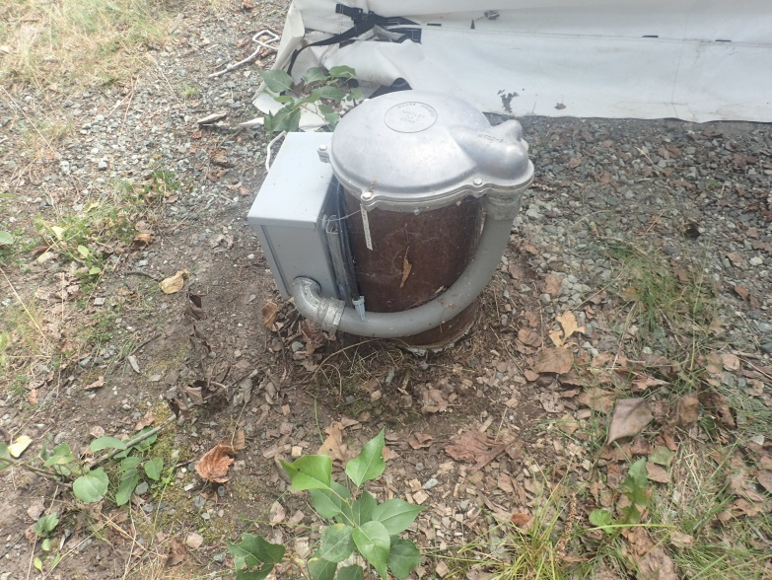
Campbell Creek Science Center Well
Well plumbing

Slide 5
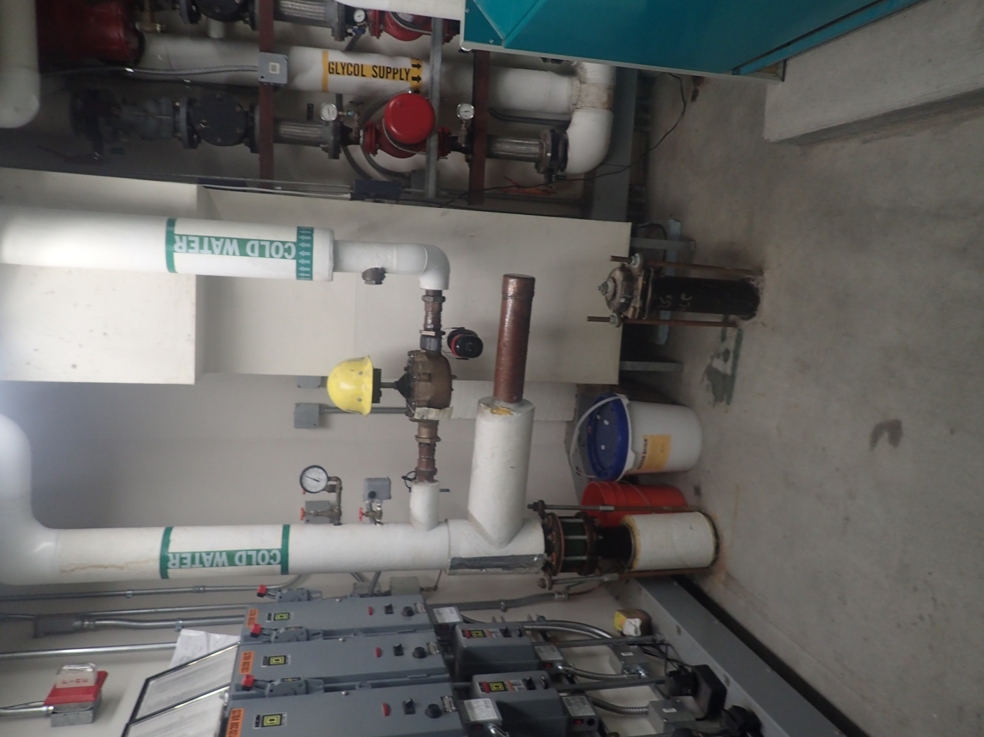
Campbell Creek Science Center Well
Well house

