Slide 1
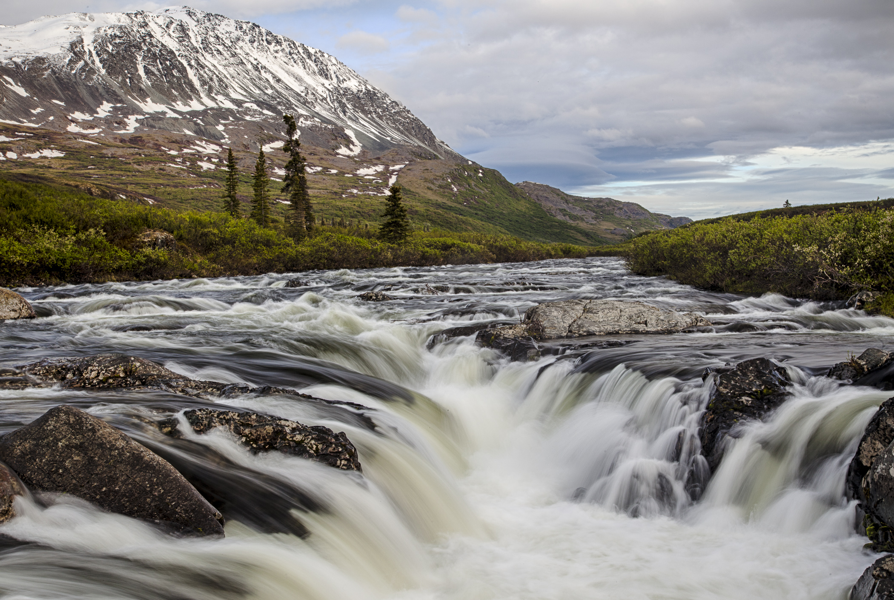
Federal Reserved Water Rights: An Introduction Roy Smith, BLM Colorado/Utah
Delta Wild and Scenic River, AK

Slide 2
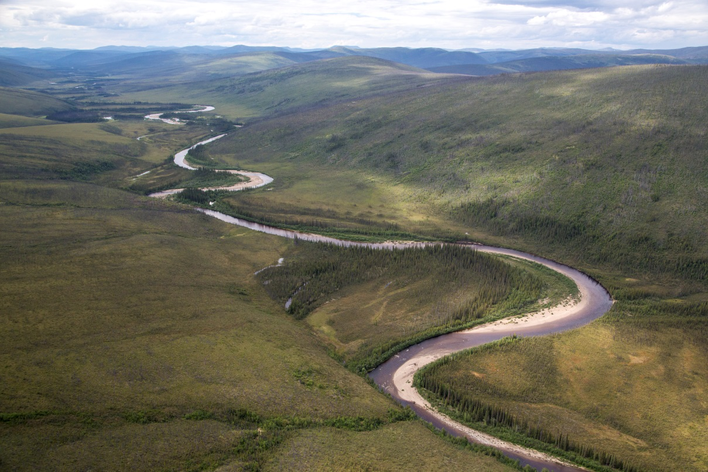
What are federal reserved water rights?
A special class of water rights that are designed to fulfill and support the purposes of federal reservations of land.
The purposes of federal reservations of land are specified in Congressional legislation and Presidential executive orders that create the reservations.
Birch Creek Wild and Scenic River, AK

Slide 3
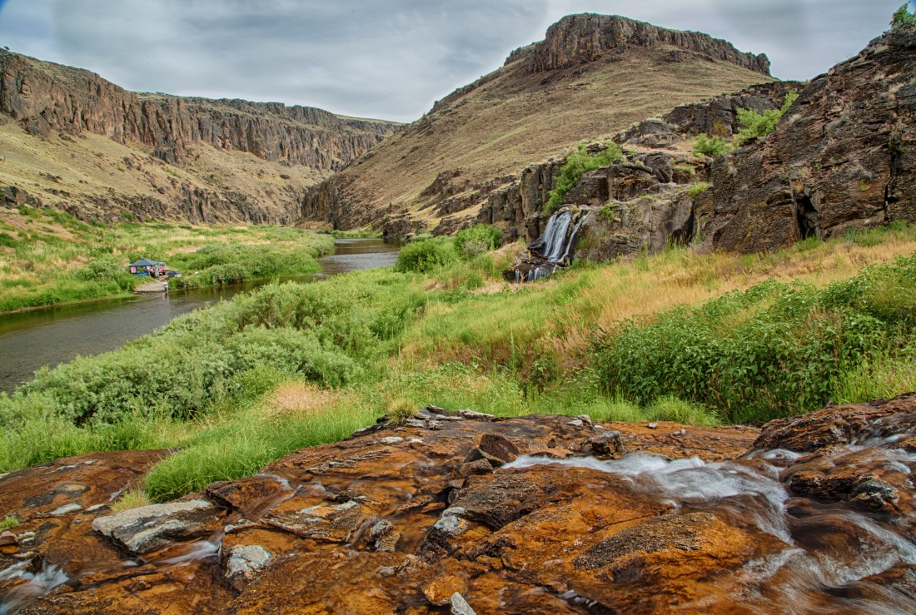
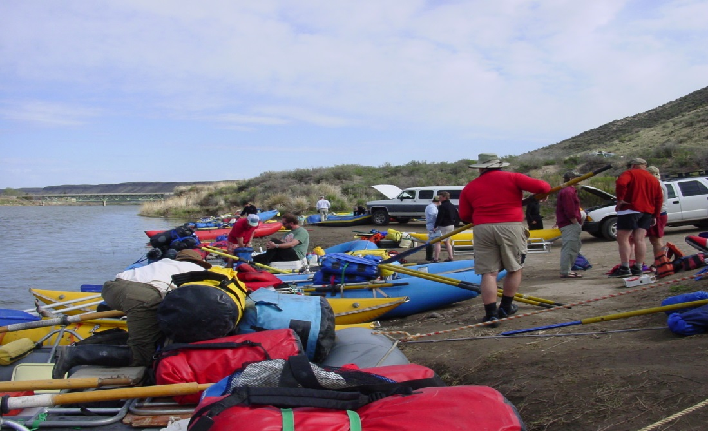
Federal Reserved Water Rights - Origins
Reserved rights were created by U.S. Supreme Court rulings:
Winters v. U.S. (1908) – Congress reserved sufficient water to effect the purpose of Indian reservations.
AZ v. CA (1963) – Extended doctrine to all federal land reservations of land.
Cappaert v. U.S. (1976) – Reserved rights also apply to groundwater.
U.S. v. NM – Reserved rights are limited to the primary purposes of reservation specified by Congress, and to the minimum amount necessary to satisfy purposes.
Owyhee Wild and Scenic
River, OR

Slide 4
Federal Reserved Water Rights - Origins
Congress has generally delegated the allocation of water to state governments.
The Supreme Court has ruled that federal reserved water rights are an exception.
Congress has created processes to fit this exception into state water allocation processes.
Via the “McCarran Amendment,” 43 USC 666 (1952), Congress allowed states to require the U.S. to participate in stream adjudications.

Slide 5
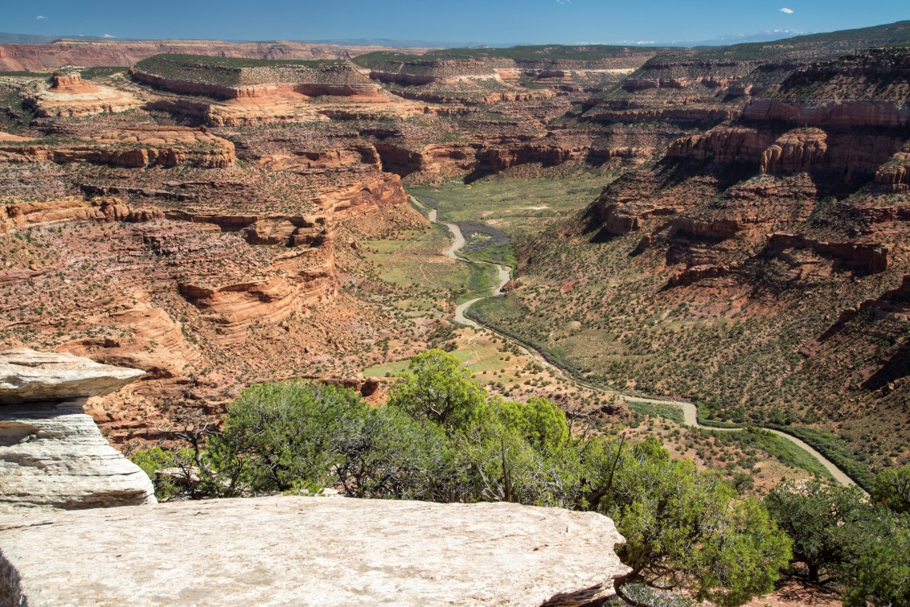
What federal lands qualify as reservations?
Lands withdrawn from the public domain by legislation or by presidential executive order for a specific federal purpose.
Dolores River, CO
Unreserved BLM lands have no federal reserved water rights because they remain within the public domain. Their specific management purpose may be changed by future Congressional action, Presidential orders, or by BLM management actions.

Slide 6
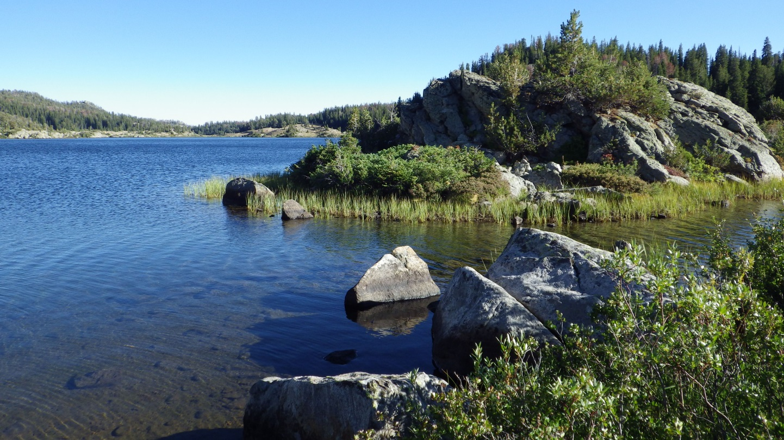
Examples of USFS Reserved Water Rights
National Forests
National Monuments
National Recreation Areas
Wilderness Areas
Wild and Scenic Rivers
Chain Lakes, Wind River Range, Shoshone NF, Wyoming

Slide 7
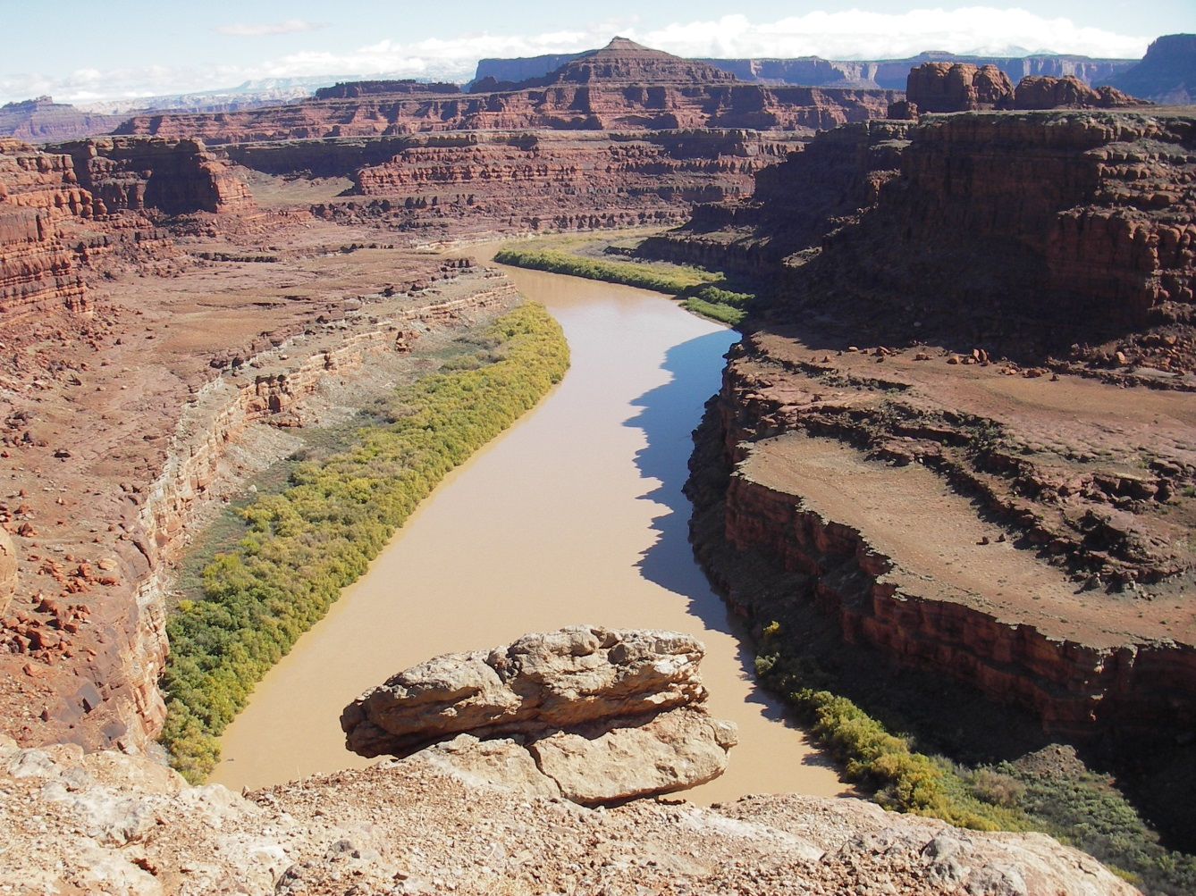
Examples of NPS Reserved Water Rights
National Parks
National Preserves
National Monuments
National Seashore
National Historic Parks and Sites
National Military Parks and Battlefields
National Recreation Areas
Wilderness Areas
Wild and Scenic Rivers
Colorado River, Canyonlands NP, UT

Slide 8
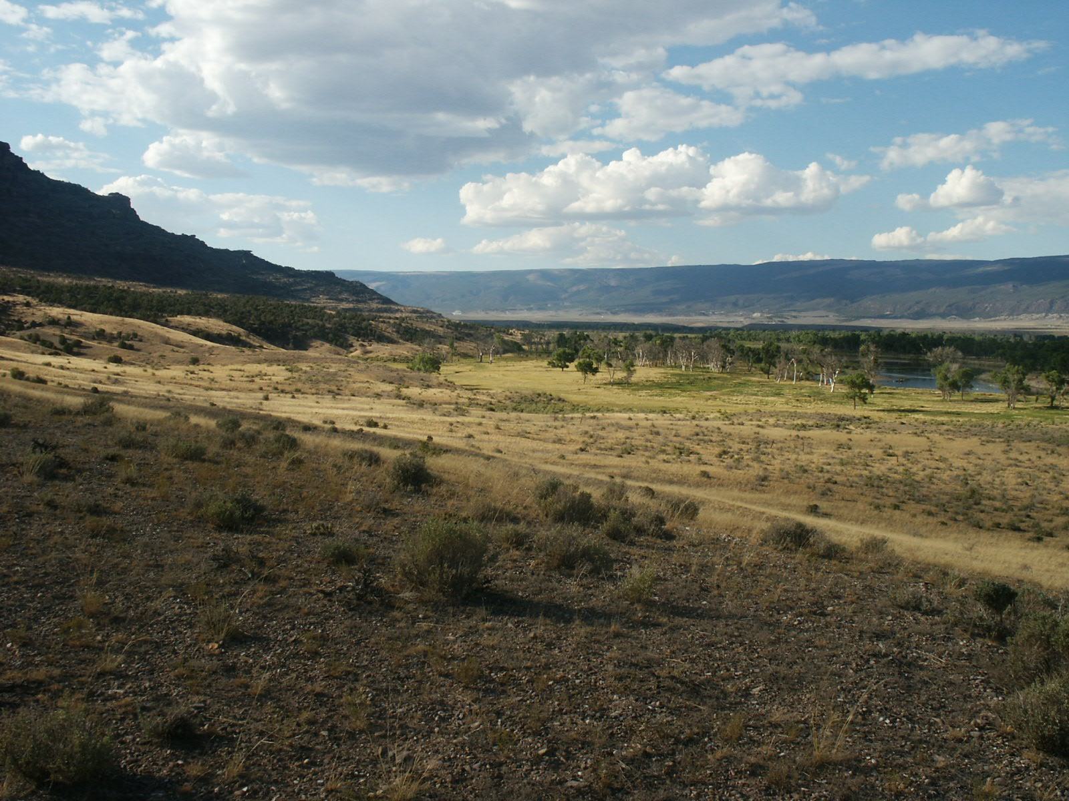
Examples of FWS Reserved Water Rights
National Wildlife Refuges
Wilderness Areas
Wild and Scenic Rivers
National Fish Hatcheries
Brown’s Park NWR, CO

Slide 9
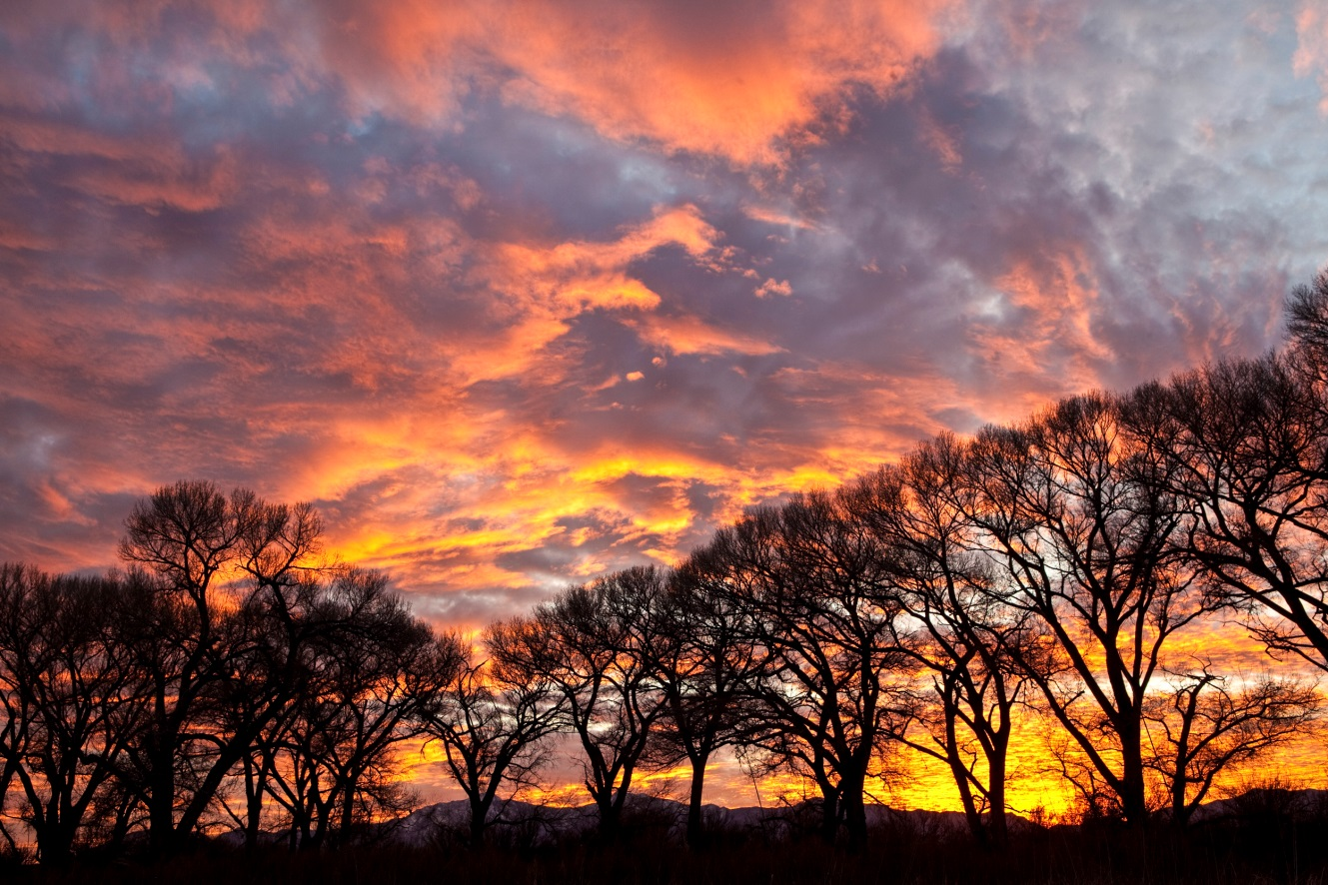
Examples of BLM Reserved Water Rights
National Conservation Areas
Riparian National Conservation Areas
National Monuments
Wild and Scenic Rivers
Wilderness Areas
Public Water Reserves
San Pedro Riparian National Conservation Area, AZ

Slide 10
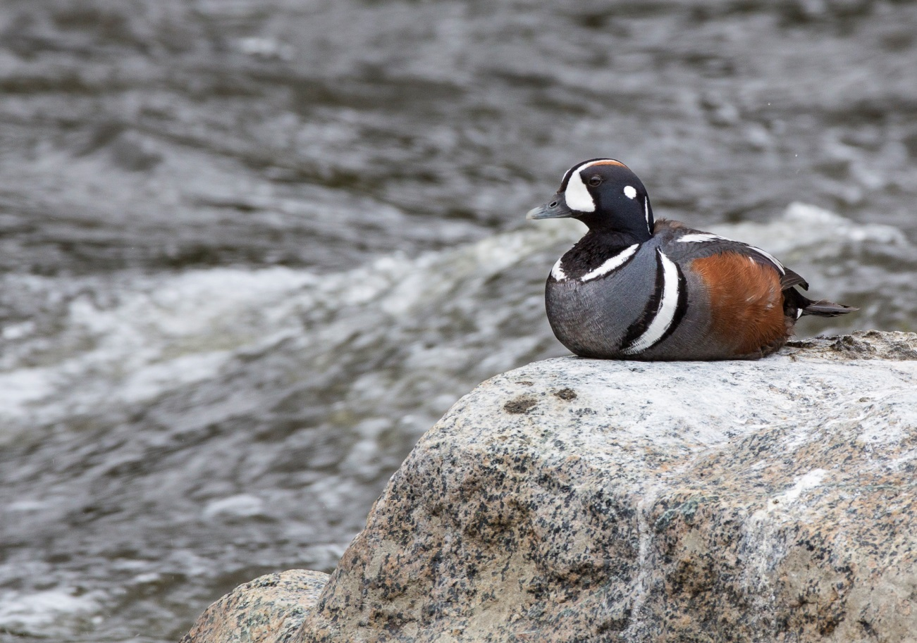
Reserved Lands In Alaska
Reserved lands and waters cover 178.8 million acres in Alaska, or about 42% of the state.
Reserved water rights could have a huge impact on future water management in Alaska.

Slide 11
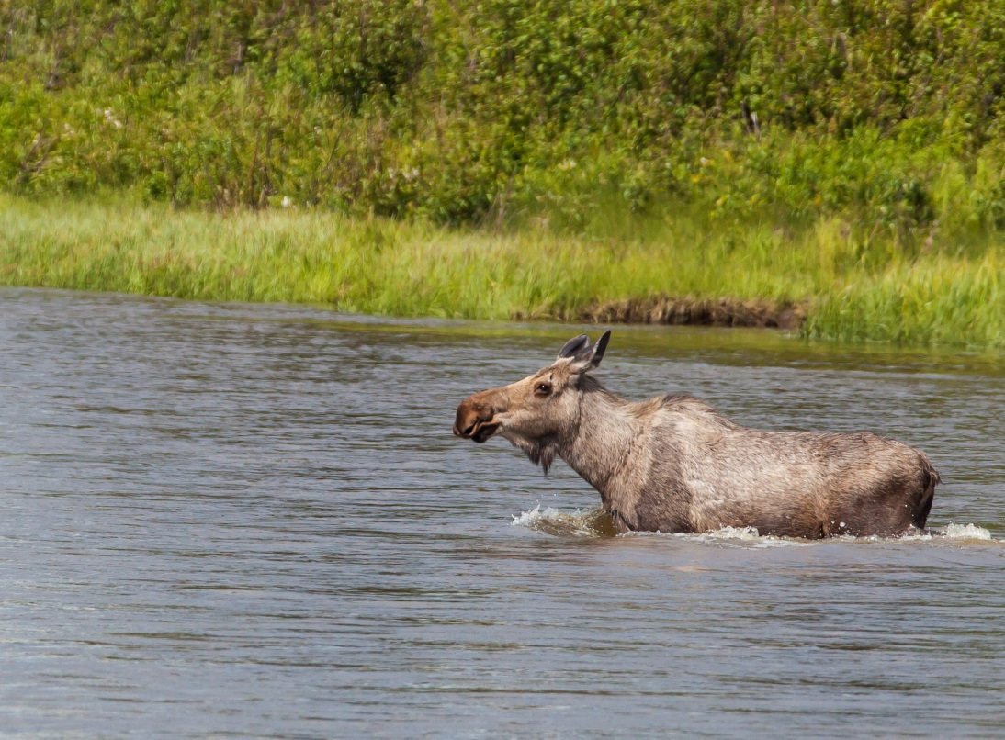
“Express” v. “Implied” Reserved Rights
Just because land is reserved, it doesn’t always have reserved water rights:
Congress or president can expressly state their intent, and may say reserved rights are or are not created by their action.
Reserved rights are implied when no explicit statement is made and the purpose of the reservation would be entirely defeated without water.
Did Congress reserve this lake for me?

Slide 12
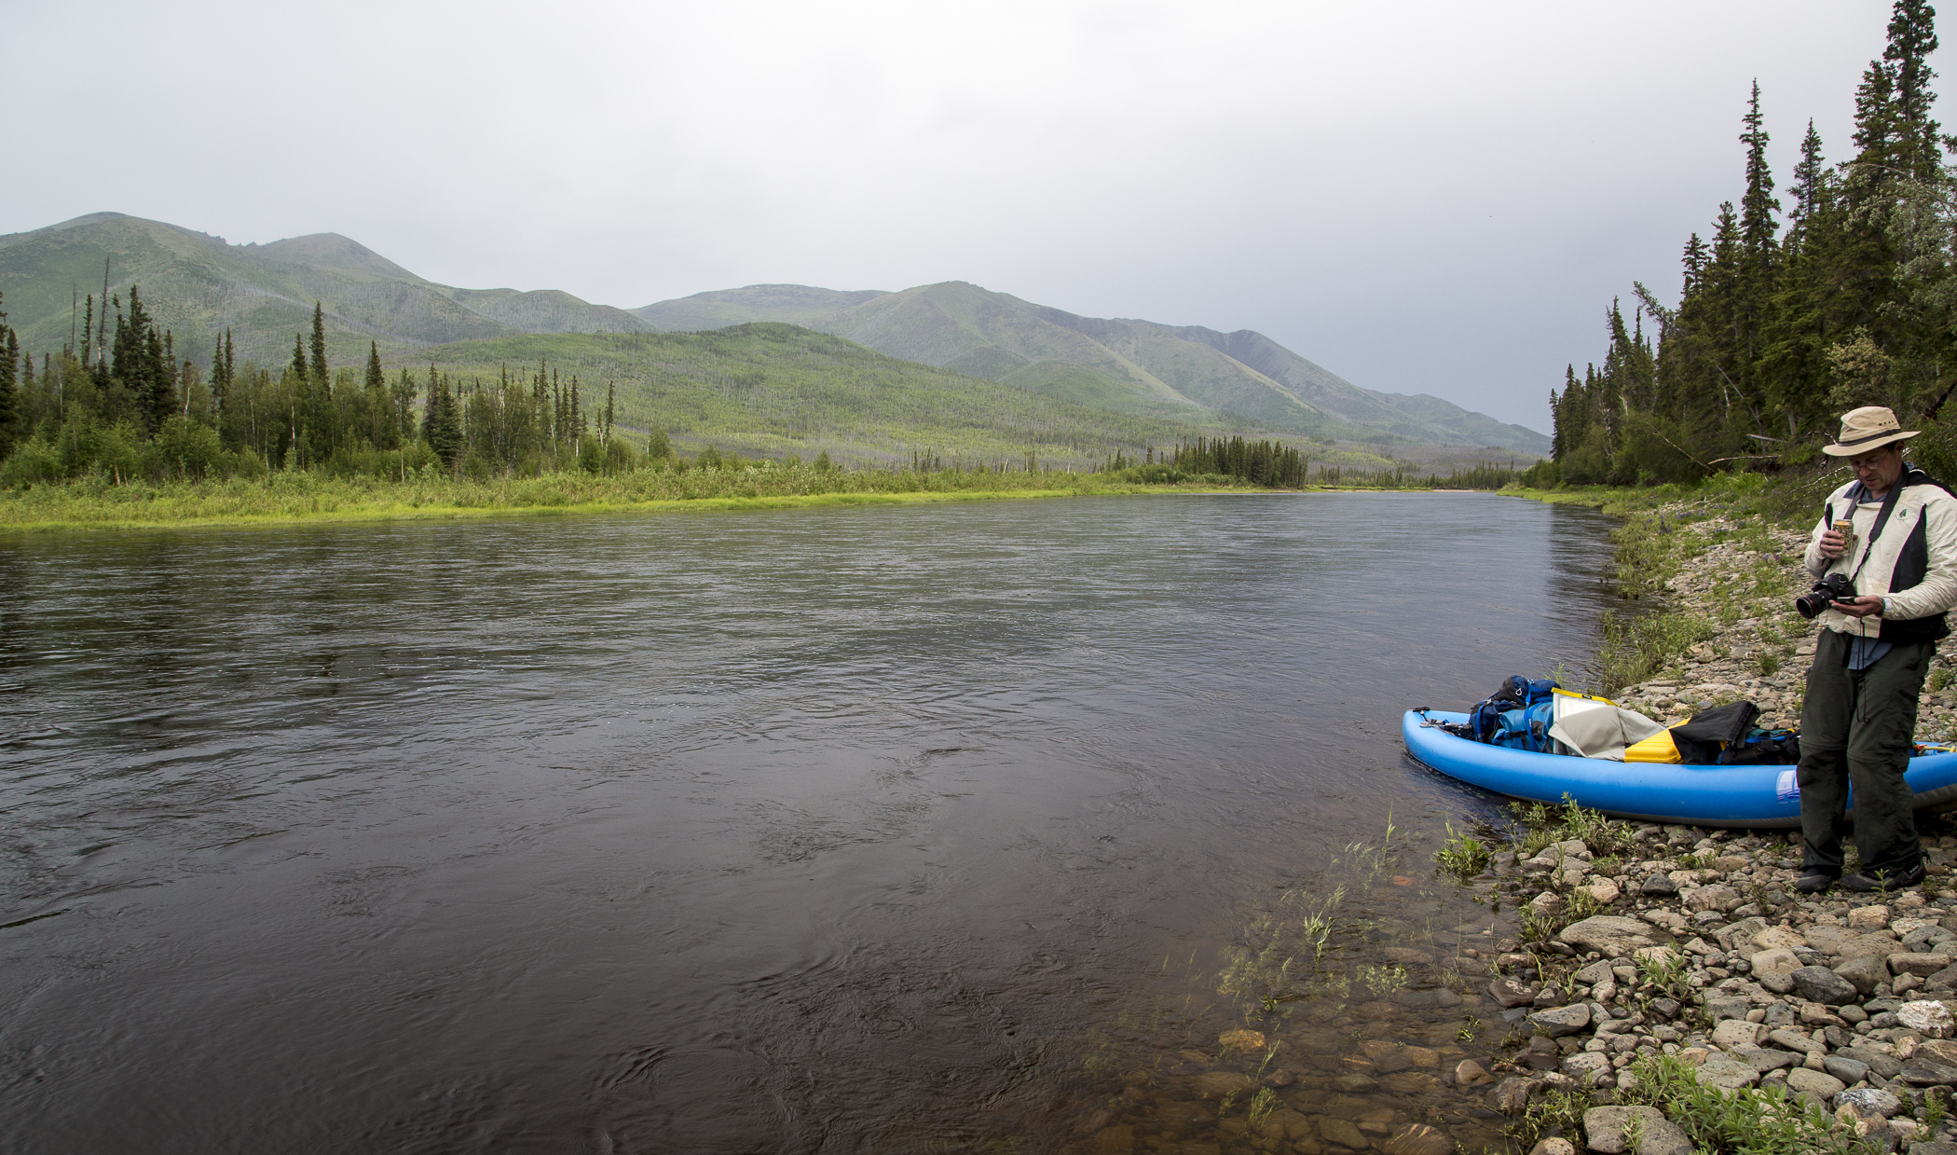
The Characteristics of a Federal Reserved Water Right:
Are Controlled By Federal Law, Including:
Priority Date
Purposes
Amount
Location
Beaver Creek Wild and Scenic River, AK

Slide 13
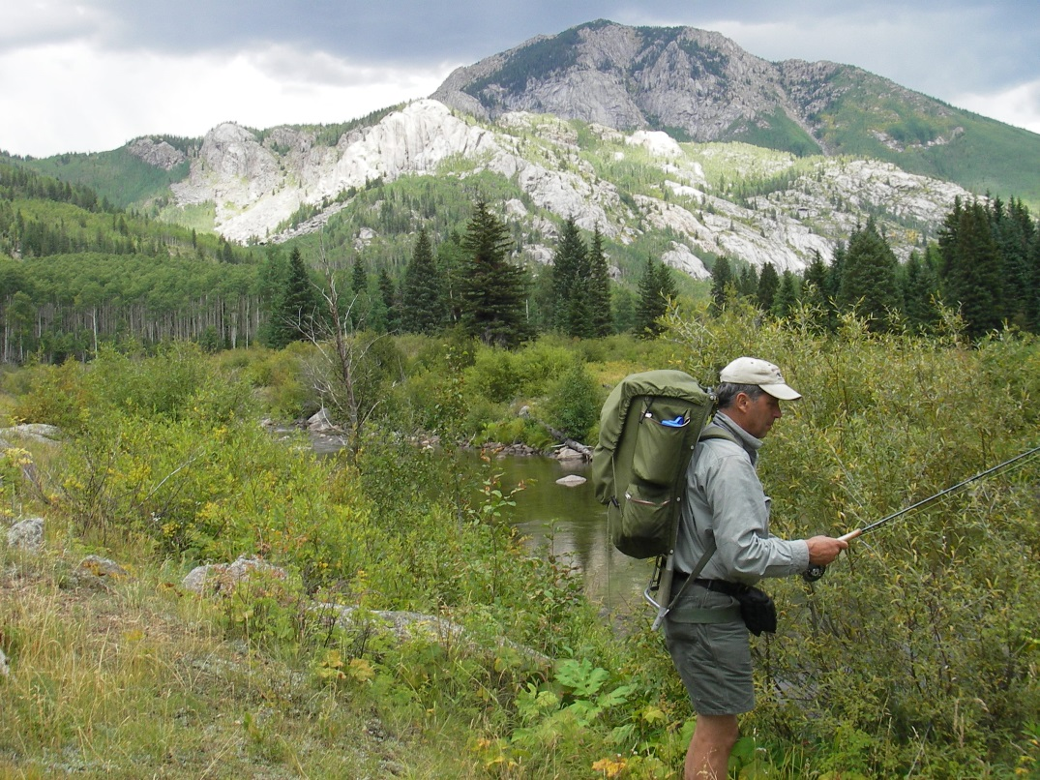
Reserved Rights: Priority Date
Date that the reservation is established by legislation or executive order, not the date when the federal agency submits a claim.
Some reservations may have multiple priority dates, if different portions of the reservation were established at different times.
White River National Forest, CO

Slide 14
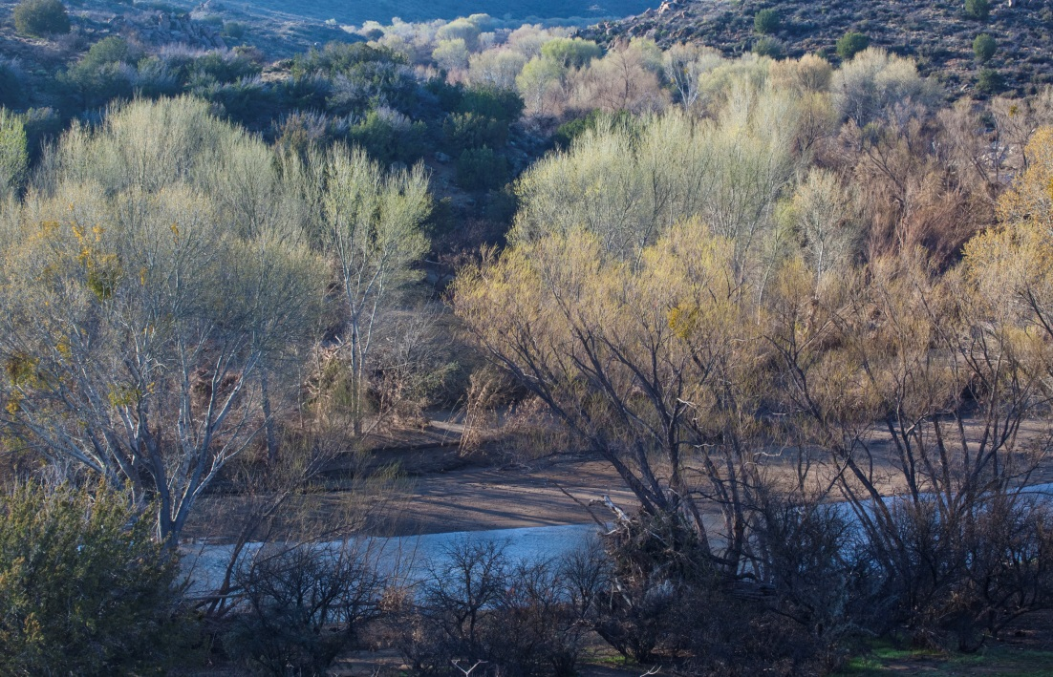
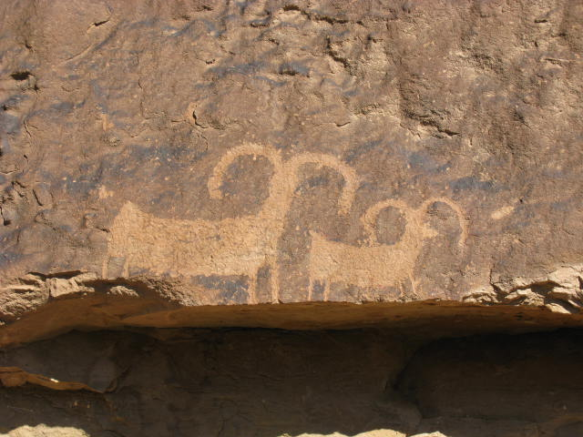
Reserved Rights: Purposes / Water Uses
Primary purposes of the reservation, as stated in legislation or executive order.
If primary purposes are broadly stated, then a legal interpretation may be required to identify water-dependent values and management purposes.
It’s possible that purposes do not match beneficial uses authorized under state law.
Agua Fria National Monument, AZ

Slide 15
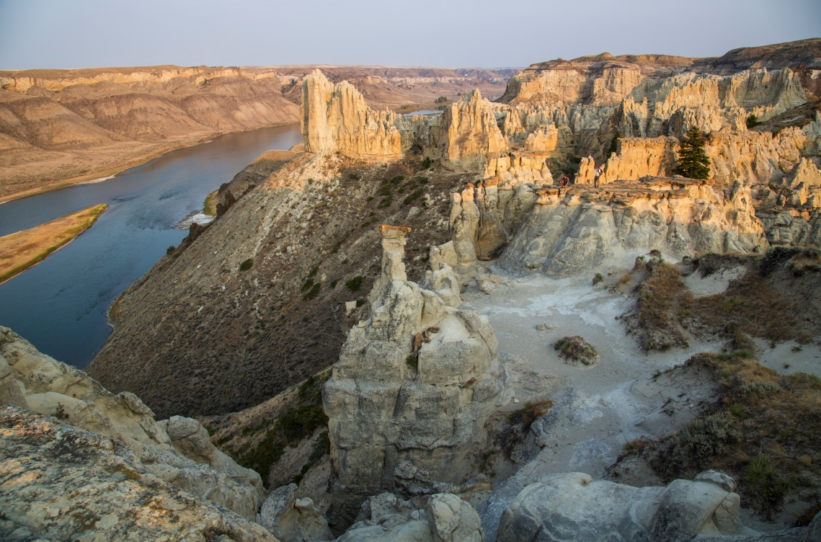
Reserved Rights: Amounts
The minimum amount necessary to effect the primary purposes of the reservation.
Typically established by federal agency studies using scientifically accepted methodologies.
Upper Missouri Wild and Scenic River, MT
Quantification can be technically complex, expensive, and very lengthy, because it is subject to intensive court or administrative review!

Slide 16
Reserved Rights: Locations
Wherever water is needed to accomplish the primary purposes of the reservation.
Can include developed sources (wells, reservoirs) undeveloped sources (natural lakes, springs)
Can include entire flowing systems (surface instream flows and underground rivers) and groundwater systems (aquifers and caves)
Great Sand Dunes NP and Preserve, CO

Slide 17
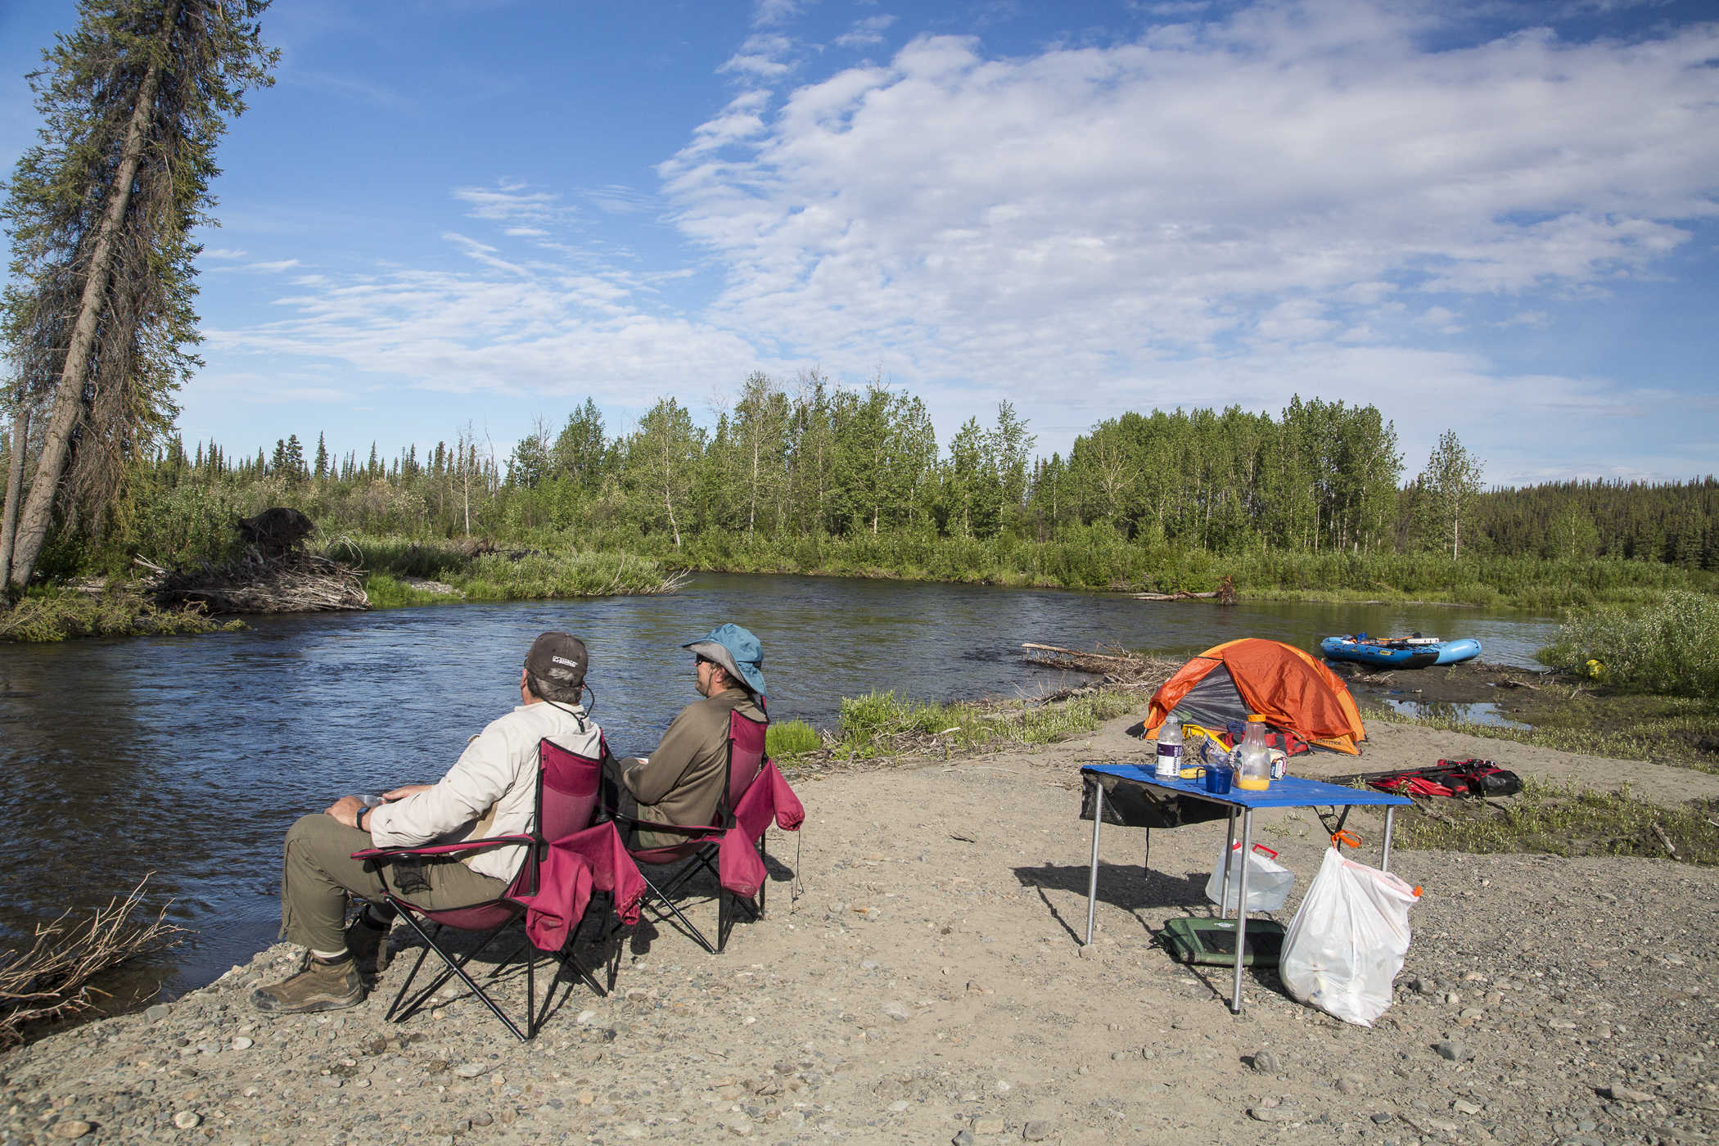
Processes For Claiming and Administering
Federal Reserved Water Rights
Gulkana Wild and Scenic River, AK

Slide 18
Adjudication of Reserved Rights
Reserved rights are typically determined by state-run adjudications.
An adjudication is a judicial proceeding that determines water rights on a specific stream system
Typically includes all claims for water rights claimed under state law and all federal reserved water rights.
Alaska law has specific procedures for determining federal reserved water rights.
Example: Snake River Basin Adjudication, ID
Reaching settlements in adjudications may require approval from state agency directors, federal agency directors, and even Congress!

Slide 19
Administration of Reserved Rights
Reserved water rights are not subject to loss through non-use
Reserved water rights include present uses and foreseeable future uses
Federal agencies are subject to priority system and must submit water use reports, just like other users
If a federal right has not been determined, it creates great uncertainty for all users
Rio Grande NF, CO – an adjudicated and
administered federal reserved water right.

Slide 20
Administering Federal Reserved Water Rights: Example
Hypothetical
National Park:
Established
1910
(Amount ???)
1970 Right:
5 cfs
Streamflow = 25 cfs
What if Park right is 5 cfs? 20 cfs?
1905 Right:
10 cfs
Notes:
Also need look at priority dates
Creates uncertainty in other users: how should I invest in regard to my water right if I don’t know the reliability of water supply?

Slide 21
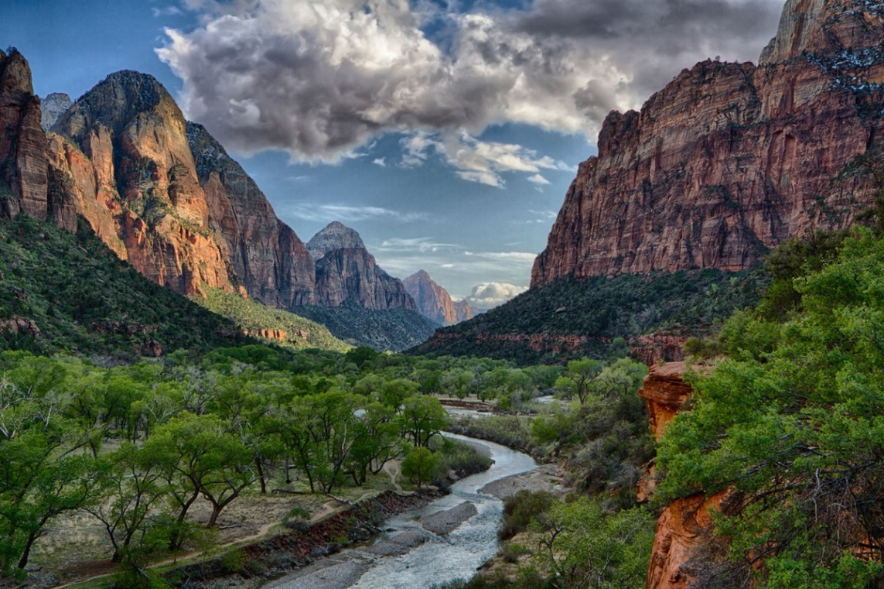
Example Reserved Water Right Claim: Zion National Park 1996 Settlement Agreement

Slide 22
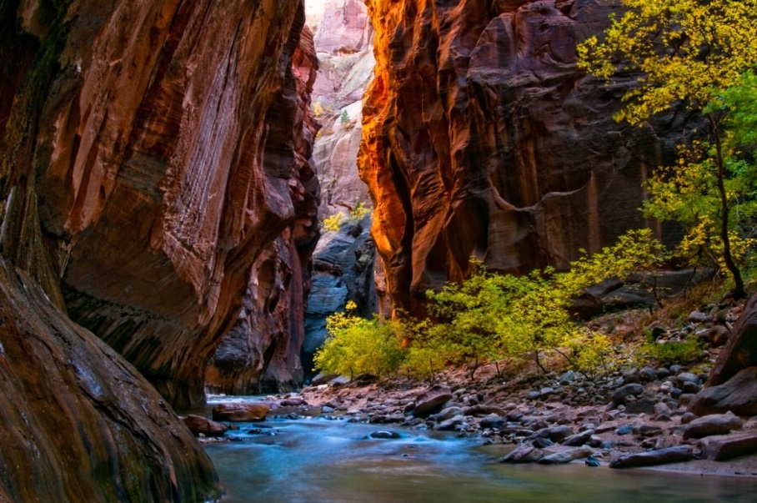
Zion NP Settlement Agreement
1996 agreement between NPS, the State of Utah, and two water districts.
In context of a state adjudication of Virgin River watershed
Surface and groundwater administered together
Avoided a very long, very expensive litigation
Recognized and quantified federal reserved right for Zion NP for both surface and groundwater

Slide 23
Zion NP Settlement Agreement
What does the Agreement do?
Recognizes and quantifies federal reserved rights
Contains volumetric limits on park and private water use
Recognizes Zion NP purposes in reserved right
Preserve canyon erosion, preserve for scientific interest, protect scenery, preserve natural and historic objects
Allows limited additional water for development outside park
Establishes GW protection zones outside park
Agreement has been issued as a partial decree and is being enforced by the State

Slide 24
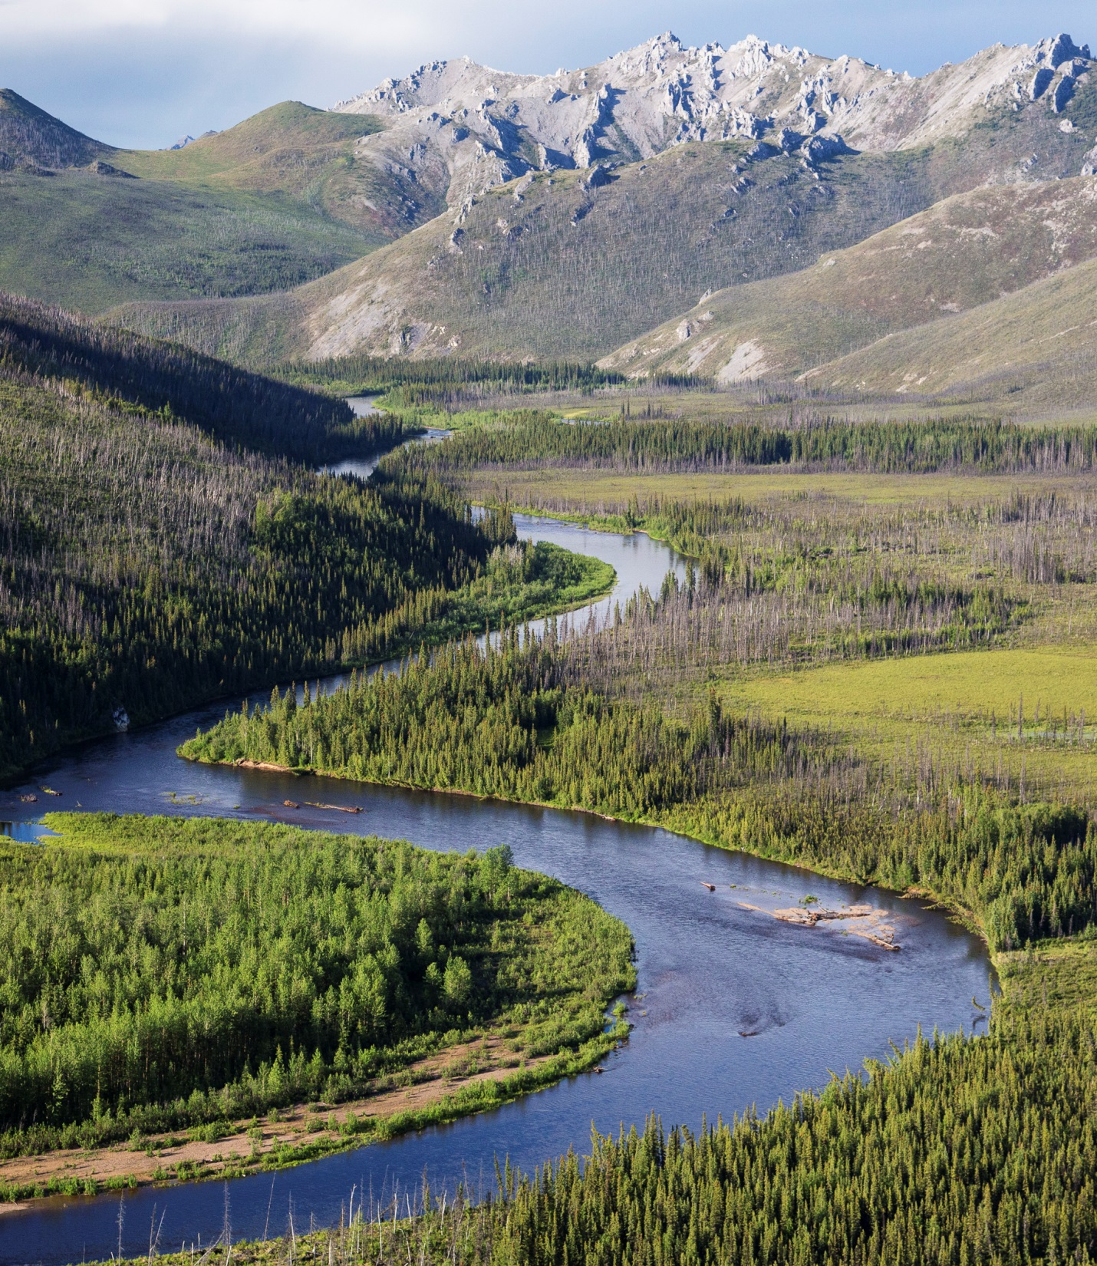
Federal Reserved Water Rights
in Alaska

Slide 25
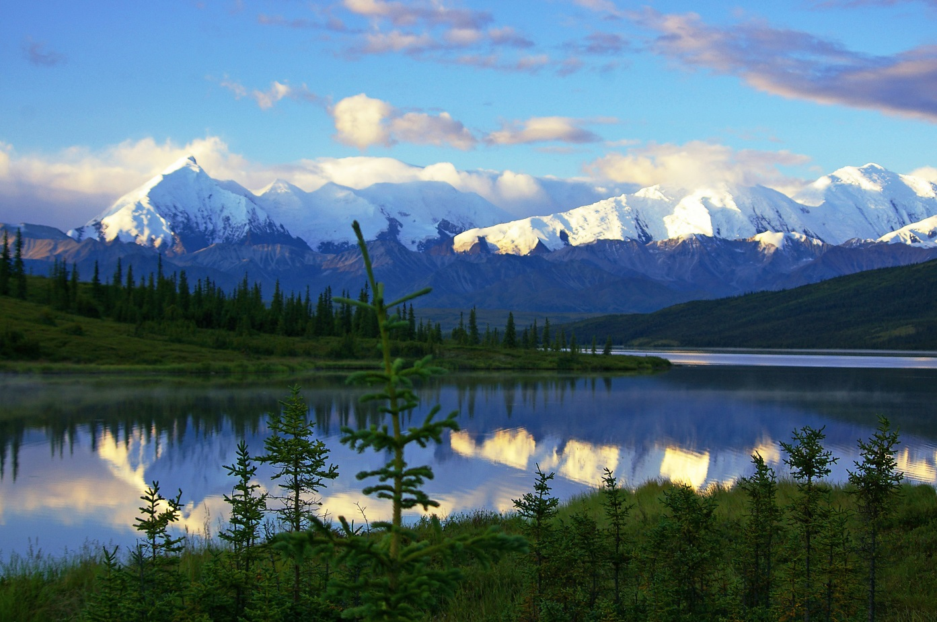
Many Federal Reserved Rights Were Established Before ANILCA
Existing National Forests – Tongass and Chugach
Existing National Parks – Denali, Katmai, Glacier Bay
Existing National Wildlife Refuges – Alaska Maritime, Arctic, Izembek, Kenai, Kodiak, Togiak, Yukon Delta
Wonder Lake, Denali NP

Slide 26
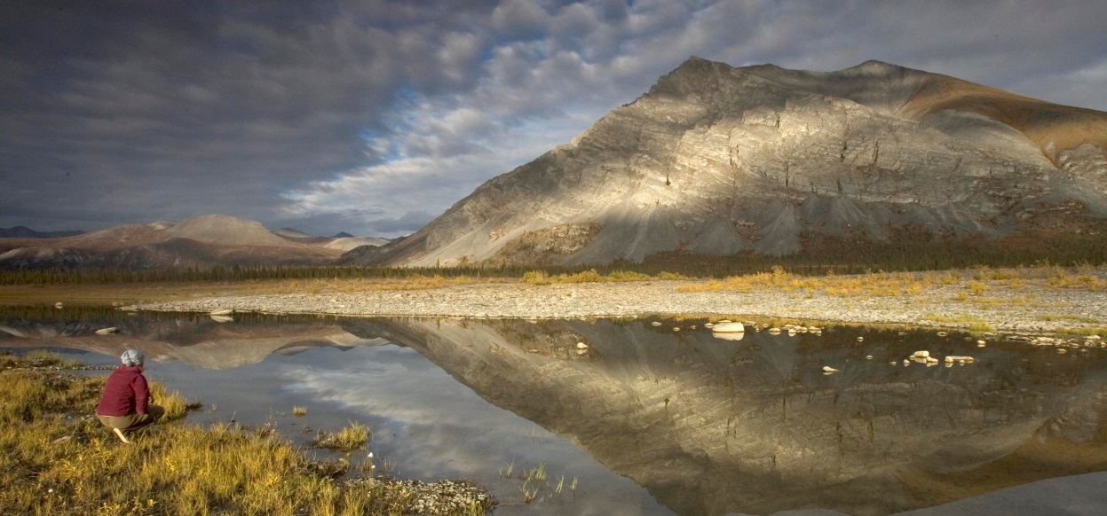
ANILCA Created New Reserved Rights
Arctic NWR
Section 101(d) (Purposes) specifies that Conservation Systems Units (CSUs) are reserved lands
Section 102(4) (Definitions) specifies that CSUs are NPS units, FWS units, Wild & Scenic Rivers, National Trails, Wilderness Areas, and USFS monuments.
Title V specifies that Steese NCA and White Mountains NRA are managed under FLPMA (no reserved rights)

Slide 27
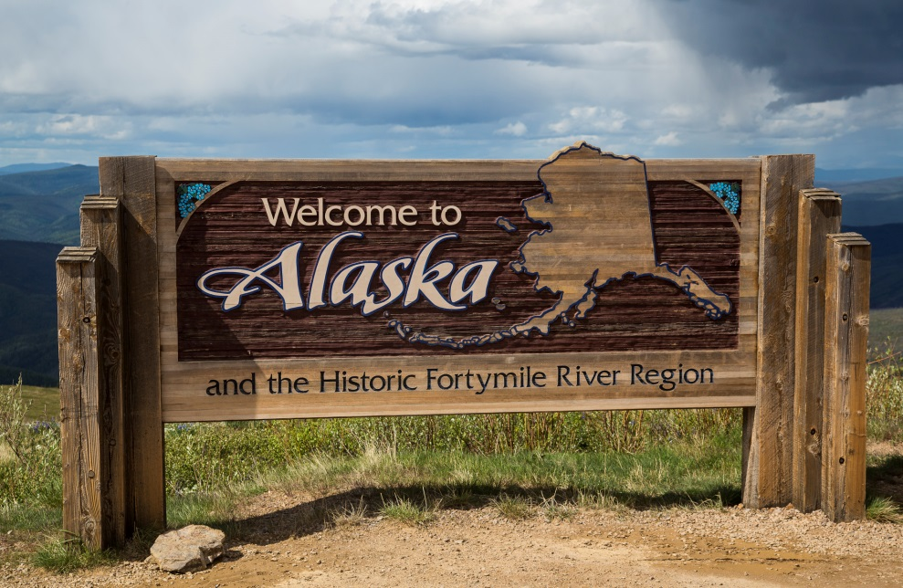
Alaska Statutory Procedures For Adjudicating Federal Reserved Water Rights
Two options:
Conduct a judicial adjudication using the Alaska Superior Court
Conduct an administrative adjudication, run by AK DNR; a special master can be appointed
Federal agencies are required to participate in either process, if served formal notice under the federal McCarran Amendment
Both processes involve notice to water users, submission of claims, investigation of claims, hearings, and final order/decree

Slide 28
How do I protect federal reserved water rights before an adjudication occurs?
Three steps (more on these in later modules):
Conduct studies to determine the likely location, amount, and timing of your reserved right
Carefully monitor public notices of water right applications in your watersheds
File a comment or protest letter with AK DNR if you believe the application would injure the reserved water right
Watch what’s happening!

Slide 29
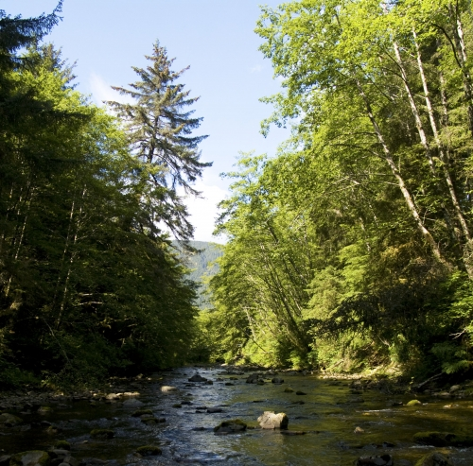
Reserved Water Rights Case Study in AK: Indian River and Sitka NHP
Park established in 1890 to preserve battle site between Russian settlers and Alaska Natives
Located along mouth of Indian River
Other users of river water include:
City and Borough of Sitka
Sitka Science Center (Sheldon Jackson College)
Alaska Dept. of Fish & Game
Small domestic users on private lands

Slide 30
Reserved Water Rights Case Study in AK: Indian River and Sitka NHP
1984: DNR decides to initiate basin-wide adjudication; completes hydrology report
1985: DNR IDs water users and landowners
1987: NPS willing to enter negotiations if result is binding on all water users; NPS completes quantification reports

Slide 31
Reserved Water Rights Case Study in AK: Indian River and Sitka NHP
1988: DNR asks ADF&G to complete instream flow analysis for state reservation of water
1989: ADF&G files reservation of water application
1990: DNR grants certificate for reservation of water
1990: DNR abandons adjudication effort with change in administration
Now: NPS and others reviewing reservation to ensure all needs met

Slide 32
Reserved Rights in AK: Looking Forward
State of AK Policy: “For DNR to efficiently manage and allocate the state’s water and to adjudicate water rights, it is necessary to have federal reserved water rights in AK inventoried and quantified by the federal land management agencies in cooperation with the State of Alaska.”
General federal land management agency policy: Adjudicate and rely upon federal reserved water rights whenever it is legally, technically, and operationally feasible to do so.

Slide 33
Reserved Rights in AK: Looking Forward
State and federal policy do not prohibit federal agencies from participating in other water right processes that can protect their water uses until an adjudication of federal reserved water rights occurs. These processes might include state-based instream flow reservations, requesting a state engineer to shut down illegal diversions, or reaching operational agreements with water rights owners.
Obtaining protection of federal water uses through processes other than adjudicating federal reserved rights may significantly reduce cost, time, and controversy.

Slide 34
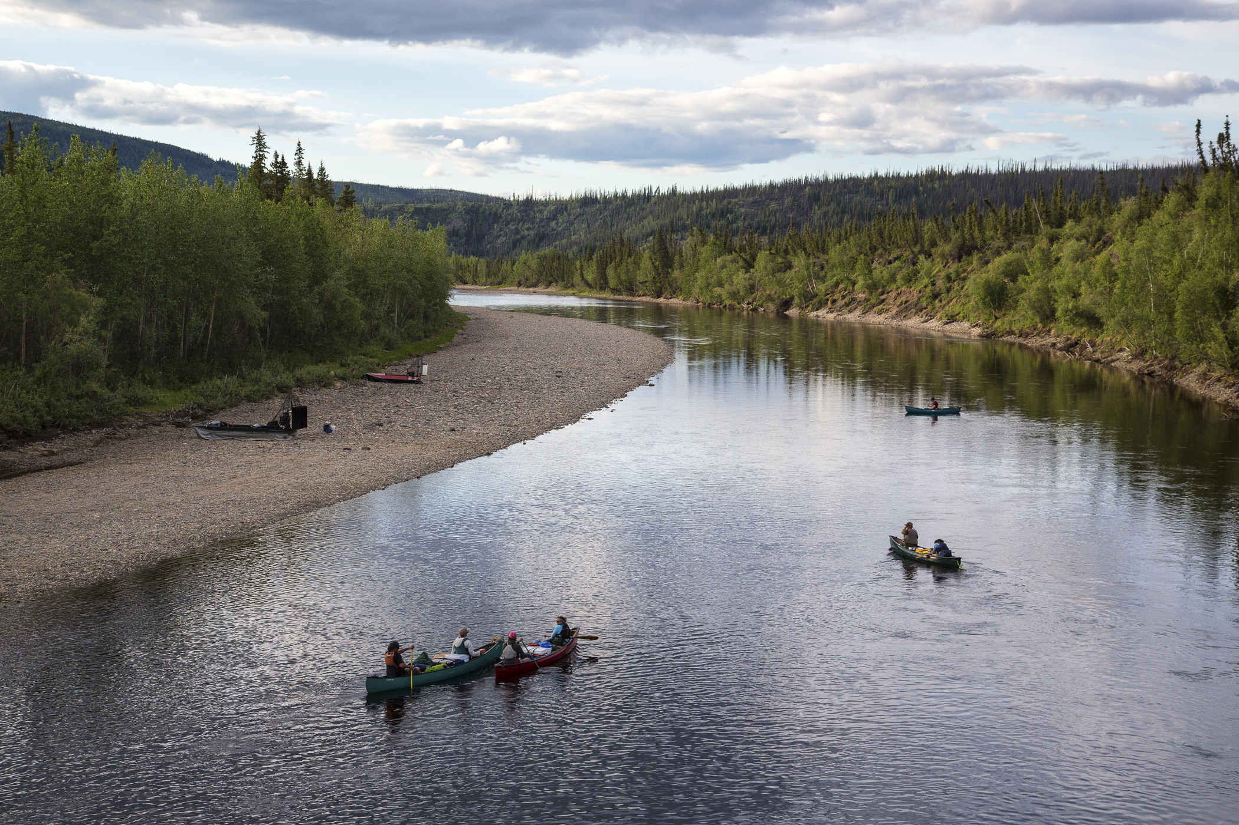
Federal Reserved Water Rights: Questions? Roy Smith, BLM Colorado/Utah
Fortymile Wild and Scenic River, AK

