Slide 1
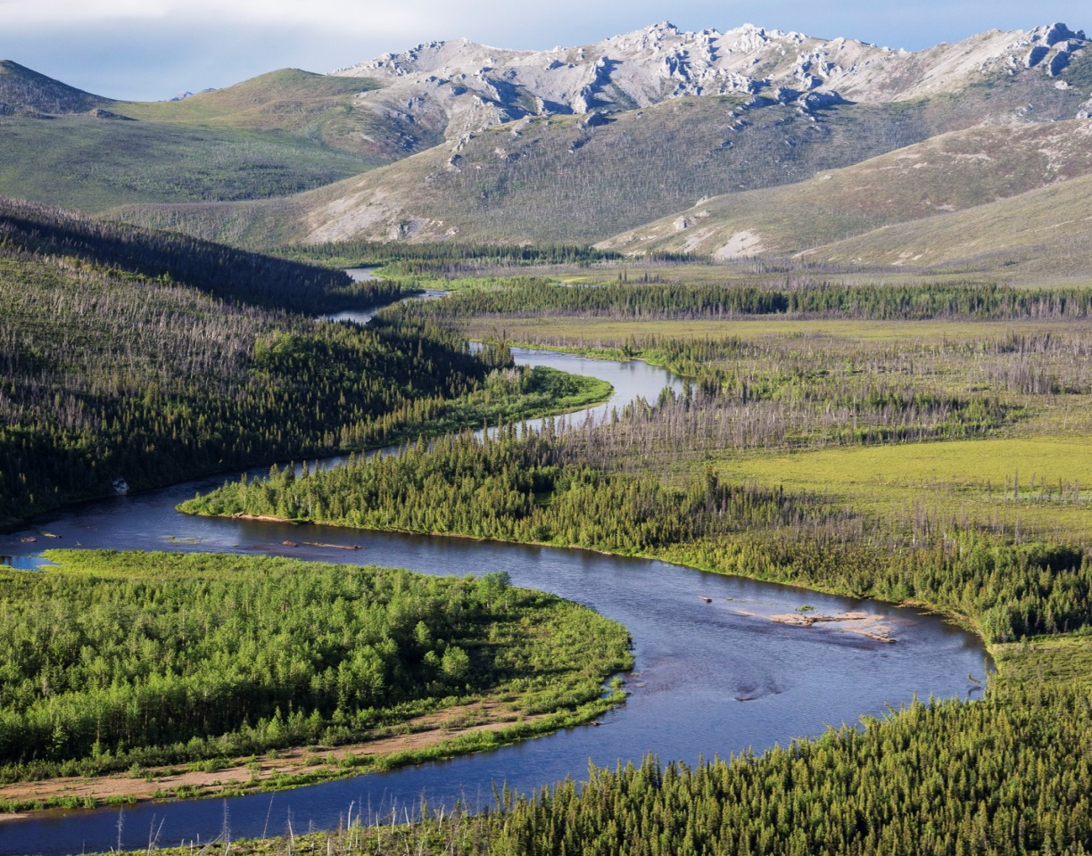
Alaska Water Rights Basic Terms, Concepts & Processes
Lin Fehlmann, Retired BLM Arizona

Slide 2
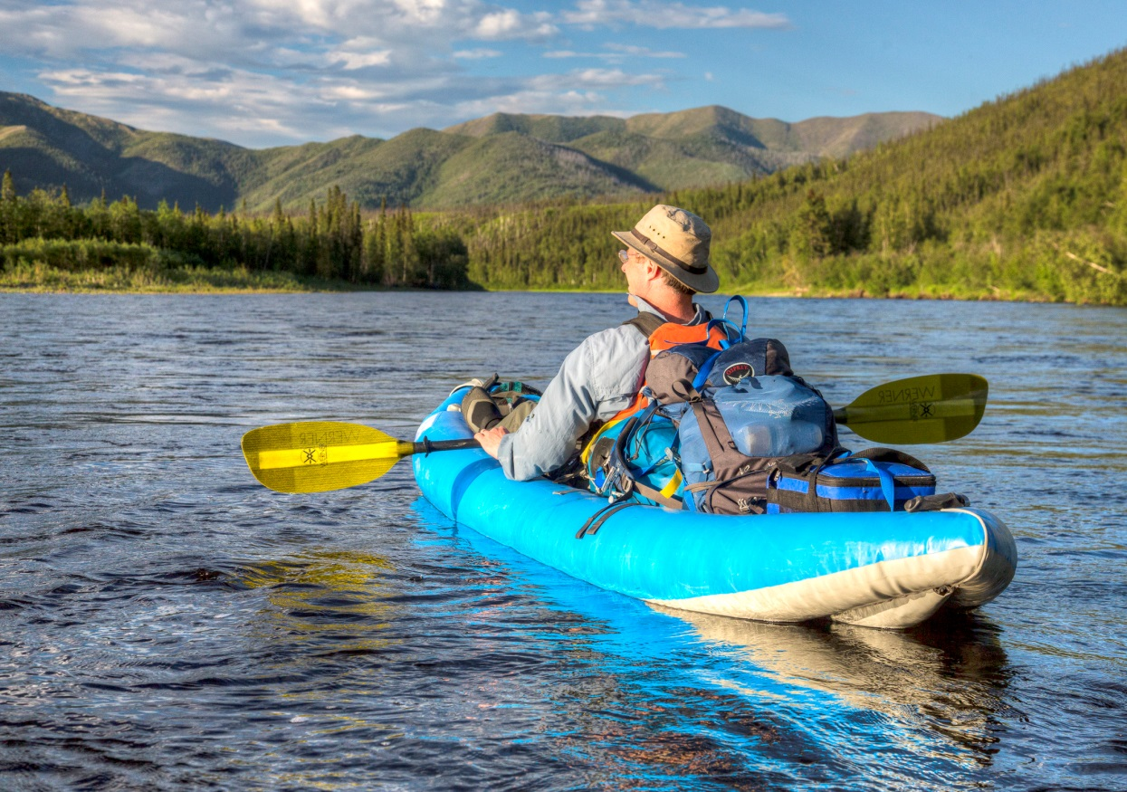
Objective
Given a variety of federal water uses within Alaska, the participant will be able to identify:
Portions of state water law and application procedures that can be used to obtain a water right for a proposed/existing use.

Slide 3
Water Rights in Alaska
What is a Water Right and what does it look like in Alaska?
The Prior Appropriation Doctrine and how it is applied in Alaska
Introduction to Types of Water Rights in Alaska
Introduction to Processes for Obtaining Water Rights in Alaska
Overview of Administration of Existing Rights in Alaska

Slide 4
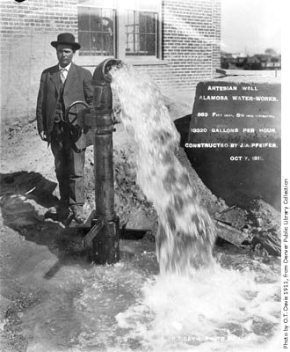
Water Rights Summary
A water right in Alaska is no different than in other Western States in that it:
Is the right to use water
May be lost through nonuse
Is real property – can be bought, sold and transferred, with approval from the Commissioner of DNR
A water right is transferable,
assignable, and must be valued,
inventoried and maintained.
Notes:
A water right is:
A right of use, called a “usufructuary right” – you don’t own the water itself – it belongs to the public – but you can obtain a right to use it.
Can be lost through non-use – “use it or lose it” concept.
Is a type of property right: one main difference between a land right and a water right is that your right is not lost through non-use for land, but it is for water.
According to the Federal Land Transaction Facilitation Act (FLTFA), water rights are considered to be an interest in land.
Is part of the “bundle of rights” that must be addressed in all land tenure actions.

Slide 5
Water Right Right to Use Water
Specific quantity (rate and amount)
Available and unappropriated water
From an identified source
Diverted from a specific location
Used at a specific place
In priority
For a beneficial use recognized by law
During an identified period of time
Without waste
Notes:
Quantity of water: gallons per minute (GPM); gallons per day (GPD), acre-feet per annum (AFA); cubic feet per second (CFS); miner’s inches (old standard varied by state – in AZ, 1 mi = 11.22 GPM; in NV, 40 mi = 1 CFS; in CO, 1 mi = .026 CFS); the GPD quantification is used in Alaska
Source: The water right will specify whether the diversion is from a surface stream, a lake/pond, a spring, or groundwater from a specific aquifer.
Location: The water right will provide a legal description for the point of diversion (POD) and place(s) of use (POU).
Priority date: A priority date is assigned to a water right, based upon when the beneficial use began (vested water right) or when the water right application was filed (new water rights).
Recognized beneficial uses are usually listed in state water statutes.
Period of use: The water right defines the annual dates of use; for example, year-round use (domestic) or seasonal use (irrigation).
Water is to be used for a beneficial use, without waste. “Waste” is the amount of water in excess of the minimum needed to support the beneficial use authorized on the water right. Waste is not well-defined by statute or rule, is often overlooked and is rarely enforced.

Slide 6
A Water Right State Law Provisions
Water is property of the State:
Alaska Statute 46.15.010 – Determination of Water Rights
The Department of Natural Resources shall determine and adjudicate rights in the water of the state, and in its appropriation and distribution.
Alaska Statute 46.15.030 – Water Reserved to the People
Wherever occurring in a natural state, the water is reserved to the people for common use and is subject to appropriation and beneficial use and to reservation of instream flows and levels of water…

Slide 7
A Water Right State Law Provisions
State determines:
How water right can be obtained
Steps required to obtain water right
What uses of water are “beneficial”
What can be done once water right is obtained
How ground & surface water will be integrated
Regulation of water rights & water use is prescribed by state statute, regulation and policy
Notes:
For Alaska:
How a water right can be obtained: AS 46.15.040-133, 145 and 155
Beneficial uses of water: AS 46.15.260 (3)
What can be done with a water right once it is obtained:
AS 46.15.140 – Abandonment, forfeiture and reversion
AS 46.15.160 – Transfer and Change of Appropriation
AS 46.15.165 – Administrative Adjudication
AS 46.15.166 – Judicial Adjudication
Alaska Statutes Chapter 46.15 – Water Use Act
Alaska Administrative Code Title 11 – Natural Resources; Chapter 93 – Water Management [11 AAC 93]

Slide 8
Water Rights in Alaska
What is a Water Right and what does it look like in Alaska?
The Prior Appropriation Doctrine and how it is applied in Alaska
Introduction to Types of Water Rights in Alaska
Introduction to Processes for Obtaining Water Rights in Alaska
Overview of Administration of Existing Rights in Alaska

Slide 9
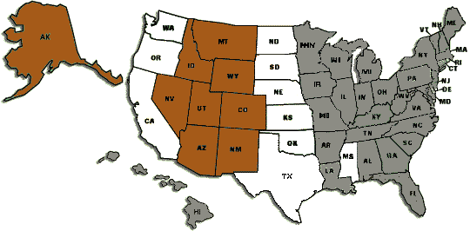
Water Law Doctrines in the U.S.
Grey – Riparian Brown – Prior Appropriation White - Hybrid
Notes:
The Riparian Doctrine is used primarily in the Eastern states; it is based on English law and is suited for areas with an abundance of water and a wetter climate. It is a shared use system where water use is based on land ownership appurtenant to a water body.
The Prior Appropriation Doctrine was developed to allocate water use in the Western (drier) states. It is based on a priority system of “first in time, first in right”. Alaska follows the prior appropriation system which provides more certainty for water users in a state that is still in its early stages of water development.
Some states use a Hybrid System, which contains qualities of both the Riparian and Appropriation Doctrines – examples are CA, OR and WA. These states began using the riparian system but evolved into using the prior appropriation system.

Slide 10
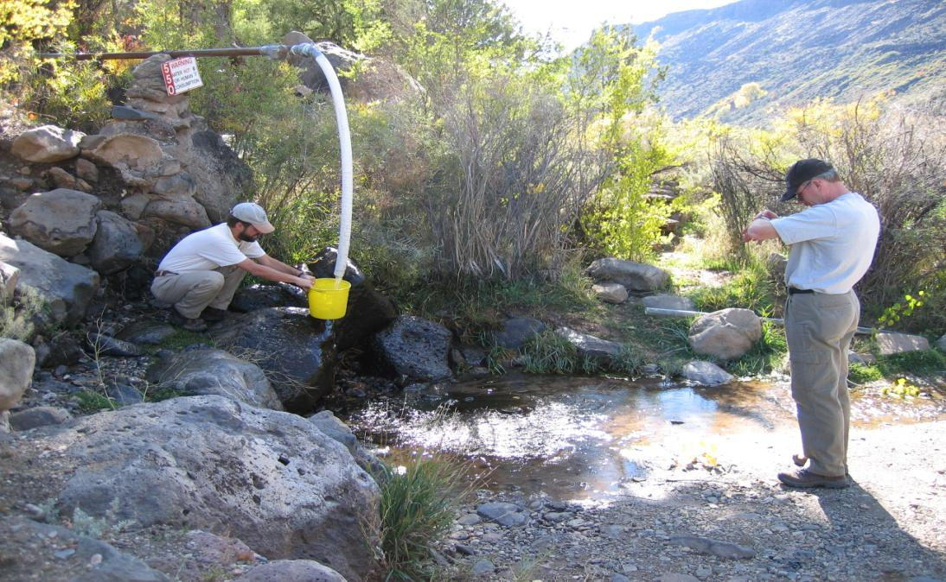
Prior Appropriation System Obtaining Water Rights – Permit or Decree?
Notes:
Most Western states use a permit system to obtain water rights (e.g., AK, AZ, CA, ID, MT, NM, NV, OR, ND, SD, UT, WA and WY).
In Alaska, water rights are administered by the Department of Natural Resources (DNR).
In Colorado, water rights are obtained in water court via a decree.

Slide 11
Prior Appropriation System Alaska / Western States
No shared use of water
“First in time is first in right”
Every water right has a priority date Earlier > senior or Later > junior
Earliest - entitled to water when supply is limited
Right to use - independent from stream ownership
*Focus - physical diversion & water removal from streams
Water must be used – nonuse can lead to forfeiture or loss of the water right
Notes:
* The majority of the states that follow the prior appropriation doctrine have statutes that allow for leaving water in the streams. Due to the relative abundance of water, Alaska has perhaps the most “progressive” statutes that allow for reservations of water to be left in the streams (instream flows) and in lakes (lake “levels”).

Slide 12
Prior Appropriation System Example – 1st in Time, 1st in Right

Slide 13
Appropriative Water Right Elements
INTENT to apply water to a beneficial use.
DIVERSION of the water from a natural stream.
An application of the water to a BENEFICIAL USE within a reasonable time.
Assigned a PRIORITY DATE.
Notes:
Intent to use: In the early settlement of the West, notice was given by “posting a notice” at the site where the water was going to be used and then recording the notice at the local land office; for example, in Alaska, after 1966, intent is shown by filing an application for a water right.
Diversion: Water must be diverted from a stream/spring or captured by a storage facility or pumped. Some states, such as Oregon and New Mexico, require a physical diversion; in others (Arizona, Colorado and Alaska), direct consumption by livestock & wildlife at an undeveloped spring is considered a diversion.
Beneficial Use: Use of water is the most important element of a water right; state law defines what constitutes a “beneficial” use. In Alaska, if there is competition between two applications, preference in issuing a permit will be given to a public water supply use.
Administration of Priorities: For water rights awarded via permit, the priority date is typically the date notice was filed or the application was made. For vested or “grandfathered” water rights, the priority date is the date when the user can prove the water was first placed to beneficial use.
Administration of Priorities in Alaska: Due to ample water supply, there are few instances where priorities have to be actively managed. However, this is likely to change as Alaska becomes more developed and if climate change reduces the available water supply.

Slide 14
Water Rights in Alaska
What is a Water Right and what does it look like in Alaska?
The Prior Appropriation Doctrine and how it is applied in Alaska
Introduction to Types of Water Rights in Alaska
Introduction to Processes for Obtaining Water Rights in Alaska
Overview of Administration of Existing Rights in Alaska

Slide 15
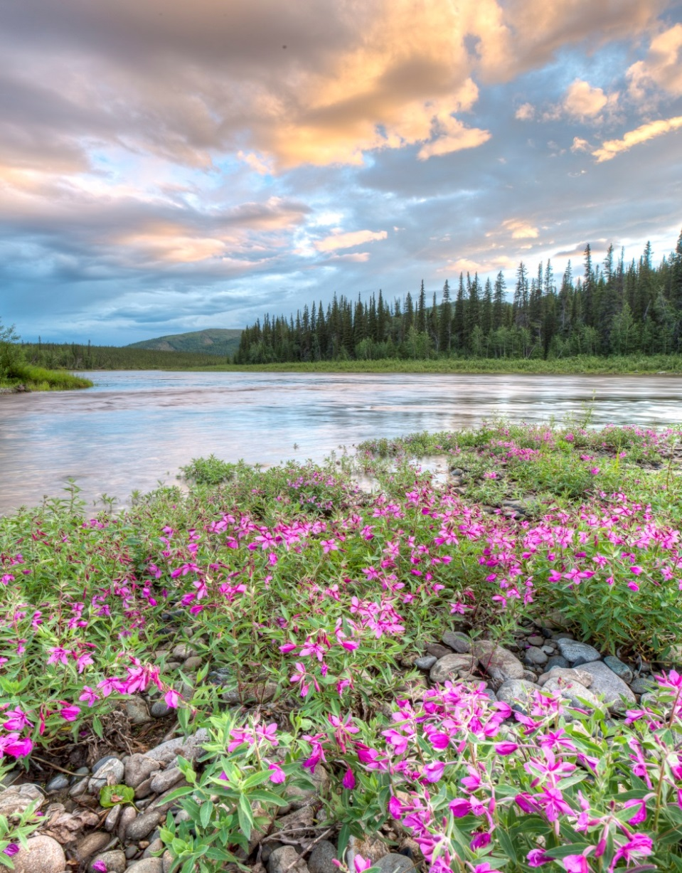
Consumptive v. Non-consumptive Water Rights
Consumptive “Out-of-Source” Uses
(e.g. irrigation, agricultural, domestic, industrial, mining, fish & shellfish processing, manufacturing, public purposes, sanitary)
Non-consumptive “Instream” Uses
(e.g. fisheries, recreation, wildlife, navigation & transportation, power, maintenance of water quality)
Alaska: Allows for instream flow water rights (called “reservations of water”)

Slide 16
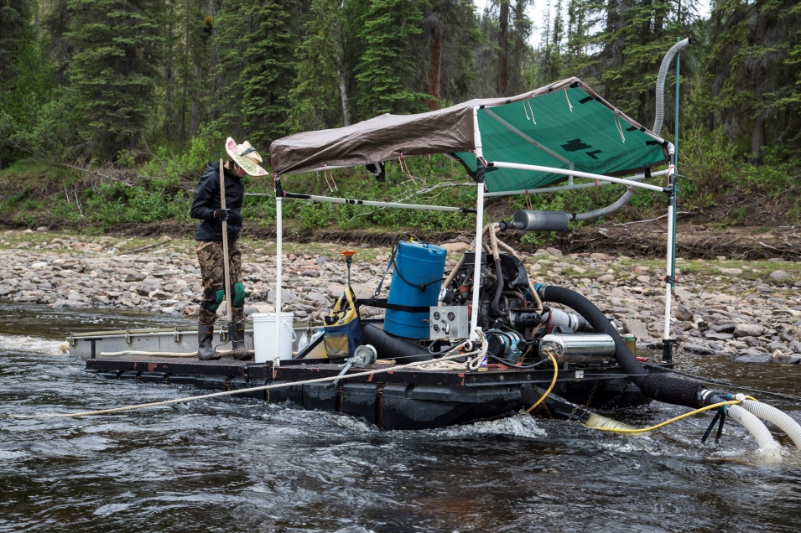
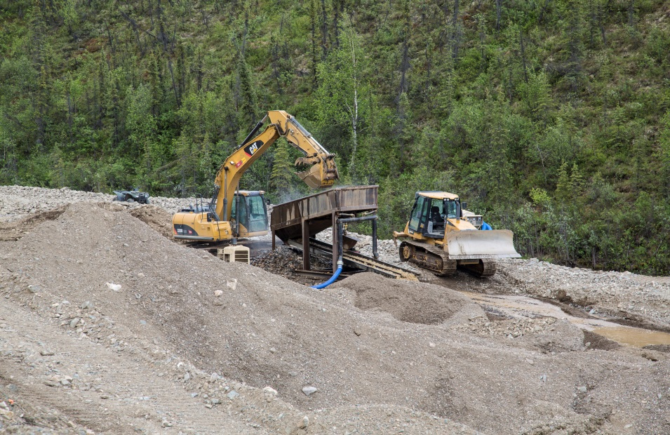
Surface Water Rights
What is a surface water right?
Right to use water from springs, lakes, rivers, & streams
What are types of surface water rights?
DIRECT FLOW RIGHTS & STORAGE RIGHTS
How do Storage & Direct Flow rights relate?
Integrated
Neither is given preference

Slide 17
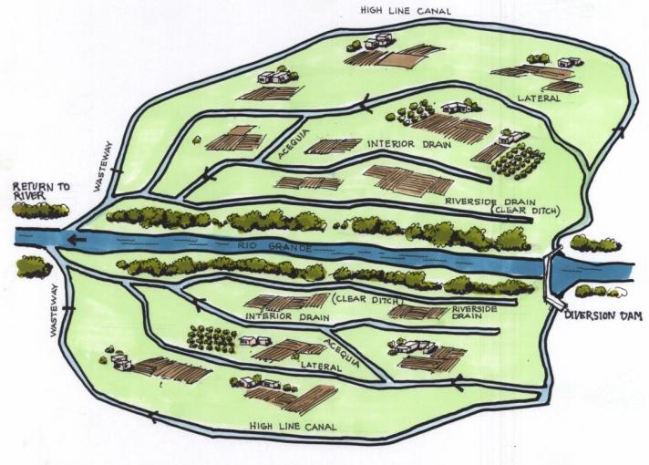
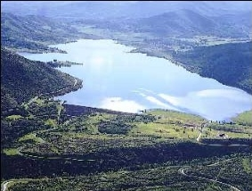
Surface Water Rights Types
STORAGE WATER RIGHTS
Impoundment of the source for subsequent use (e.g., dam on river, lake). Right to use stored water for any beneficial purpose.
DIRECT FLOW
Diversion/withdrawal from the source.
Notes:
Direct flow rights and storage rights are often used to satisfy the same beneficial use. Typically, direct flow rights are exercised during periods of abundant stream flow and then water from storage is used during a period of low stream flow. Irrigation rights, which need a highly reliable supply of water from week to week during the growing season, often implement this approach.
Once water is diverted in priority into a storage facility, the owner can use the stored water at any time. The owner has complete control of the stored water regardless of the priority in effect on the stream system at the time the water is released from storage.

Slide 18
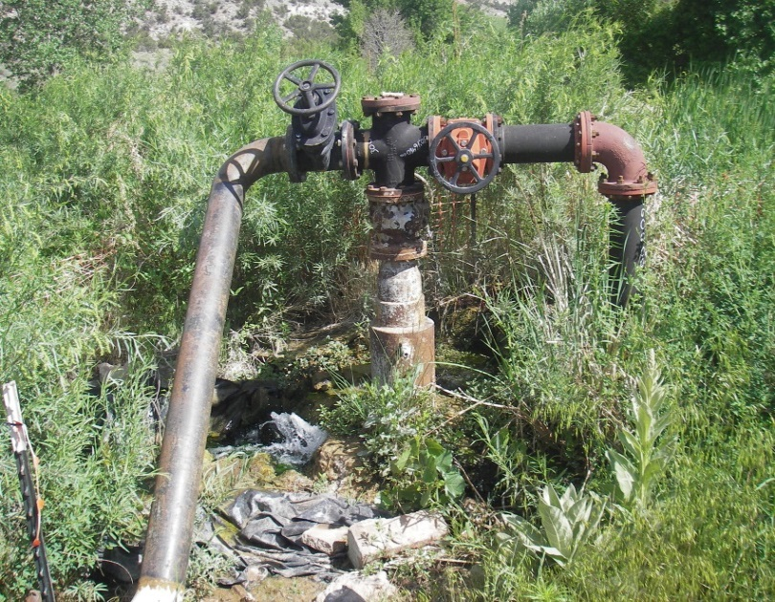
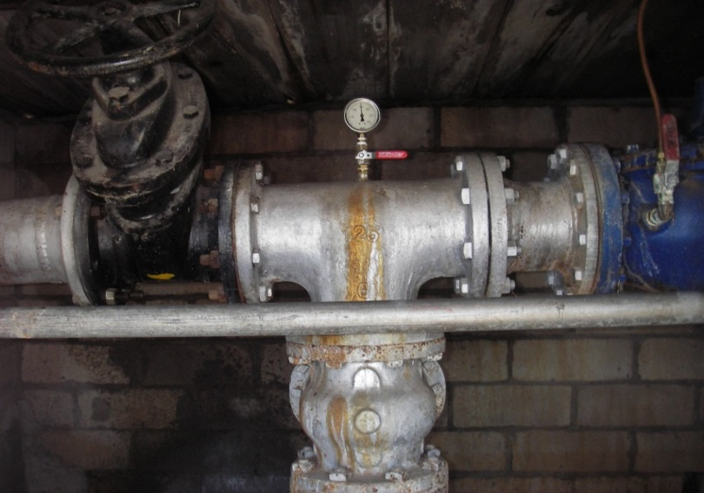
Ground Water Rights
In general, states regulate ground water via:
Statutory regulation: Controls amounts, uses, & locations that can be authorized. Distinguishes between exempt & non exempt uses.
Permit requirements: Controls well construction & operation (e.g., drilling depths, aquifers tapped, pumping rates, metering, etc.)
Notes:
States that rely upon a permit system: A separate application must be secured to acquire a ground water right for a beneficial use, and groundwater is allocated based upon the prior appropriation system.
Prior appropriation: A priority date is established when a ground water right is sought and reasonable pumping levels are set in all or parts of the state.
Exempt uses: In Alaska, a ground water right is not required if the use is for not more than 5,000 gallons per day for one day from a single source OR if the use is for not more than 500 gallons per day from a single source for more than 10 days/ year.
Well construction permits: Most states require a permit to drill a well in order to prevent well-to-well interference and to protect aquifers from poor well construction techniques. This permit does NOT convey a water right.
Alaska does not have a separate well construction permit. An approved “Application for a Water Right” serves as authorization to drill a well.
Well metering: Well meters are generally required for large commercial wells (>30,000 GPD) but not for small domestic wells.

Slide 19
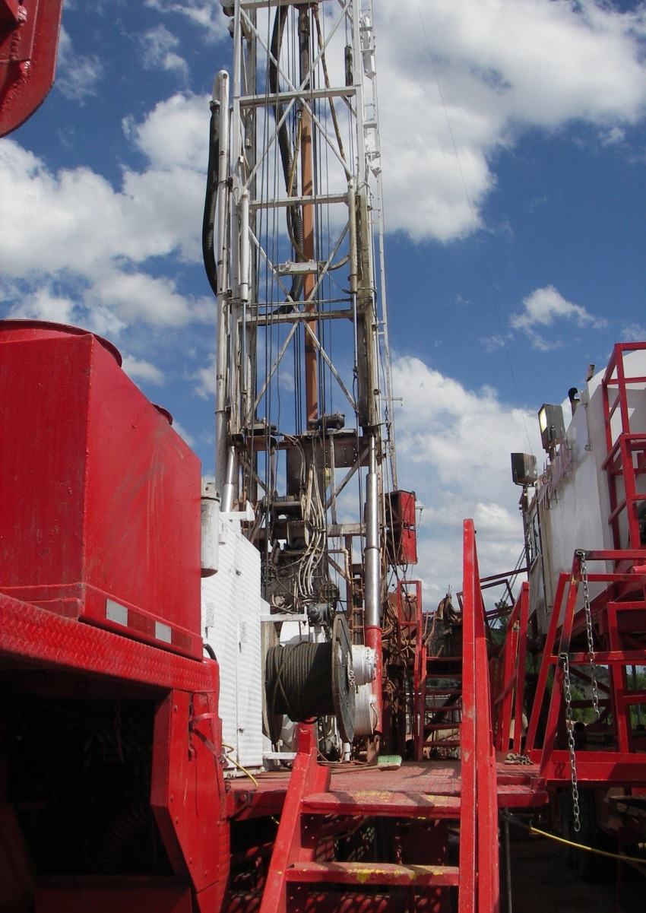
Ground Water Rights
Many states regulate ground water via:
Conjunctive management : Aquifers & surface streams are managed together as one hydrologic resource; Alaska currently manages aquifers & surface sources separately
Controlled / critical / designated areas: Place additional restrictions on use & measurement to maintain aquifer conditions
Notes:
Most western states use prior appropriation of groundwater PLUS establishment of controlled/critical/designated areas.
Prior appropriation: A priority date is established when a ground water right is sought . After the priority is established, it is administered along with the priority date for all other groundwater and surface water rights. When states recognize that surface water and groundwater are one connected system and integrate the priorities of groundwater rights and surface water rights, it is called “conjunctive use.” Alaska currently manages aquifers and surface sources separately.
Most states have designated regions where there is a serious threat of overdraft – called critical or designated groundwater basins, controlled groundwater management or active management areas, or priority basins. Intensive management of the groundwater resource is required and restrictions may limit the quantity of water withdrawn, type of use allowed and require metering devices or submittal of yearly use records.
Alaska has “critical ground water areas”. DNR has only formally designated these areas a few times – in the Juneau area for saltwater intrusions and in the St. Paul area for ground water contamination. More areas may be designated in the future as ground water usage increases.

Slide 20
Instream Use Water Rights
Fortymile River

Slide 21
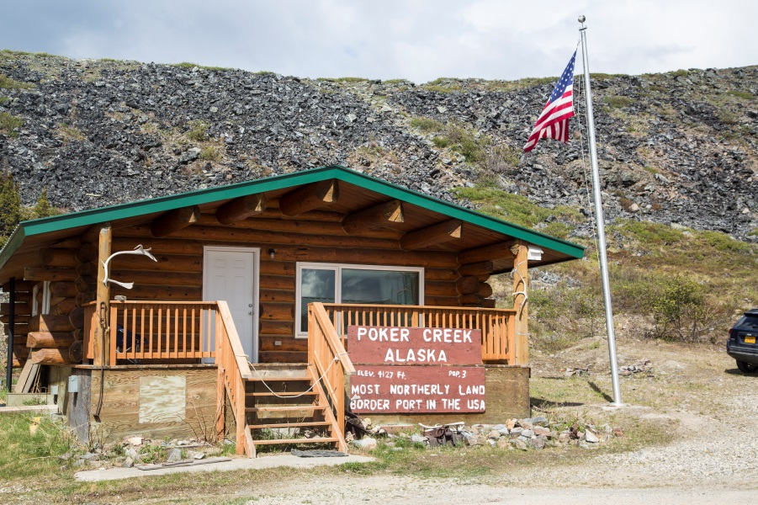
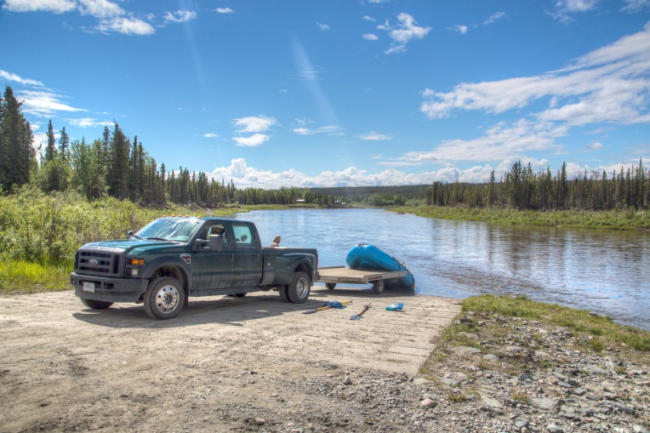
Traditional versus Instream Use Water Right
Traditional
Usually removes water from stream
Uses usually occur outside stream channel
Use could occur in stream (e.g. hydrokinetic)
Instream Use
Leave water in stream
Uses occur in stream
and/or
Resource values are dependent upon stream or lake level

Slide 22
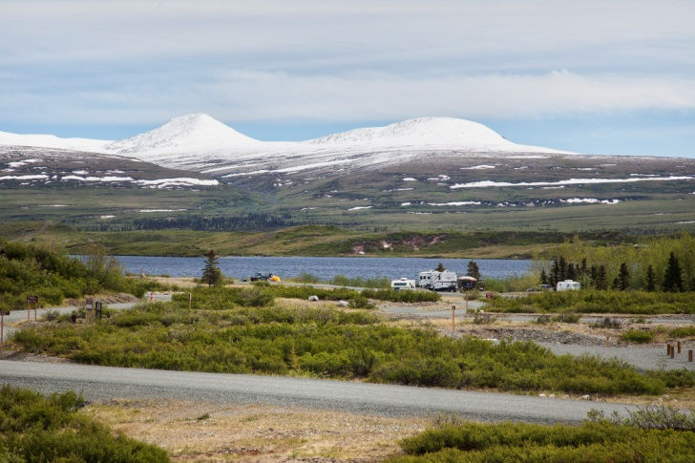
Alaska: Reservation of Water
In Alaska, an instream use water right is called a “reservation of water”. It sets aside water necessary to protect water uses in rivers and lakes.
Beneficial uses of reservations of water under state law can be used for:
Protection of fish and wildlife habitat, migration and propagation
Recreation and parks
Navigation and transportation
Sanitary and water quality

Slide 23
Water Rights in Alaska
What is a Water Right and what does it look like in Alaska?
The Prior Appropriation Doctrine and how it is applied in Alaska
Introduction to Types of Water Rights in Alaska
Introduction to Processes for Obtaining Water Rights in Alaska
Overview of Administration of Existing Rights in Alaska

Slide 24
How Do I Obtain A Water Right In Alaska?

Slide 25
Obtaining Water Rights “Vested” Water Rights
Historic use that continues to present day
Use began before state water code passed
Use restricted to water amount historically diverted & used
Typically claimed in adjudications, where right is confirmed or challenged
In AK, claims for “vested or existing” rights were filed as “declarations of appropriation” with DNR. These claims were extinguished unless filed by specific dates in 1967 and 1968.
Notes:
Vested rights are water uses established prior to the establishment of a state’s water code that set forth permit and adjudication processes. In Alaska, vested rights are called “existing” or “grandfathered” rights.
Notification and confirmation of vested uses varies by state. Typically, owners of vested rights are required to submit claims in an adjudication. In the adjudication, the state’s water right agency will confirm that the amount claimed is needed for the claimed uses and has been diverted continuously since the usage began. The state water agency may also require the water user to furnish proof of the date that water usage began. If a vested right is located in a basin that has never been adjudicated and is not actively administered, there may be few or no formal paperwork records to verify the amount and priority of the vested water right.
One of the purposes of adjudications is to integrate vested rights with rights more recently awarded via the permit system.

Slide 26
Establishing Vested Water Rights
USING Historic & Continuous Use
(latest date that can be claimed for start of usage)
Prior Appropriation State | Surface Water | Groundwater
Alaska | 1966 | 1966
Arizona | 1919 (1995) | Not Applicable
California | 1914 | Not Applicable
Colorado | 1969 | 1972
Idaho | 1971 | 1963
Montana | 1973 | 1961
Nevada | 1913 | 1939
New Mexico | 1907 | 1931
North Dakota | *No vested date | Not Applicable
Oregon | 1909 | 1955
South Dakota | 1955 | 1978
Utah | 1903 | 1935
Washington | 1917 | 1945
Wyoming | 1890 | 1945
Notes:
The public water code in Alaska was established on July 1, 1966, known as the Alaska Water Use Act. Prior to this date, a person acquired a water right by simply putting the water to beneficial use or posting a notice at the point of diversion.
After July 1, 1966, a water right was obtained by filing an Application for Water Right with the Department of Natural Resources (DNR).
Under 11 AAC 93.20, persons claiming existing or “vested” rights were given a period of time (between March, 1967 to April, 1968) to file “declarations of appropriation” with DNR, where they were validated and issued Certificates.
*Note: Formation of North Dakota’s State Engineer’s Office occurred in 1905; both riparian and prior appropriation rights were administered from 1905 until 1963, when the Prior Appropriation Doctrine was used exclusively. Also in 1963, a law was passed creating a registration of existing prescriptive rights (including documentation of riparian rights).

Slide 27
Obtaining Water Rights Permits Authorize Proposed New Uses
Permit application will generally be approved if:
Applicant follows prescribed procedures & the proposed use is beneficial;
State authority determines that there is unappropriated water available;
The proposed means of diversion or construction are adequate;
The proposed appropriation is in the public interest;
AND
Appropriation does not harm the public welfare or senior water rights.

Slide 28
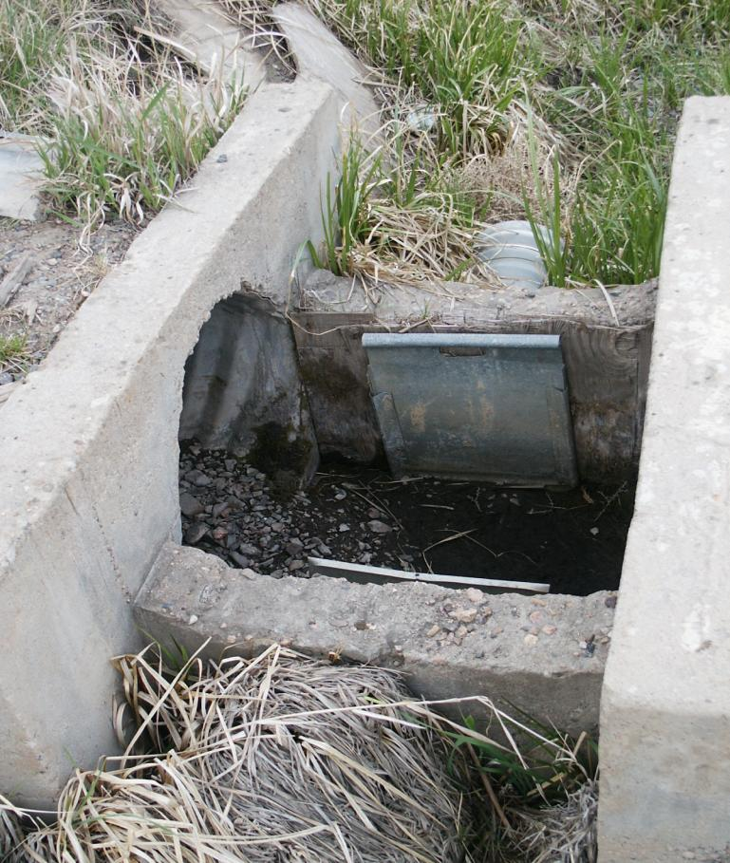
Permit Process
Major Steps:
File an application
Post a notice
Permit is issued with terms & conditions
User submits proof of completion
Certificate or license is issued

Slide 29
Permit Process
Application priority date assigned
(exemptions)
Notice Protest ?
No Yes
hearing/contested case
Permit issued protest resolved
Proof submitted Certificate issued
Notes:
File an application with the state water agency, describing the water use and the proposed water development.
A priority date is established by the date an application is accepted by the state water agency.
In most states, the application is published or noticed in the local paper, and on a state internet site.
In Alaska, new applications are posted on DNR’s website and at the nearest post office, published in a local newspaper, and/or sent to appropriators DNR feels might be affected.
Interested parties are allowed to protest the permit application in a state administrative process. In Alaska, protests can be made within 15 days of publication of the notice.
If protests are received, a public hearing may be held to gather further information and evidence.
If no protests are received or protests are resolved, a permit is issued with terms and conditions, and development may begin.
Exemptions. Some states (e.g., OR,WA) exempt certain small uses of water, such as for stockwatering, wildlife or small domestic uses, from the permitting process (do not require a water right). For AK: no water right is needed for consumptive use of not more than 5,000 GPD from a single source for a single day; not more than 500 GPD from a single source for more than 10 days/year; or not more than 30,000 GPD non-consumptive use from a single source,

Slide 30
Proof of Completion – Beneficial Use
Notes:
Proof of completion forms are submitted to the state once development has been constructed (shows diversion is made) and water put to its intended beneficial use.
For Alaska: a “Statement of Beneficial Use of Water” form is submitted to DNR.
A licensed engineer or surveyor is not needed to complete a Statement of Beneficial Use form.

Slide 31
Perfected Water Right (First Page)
Notes:
A certificate or license is issued once the proof has been received that water is being beneficially used consistent with the terms of the permit. The right is now considered “perfected”.
A perfected right in Alaska is called a certificate of appropriation.
Instream flow reservation applications are processed using the same general process, with the exception that there is an additional ten-year review of each certificate (to determine if it should be revoked or modified). There is no intervening permit to appropriate water that is issued before a certificate of reservation is issued.

Slide 32
Perfected Water Right (Second Page)

Slide 33
Permit Process Changes & Amendments
Most states allow short-term & long- term changes to existing water rights if:
There is no injury to existing senior or junior water rights, including vested rights
There is no expansion of historic use
The right to be changed is not subject to forfeiture or abandonment
The procedure to change an existing permit or certificate is similar to making an application for a new water right
Notes:
Most states allow short- or long-term changes where certain portions of an existing water right can be changed if there is no injury to other water users or no expanded use.
Under 11 AAC 93.930, the procedure in Alaska to change an aspect of an existing permit or certificate is similar to that of filing a new application (notice, protest, revised permit and/or certificate).
However, there is NO form to change an aspect of an existing permit or certificate. A letter should be submitted to DNR with the requested change.
DNR will either deny the change or grant it by amending the permit/certificate or issuing an intermediate change permit.

Slide 34
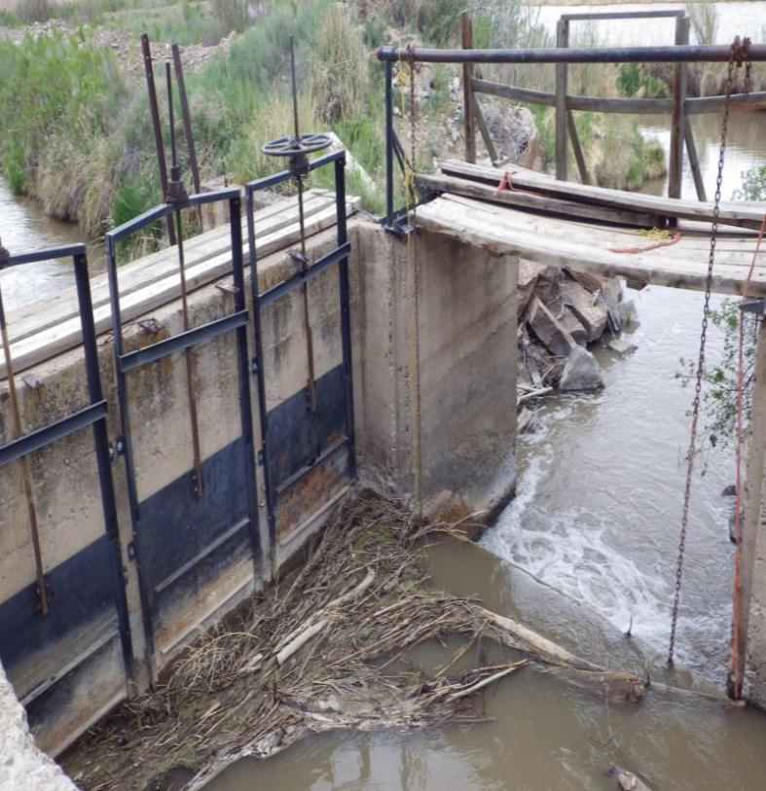
Permitting Process Changes
Water rights elements that can be changed:
Point of diversion
Means of diversion
Place of use
Type of use
Time of use (expanding seasonal use is not allowed in AK)

Slide 35
Unique Alaska Process: Temporary Water Use Authorization (TWUA)
A short-term, revocable use of a significant amount of water (for up to 5 consecutive years, including one extension)
File an “Application for Temporary Use of Water” form
A TWUA is exempt from the public notice process but DNR does notify ADF&G and ADEC
A TWUA does not establish and water right and there is no priority date
A TWUA is good for a maximum of 5 water sources
A TWUA is issued only for water not already appropriated
For mining, a TWUA is generally issued for exploration and mine construction. A water right should be applied for mining operations.

Slide 36
Alaska Ground Water Appropriation Process

Slide 37
Appropriation of Groundwater in Alaska
File “Application for Water Right” for ground water
DNR authorizes applicant to drill a well
Conduct research to choose water well contractor
Drill well - driller submits “Water Well Log” within 45 days after completion to DNR – incorporate into WELTS system
DNR issues Permit to Appropriate Water
Permit holder completes “Statement of Beneficial Use” form
DNR issues Certificate for groundwater use
OR
Applicant files for a TWUA to drill a well & then files for the “Application for Water Right”
Notes:
To drill a new water well in Alaska:
Submit an “Application for Water Right” with DNR
DNR will issue permit for the applicant to drill a new well.
Alaska does not have a specific process for general water well contractors to be “certified” in well construction. It is up to the well owner to research contractors.
National Ground Water Association (NGWA) has a list of certified NGWA well contractors.
Alaska Water Well Associates (AWWA) also has a list of Alaska professional water well contractors.
Once the well has been drilled, the contractor must submit the “Water Well Log” form within 45 days after completion to both the well owner and DNR (to be incorporated into the WELTS system).
Submit a completed “Statement of Beneficial Use of Water” form to DNR
Receive a Certificate of Appropriation for ground water use

Slide 38
Appropriation of Groundwater in Alaska
To deepen, modify or abandon a water well OR to drill a monitoring, observation or aquifer testing well
Submit “Water Well Log” to DNR
To abandon a well, also need to submit “Well Record of Decommissioning” form
Mineral/medicinal water: no appropriation by DNR – mineral water is regulated by Alaska Oil & Gas Conservation Commission; medicinal water is reserved by the Federal Govern-ment under PLO No. 399

Slide 39
Water Rights in Alaska
What is a Water Right and what does it look like in Alaska?
The Prior Appropriation Doctrine and how it is applied in Alaska
Introduction to Types of Water Rights in Alaska
Introduction to Processes for Obtaining Water Rights in Alaska
Overview of Administration of Existing Rights in Alaska

Slide 40
Alaska’s Dam Safety Program

Slide 41
Dam Safety Program
Most Western states have special regulations to manage large reservoirs. In Alaska, large dams are managed by the Dam Safety and Construction Unit (DSCU) of DNR.
To qualify, a dam must:
Impound 50 acre-feet or more AND have a dam height of 10 feet or greater;
Have a dam height of 20 feet or more; or
Threaten lives and property if it failed
These statutes do not apply to federally-owned /operated dams or to hydroelectric dams managed by FERC.

Slide 42
Dam Safety Program
For new dams, an “Application for Certificate of Approval to Construct, Modify, Repair, Remove or Abandon a Dam” is required.
Once the dam is constructed but before it can be put into operation, a “Certificate of Approval to Operate a Dam” is issued after review and approval of a completion report.
To change ownership of a dam, an “Application to Transfer a Certificate of Approval to Operate a Dam” is used.

Slide 43
Forfeiture & Abandonment
Forfeiture of Water Right:
Loss due to holder’s voluntary failure or neglect to use water for a specified time period
Loss due to water right not used for 5 successive years (in Alaska)
Abandonment of Water Right:
Can be voluntarily surrendered or revoked
Rebuttable presumption of abandonment shifts burden to appropriator to prove otherwise
Forfeiture or Abandonment can apply to all types of water rights – surface, groundwater, vested, etc!
Notes:
Forfeiture:
Loss of a water right due to some kind of fault or negligence by the holder is called forfeiture.
Abandonment:
In most states, a water right not used for four or five successive years (when water is available to satisfy the right) is considered to be abandoned. [4 years = New Mexico; 5 years = Alaska, Arizona, California, Nevada, Oregon; 10 years = Colorado]
For a water right to be considered abandoned, it must be voluntarily surrendered or relinquished and the intent to abandon must be proved.
In Alaska, a “Notice of Relinquishment” form is completed by the water rights owner to voluntarily relinquish the water right ; can be used to amend the water right “down” to the amount actually used.
Special Notes:
All state statutes contain some kind of forfeiture or abandonment language.
Intent is very difficult to prove and most states do not actively seek to abandon or forfeit a water right.
In Alaska, DNR sends notification to the water right owner by certified mail who is given 30 days to object and 60 days to submit evidence of rebuttal. If there is no rebuttal, the water is considered forfeited and the unused amount reverts back to the public.

Slide 44
Water Right Assignment/Conveyance/Change of Ownership
There is assumption that all appurtenant water rights automatically transfer with a change in land ownership, unless expressly stated otherwise in deed (except Colorado).
AK Statutes – With DNR approval, all or part of an appropriation can be severed, sold, leased or transferred to other purposes with a certified copy of the transferring deed.

Slide 45
Water Right Assignment/Conveyance/Change of Ownership
All western states have a process to notify the state water agency of changes in ownership of water rights (except Colorado).
In Alaska, DNR requires submission of an “Ownership Transfer” form.
A MUST - Update ownership in order to receive important notices from state.
See Land Tenure module for more information

Slide 46
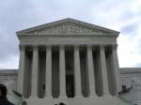
Water Rights Adjudication Process
An administrative or judicial proceeding run by a state government to determine all water rights on a stream system.
Why adjudicate? Resolve uncertainty regarding claims for vested rights by private parties and/or reserved water rights for federal lands.
Establishes and validates the priorities of all water rights in a stream system or watershed
Alaska has both administrative and judicial (McCarran) adjudications

Slide 47
Administrative Water Adjudication Elements
DNR:
Files notice of adjudication to all users within a specific hydrologic unit (river system, groundwater basin, etc.)
May appoint a Master
Gathers data - Hydrographic Survey Report (HSR) & Maps
Enters interlocutory orders
Final Order issued by Commissioner; appeal process
Adjudicated Right:
Holder has certainty of priority & value of water right compared to other rights on stream/watershed

Slide 48
Judicial Water Adjudication Federal Agencies’ Participation
State must formally “join” federal government under the McCarran Amendment
Adjudication must be “comprehensive” (include all water users on the stream system)
Federal claims processed under state procedures, but under applicable federal laws
Alaska: to date no judicial adjudications (where federal reserved rights asserted); all federal rights claimed under state law filed under administrative adjudication process
Notes:
The McCarran Amendment, 43 U.S.C. section 666, is a federal law, created in 1952, that confirms the historic deference of the federal government to the states in water allocation matters, and it specifies procedures for including federal government water rights in state procedures.
States may enact “joinder” against the federal government (the federal government must participate) in an adjudication only if the adjudication is comprehensive and includes all water uses in the stream system.
The federal government waives its sovereign immunity for the purpose of securing federal reserved water rights recognition by the state.
To date, there has been no judicial adjudication in Alaska (where federal reserved rights have been asserted and quantified). All state appropriative rights held by federal agencies have been processed under administrative adjudications.

Slide 49
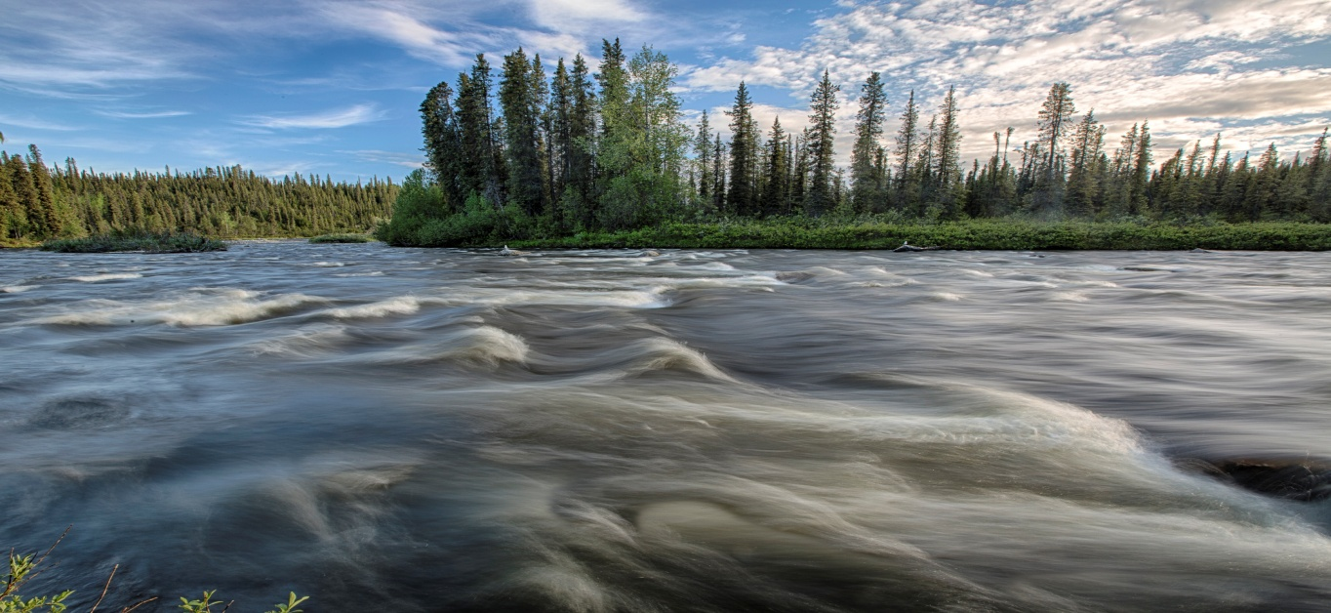
Summary
Water rights established by the federal agencies:
Generally fit the types of water rights issued in Alaska;
Generally fit within the prior appropriation system (have priority dates; are permitted, processed and administered as any other state-based water right; subject to forfeiture/abandonment and safety requirements; can be transferred, etc.)
However…. federal agencies are subject to exceptions to the guiding principle of “follow state law” in the form of a unique federal critter called the
“federal reserved water right”.

Slide 50
Alaska Water Rights Basic Terms, Concepts & Processes Questions?

