Slide 1
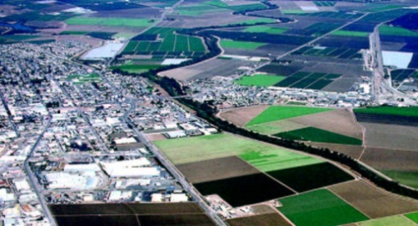
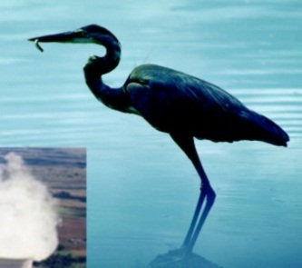
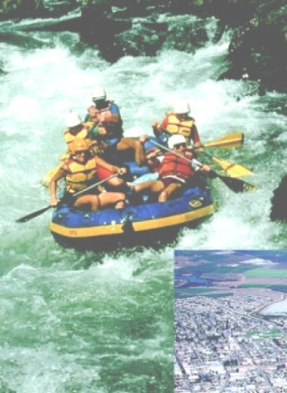


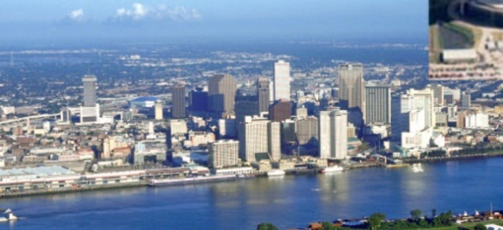


Interstate Council on Water Policy
AFWA Webinar
August 10, 2020
Sue Lowry
Executive Director

Slide 2

ICWP Mission – Enhance the stewardship of the nation’s water resources
Established in 1959 to serve as the national policy voice for the state and interstate water resource managers
Provide a national forum for the evaluation of policy issues and the development of solutions
Support Integrated Water Resource Planning and Management
Provide opportunities to engage federal agencies and Congressional leaders

Slide 3
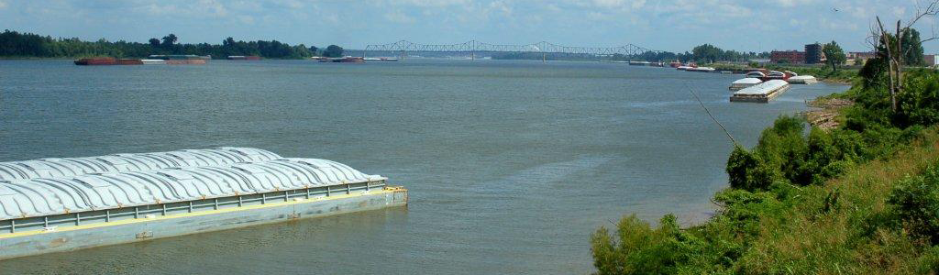
ICWP Members Include:
State Water Management Agencies
Interstate Basin Commissions & Organizations
Regional Water Management entities
Engineering/Planning Consulting Firms
Water Monitoring Equipment Firms
Academic Water Policy &/or Research Centers/Institutes
Full membership list found at https://icwp.org/about/

Slide 4
Four Subject Matter Committees
Water Data and Science
—USGS (NGWOS, NWIS, Water Use Data/Research, 3DEP-NHD+, Streamgage network support)
--NOAA-NWS (Atlas 14, Seasonal to Sub-Seasonal Forecasting, National Water Model)
Water Planning
--US Army Corps of Engineers (Planning Assistance to States, FPMS, Revolutionize Civil Works)
--Forum for State Water Planners to discuss what works and pitfalls to avoid
Interstate Water Management
--Update of 2006 Interstates Report
Legislation and Policy (separate slide)

Slide 5
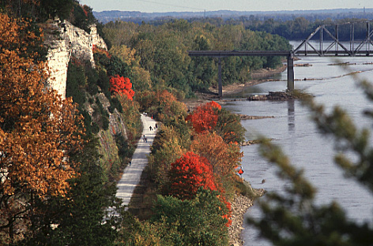
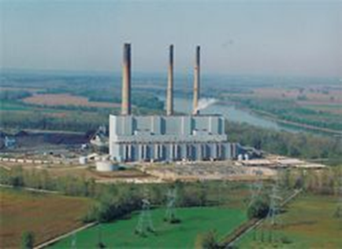
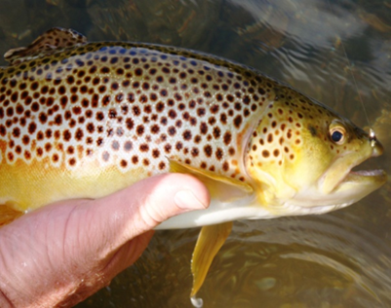


Streamgage Support Letters
ICWP continues to build awareness and demonstrate national support for funding of the national streamgage network
“Backbone” for water data collection & decision making
Needed by private sector, federal agencies, recreationists
ICWP has delivered streamgage support letters to Congress and Interior for 15 years; March 2020 Letter signed by 57 organizations
Repeating this clear message with a unified voice has proven successful

Slide 6
Legislation and Policy Committee
Water Resources Development Act 2020
Comment letters sent to Senate and House
Project Partnership Agreements
PAS In-kind funding discrepancies across programs
WIFIA Infrastructure Funding
3DEP Coalition Supporting Lidar and other Mapping
Resiliency Revolving Fund Act Support
As a small, nimble organization, ICWP can quickly address topics of interest to members

Slide 7
ICWP Events and Membership Dues
Washington DC Roundtable (late March-early April)
Annual Meeting (mid-October—moves around the US)
October 13-15, 2020--Philadelphia
Dues: $5,000 for large states, $3,500 for smaller states and tribes, $1,500 for affiliate members
Affiliate members include Academic Policy and Research Institutes
Many opportunities to “give us a test drive”

Slide 8
Thanks for Your Interest, Please contact me anytime!
Sue Lowry, Executive Director
(307) 630-5804
Sue@icwp.org
www.icwp.org

