Slide 1

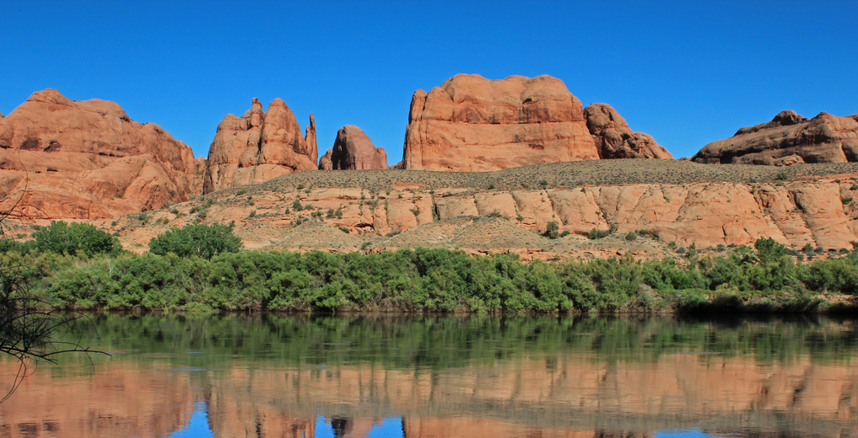
Water Resources Availability Portfolio - updates
Mindi Dalton
WSWC Webinar
May 13, 2020

Slide 2
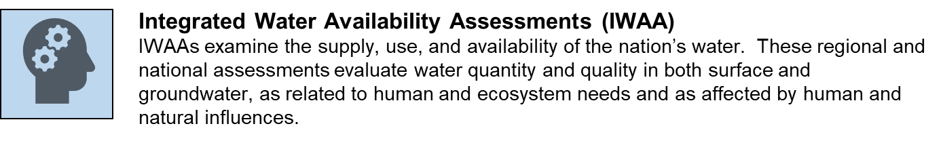
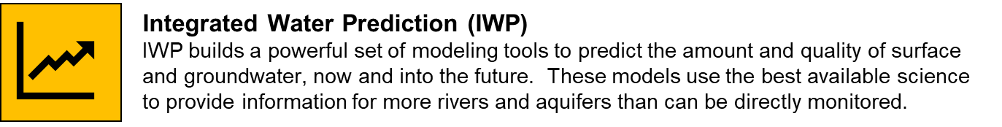
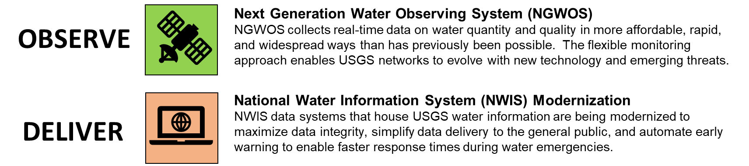
USGS Integrated Water Science Priorities
ASSESS
PREDICT
Notes:
The WRAP portfolio supports 2 of the four priority activities Chad mentioned during his WOSP update, Integrated Water Prediction (IWP) and IWAAs. Along with NGWOS these activities will be carried out in an integrated manner in selected basins. Science Plans will be developed in each basin, following a consistent framework laid out to achieve national goals.

Slide 3
What is Integrated Water Prediction?
IWP will be a National asset supporting the Nation’s earth and biological system prediction capability of system structure, function and evolution over a range of temporal and spatial scales:
USGS science – our observations, process understanding, models, and data delivery system - will be an engine that drives prediction of
Surface and subsurface hydrological processes
Stream temperature
Surficial and relevant landscape processes
Transport, storage, and biogeochemical alteration of constituents
Ecological processes
Notes:
IWP is a national program designed to improve the federal capacity to predict a variety of water availability drivers, including surface and subsurface processes, stream temperature, landscape processes, transport, and ecological processes

Slide 4
Integrated Water Prediction
Community development test bed - systematic framework for developing and testing skill of high performance models to formulate investment framework
Enterprise Capacity – qualitative and quantitative code evaluation for evidence based design and development of new integrated modeling architecture inclusive of social sciences
Observational requirements and data assimilation (ORDA) – facilitates the optimal utilization of currently available data sources and potential future collections to support modeling and other analysis efforts, NGWOS
Watershed Testbed – models developed and tested to address important stakeholder needs and inform the design of observational networks and synoptic campaigns (with ORDA)
Notes:
Currently, there are 4 main components of IWP, planning is underway right now for activities within each to begin in FY20 and FY21. Testbed and ORDA activities will start in the DRB and UCOL to support the goals of NGWOS and IWAAs, as well as inform design and development of national capabilities.

Slide 5

Integrated Water Availability Assessments
Evaluate current water supply and demand and factors that influence water availability
Evaluate long-term trends in water availability and their causes
Provide seasonal to decadal forecasts of water availability
Support water resource management through design and delivery of management-relevant data and integrated water-availability assessment products
Notes:
Slide 2 – Specifically, the principal objectives of the integrated assessments reflect this described goal and include
Evaluate current water supply and demand and factors that influence water availability
Evaluate long-term trends in water availability and their causes –
As noted, these evaluations are brought together in an evolving simulation and prediction capacity – to eventually allow for… seasonal to decadal forecasts of water availability –
lastly and critical to the success of these programs is the delivery of management-relevant data and integrated water-availability assessment products – incorporating understanding of what information and tools you need, and how you wish to consume them.

Slide 6
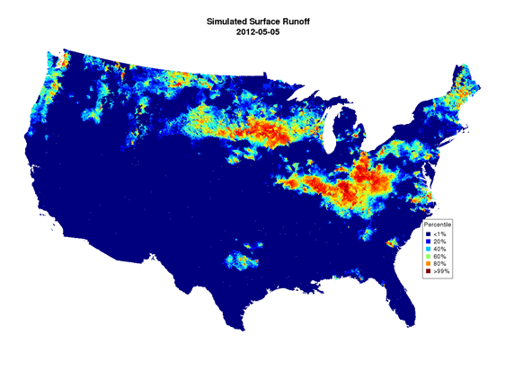
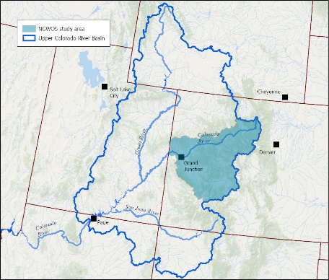
National and Regional Assessments
National: Will provide a near-real time census of water resources nationally at the HUC-12 scale – a fully integrated census accounting for both the quantity and quality of supply, water use, and the attributes which influence availability.
Regional: Will be designed to inform and improve National IWAAs, while providing local partners and stakeholders the data, tools, and information needed to make water resource management decisions
Notes:
Slide 3: These goals and objectives of our integrated water availability assessments apply at National and Regional Scales – that is there is a National integrated availability assessment, or census, and there are Regional water availability assessment projects – with the Colorado River Basin being one such project.
At the national scale assessments will provide a near-real time census of water resources nationally at the HUC-12 scale – it will evolve toward a fully integrated census providing baseline information on both the quantity of supply and use and the attributes which influence availability including occurrence, water quality, and even, eventually, socio-economic factors that affect water diversion and use.
Regional assessments take the tools developed for the National program and applies them to a specific area. These tools and supporting data will be refined in scale and added onto to improve core water availability projections in the region and add to those to address the specific information needs of each basin, in this case the upper Colorado, as informed by the basin’s hydrologic condition and local stakeholder input and need – thus, each regional assessment supports and enhances our national assessment and prediction capacity and also addresses regional information and tool needs.

Slide 7
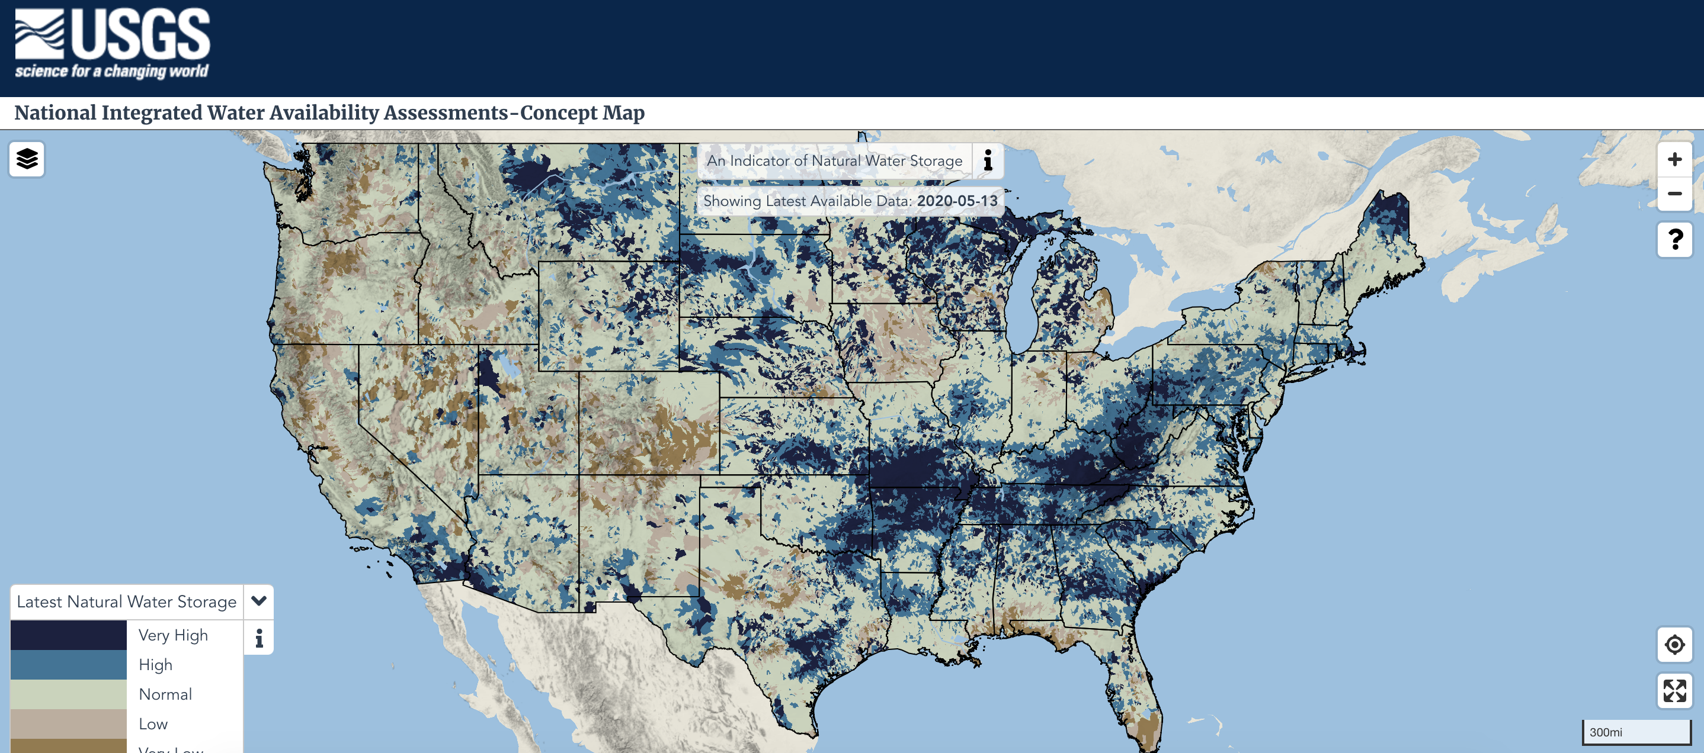
National Concept Map
Notes:
Slide 4 – This next slide shows a screen-shot of… the inaugural product of the National IWAA (we need to update this)
On Dec. 18, 2019, the USGS Water Resources Mission Area released the National Integrated Water Availability Assessments concept map. The map shows daily estimates of natural water storage for approximately 110,000 regions across the conterminous United States.
The USGS National Integrated Water Availability Assessments (IWAAs) concept map is the first product to visualize a current, quantitative view of water availability at the national scale,
While the demonstration map is not ready for decision making, it can be used to compare an individual region’s current water storage to its historical storage. “Natural water storage” sources include water present on the landscape such as standing water, snowpack, soil water, and shallow groundwater - but water in rivers or deep groundwater is not included.
The concept map is an example of an evolving USGS capacity to provide integrated baseline information on water availability. As this part of National IWAAs matures, additional hydrologic parameters will be produced and other indicators of water availability will be included on this representation, as well as water availability predictions.

Slide 8
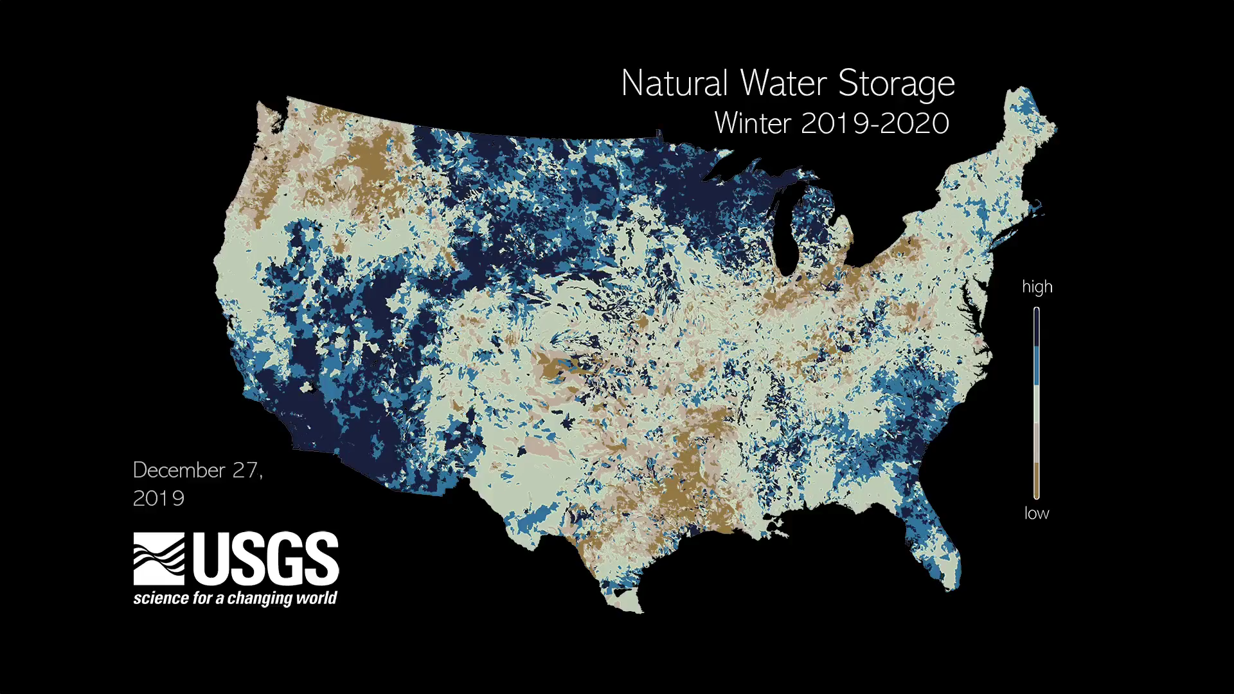
National Concept Map - Visualization

Slide 9
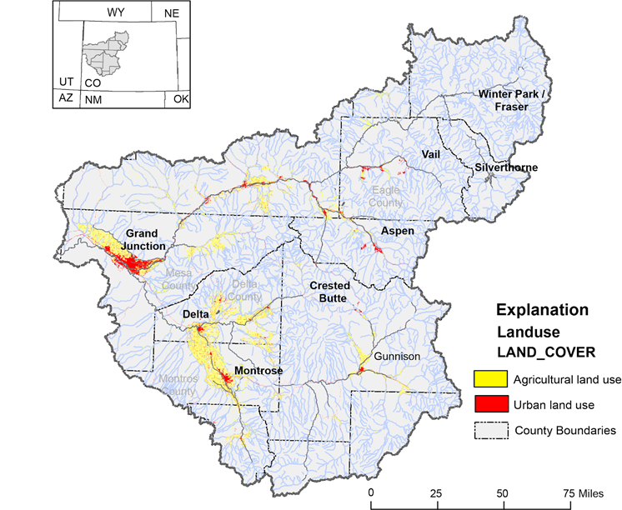
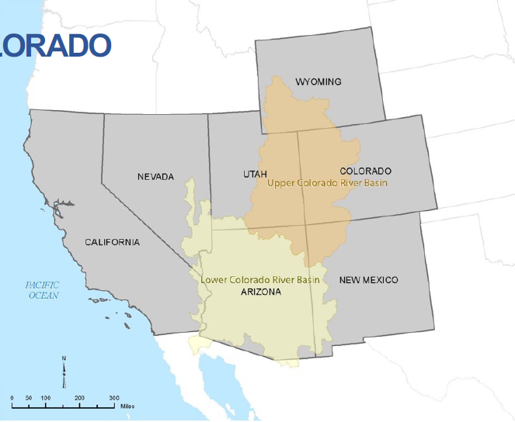


Regional Assessments
Will be implemented where Next Generation monitoring networks are established.
Will have the flexibility, beyond national-assessment requirements, to address regionally important science gaps or stakeholder information needs.
Can be used as a test bed for innovative methods and approaches in assessment and model prediction.
Will produce data and integrated assessment products defining regional water availability including predictions and forecasts of availability incorporating supply, use, and the factors influencing both.
Intensive Next-Gen Obervations
Integrated water assessment and prediction
Notes:
Slide 5 – Regional Assessments will be implemented where Next Generation monitoring networks are established. As Chad reported, selected Western Next Generation Observation System basin is the combined Headwater of the Colorado River HUC 4 (for those familiar with that terminology) and the Gunnison River Basin HUC four. Considering, however, the water-resource characteristics and resource management issues in this area, the regional Integrated water availability assessment in coordination with Integrated Water Prediction Program activities will encompass the entire Upper Colorado River Basin. Lee Ferry and up gradient.
Regional availability assessments will have the flexibility, beyond national-assessment requirements, to address regionally important science gaps and stakeholder information needs. Assessment tool development does not aim, necessarily, to replace existing trusted approaches but can be designed to enhance their capacity – filling in valuable information and system representation gaps where needed.
Assessment and prediction tool building period will match the decade long activity of the Next Gen Observations work in the region with an intensive first 5-years of work focusing on data synthesis and harmonizing, evaluation of availability components and trends in those components, and prediction and forecast tool building. The second phase of work will maintain, and update established data streams and modeling tools
In the end, our goal is to provide an better understanding of historic and present water supplies and use in the basin and to integrate the characteristics of both to inform availability – that is, to be able to estimate for example, what portions of water supply are in the ground verses in surface flow and storage, what portions of groundwater reside in transmissive aquifers for example, what percent of flow is of a certain quality compared to a potential use.
T

Slide 10
Western Basin IWAAs Requirements
Regional Data Discovery, Evaluation, and Synthesis Augmenting National IWAAs Data Sets: Compile and evaluate multi-source data relevant to the assessment of water availability and the hydrologic attributes, water-availability influencers, and water-supply disturbances.
Regional Modeling Capacity and “Ecosystem”: Curate, and prioritize approaches of, the existing modeling ecosystem pertinent to answering stakeholder-driven science questions.
Availability-Metrics and Assessments: Define and assess regionally-relevant water-availability components and metrics of water supply and use (including eco-flows) incorporating enhanced data collection in the IWAAs region and refined regional-scale water models and tools.
Water-Availability Influencers and Disturbances: Assess identified core (water-quality, climate change, drought) and regionally-relevant influencers and disturbances to water availability.
Water-Availability Trends and Drivers: Shall evaluate long-term trends in water availability (core and region-specific factors) in selected regions.
Integrated Regional Prediction and Forecasts: Provide model-generated predictions and forecasts of available regional water supplies and the factors that limit their use.
Notes:
Regional integrated prediction and forecasts will enhance and augment baseline national water availability assessments – mention socio-economic

Slide 11
Presidential Memo
Action Plan Deliverables
Operational Delivery of National IWAAs
Incorporate Quality in IWAAs
Incorporate Use in IWAAs;
GW to NWM
2019
2020
2021
Daily delivery of water availability indicies inclusive of quantity and quality
Daily delivery of water availability indicies inclusive of quantity, quality, and use. Add GW module to NWM.
Daily delivery of water availability indices focused on quantity
2019
2020
2021
Select 2nd NGWOS Basin; DRB Drought Pilot
Align Basin Implementation for all Priorities
Implement WMA Priorities in Western Basin
Organize team to Identify priority NGWOS basins, select watershed in west, begin IWAAs drought pilot in DRB
Develop Implementation Plan coordinated with NGWOS, 2WP and Regional IWAAs
Develop holistic workplan through stakeholder engagement.

Slide 12
Water Resuse Action Plan (WRAP)
Builds on deliverables in the Action Plan for the Presidential Memo on Western Water availability
Development of indices that evaluate water supply and demand based upon integrated assessments of quantity, quality, and use.
Understanding impacts of human water use on availability.
Evaluating the spatial and temporal impacts of water discharges into surface and groundwater systems and potential future uses
Operationally deliver National IWAAs that evaluate potential suitable uses of available water for the 8 categories of use USGS reports
Notes:
In addition to the Pres. Memo Action Plan, the USGS is engaged in activities as part of the Water Reuse Action Plan…the goals outlined for Action 2.5.4 in the plan build on the pres memo deliverables for the eventual development of the capacity to evaluate potential uses of water for each of the 8 categories of use USGS currently reports on. Finally, USGS is also actively engaged in the NDRP again, building on the these deliverables to evaluate water availability for ecological uses.

Slide 13
WUDR Overview
The USGS Water-Use Data and Research Program (WUDR) is authorized under the SECURE Water Act Section 9508
SECURE goals for WUDR
Improve the availability, quality, compatibility, and delivery of water use data that is collected and/or estimated by States to support National water use assessments
Integrate State water resource agency water-use or water-availability datasets into USGS databases
Support for USGS Strategic Goals and Priorities
In addition, data and delivery improvements at the state level support USGS model development and daily delivery of water use Nationally
Notes:
SECURE had 2 main goals for WUDR, the first is to improve the availability, quality, compatibility, and delivery of water use data that is collected and/or estimated by States to support National water use assessments; and the second is to ensure this improved water-use data is integrated into USGS databases.
The USGS Water Use Science Project has been producing national water use compilations every 5 years since 1950; while this dataset has been invaluable to our partners what we have heard and continue to hear is a need for water use data at smaller temporal and spatial scales and for that data to be released in a more timely manner. In the last year the USGS has developed a strategic goal to develop models to estimate water use and serve those estimates on a daily basis. WUDR is a critical component for the USGS’s success in achieving this goal, working with states to improve data collection methodologies and database development and access is crucial to the effective development of water use models.
Currently the USGS has 2 main databases for water use, one for site specific data and another for aggregated data (for example by county or aquifer). Ensuring that our databases are agile enough to store and serve new data streams collected via WUDR is critical and we’ve begun a process to modernize our water use databases this fiscal year. This modernization includes setting up data services to collect data from states as well as storing and serving time-series data from water use models that we’ll talk about shortly.

Slide 14
WUDR Project Summary
47 projects over 4 years
Over half focus on database improvements
States with multiple-year awards (ID, IL, KS, ME, MO, MT, NM, ND, PA)
Multiple projects support USGS water use model development
Notes:
I wanted to provide a quick summary of the projects funded to date to illustrate how WUDR funds are supporting not only state needs but also USGS goals moving forward. We’ve funded 40 projects in 3 years, and half of those projects support database improvements, these include improvements in data delivery as well. Modernizing databases was a foundational need identified by most states in 2015 (remember most were still working with paper surveys) and will help to improve the uncertainty and timeliness associated with USGS modeled estimates.
Bring up circle - We’ve also supported a number of projects that support methodology development for our 3 focal categories (Irrigation, public supply, and thermoelectric water use). These methods fill a critical need for states in understanding water availability, now and in the future, and also support USGS model development.

Slide 15
WRAP Portfolio Structure
WRAP
Science, Analysis, and Assessments
Integrated Water Availability Assessments
Water Budget
Water Availability Impacts of Extreme Events
Water Use
Ecoflows
Drought
Water Quality Processes
Social and Economic Drivers
Integrated Water Prediction

Slide 16
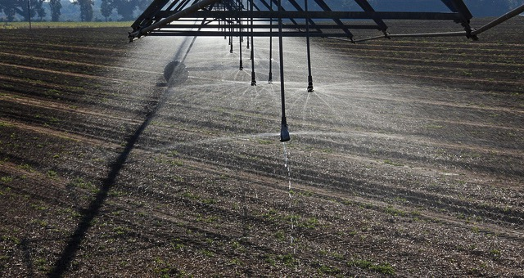

Questions
Mindi Dalton
Water Availability and Use Science Program Coordinator
msdalton@usgs.gov
770-283-9728
Notes:
That is all I have for today, thank you for your time this morning, I’ve provided my contact info on this final slide and am happy to take any additional questions.

